Slide 1

STUDENT-CENTERED
ENROLLMENT PRACTICES
Nov. 18, 2020

Slide 2

Lloyd A. Holmes, President
Christina Espinosa-Pieb
Vice President, Instruction
Lorrie Ranck
Associate Vice President, Instruction
Rob Mieso
Vice President, Student Services

Slide 3



Enrollment Gains
SUMMER
2019: 1,543 FTES
2020: 1,996 FTES, up 29%
FALL
2019: 5,064 FTES
2020: 5,122 FTES, up 1%

Slide 4
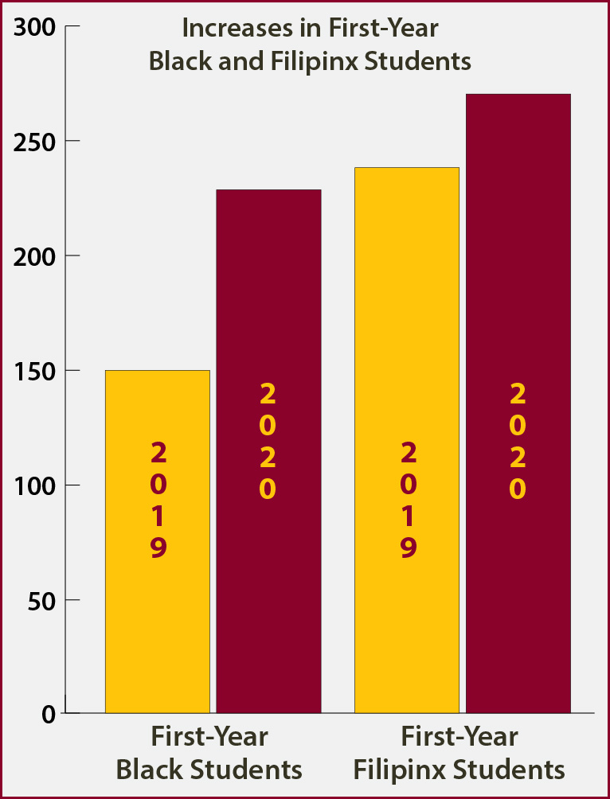
Enrollment Gains
Significant enrollment gains for two historically underrepresented populations
First-year Black students increased 53% to 230
First-year Filipinx students increased 13% to 269
Overall Black student enrollment increased 18% to 893
Overall Filipinx student enrollment increased 10% to 1,289

Slide 5
Student-Centered Enrollment Practices
Key Contributing Factors
Equity-centered leadership – ensured smooth transition to support faculty and staff in best serving students and minimizing disruption
Strong college reputation – including for offering wraparound student support
Student outreach and communication – continued extensive outreach and recruiting, including to historically underrepresented populations, while adapting for online environment

Slide 6
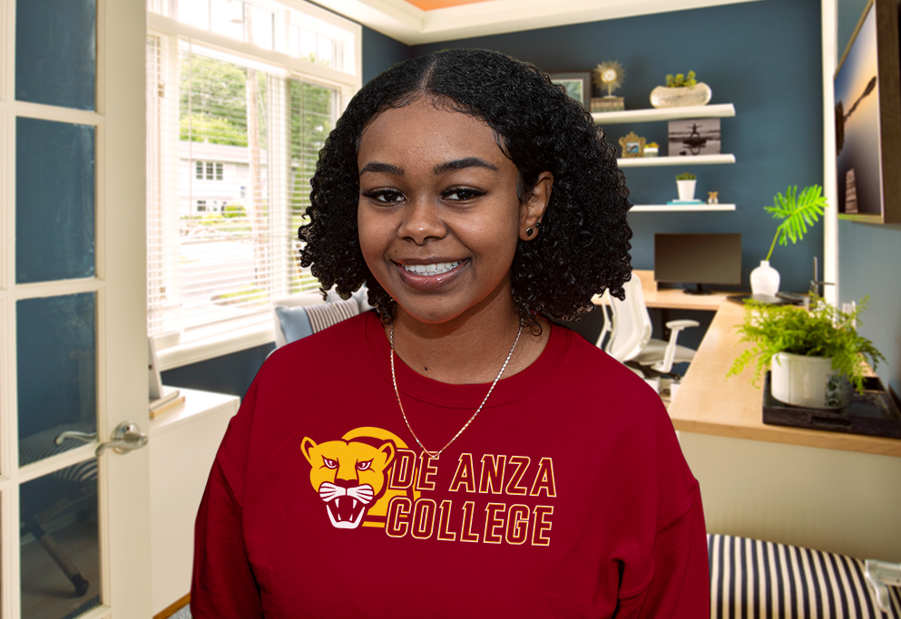
EQUITY-CENTERED LEADERSHIP

Slide 7
Leadership – Transitioning to Online
Moved to remote instruction only one week before winter quarter finals – unlike most colleges that were in mid-semester
Worked collaboratively with district leadership and employee groups, including Senates and bargaining units
Empowered instructors to be flexible in administering final exams

Slide 8
Leadership – Transitioning to Online
Continually assessing and meeting needs of
students, faculty and staff
Met with all divisions, Academic and Classified senates
Surveyed all students, faculty and staff on access to technology and other needs
  Surveys also provided direct mechanism for students to request assistance
  College responded to more than 1,000 students who indicated specific needs
Revised scheduling process and online schedule to ensure that all course listings inform students whether each course has regularly scheduled meetings or is asynchronous

Slide 9
Leadership – Transitioning to Online
Leading with ethic of care
Encouraged employees to take home needed computers, supplies and ergonomic chairs, with minimal bureaucratic hurdles
Gave faculty members flexibility in choosing to teach their courses asynchronously or to include regularly scheduled meetings
Began weekly Zoom “Conversation and Q&A With Senior Staff” for employees and student leaders to share information and allow frequent interaction

Slide 10
Leadership – Transitioning to Online
Rapid ramp-up in month before spring classes began April 13
More than 600 instructors and staff received online training
310 participated in Canvas certification training
620 took workshops on specific Canvas tools or topics
More than 650 participated in Zoom training sessions

Slide 11
Leadership – Transitioning to Online
Online Education Center quickly developed new Resource Hubs – one each for faculty and students
One-stop websites with guides, tips and resources for using Canvas and other online tools
Student hub included newly created video with tips for online learning success
Both hubs promoted via college website, social media and emails to students, faculty and staff

Slide 12
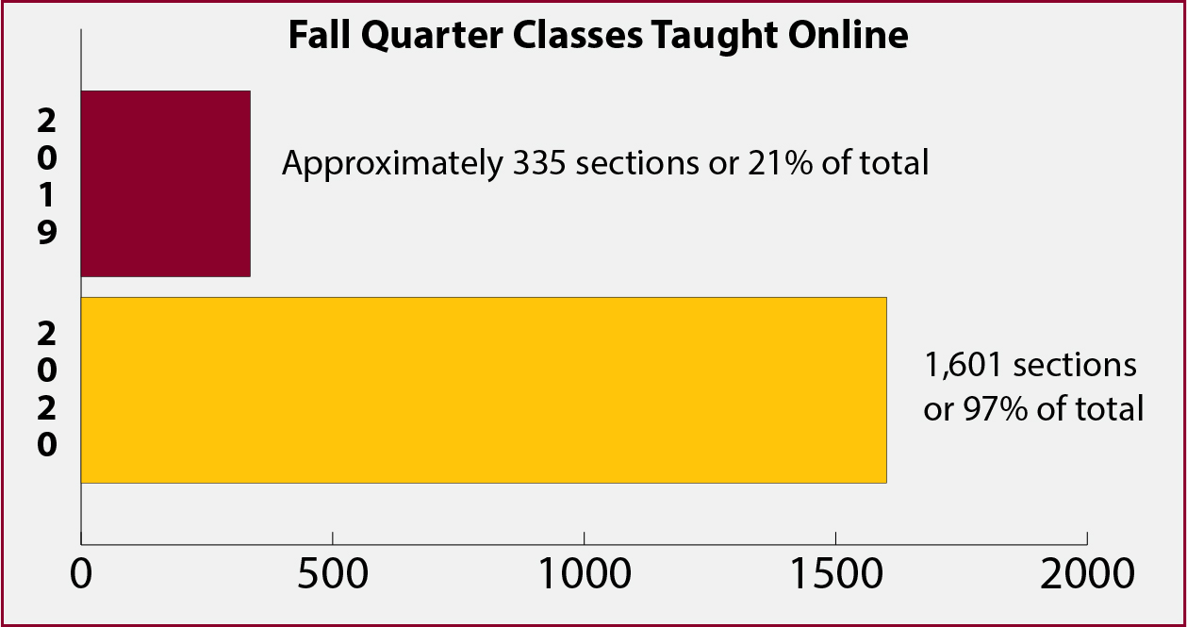
Fall Quarter Classes Taught Online

Slide 13


STUDENT SUPPORT

Slide 14
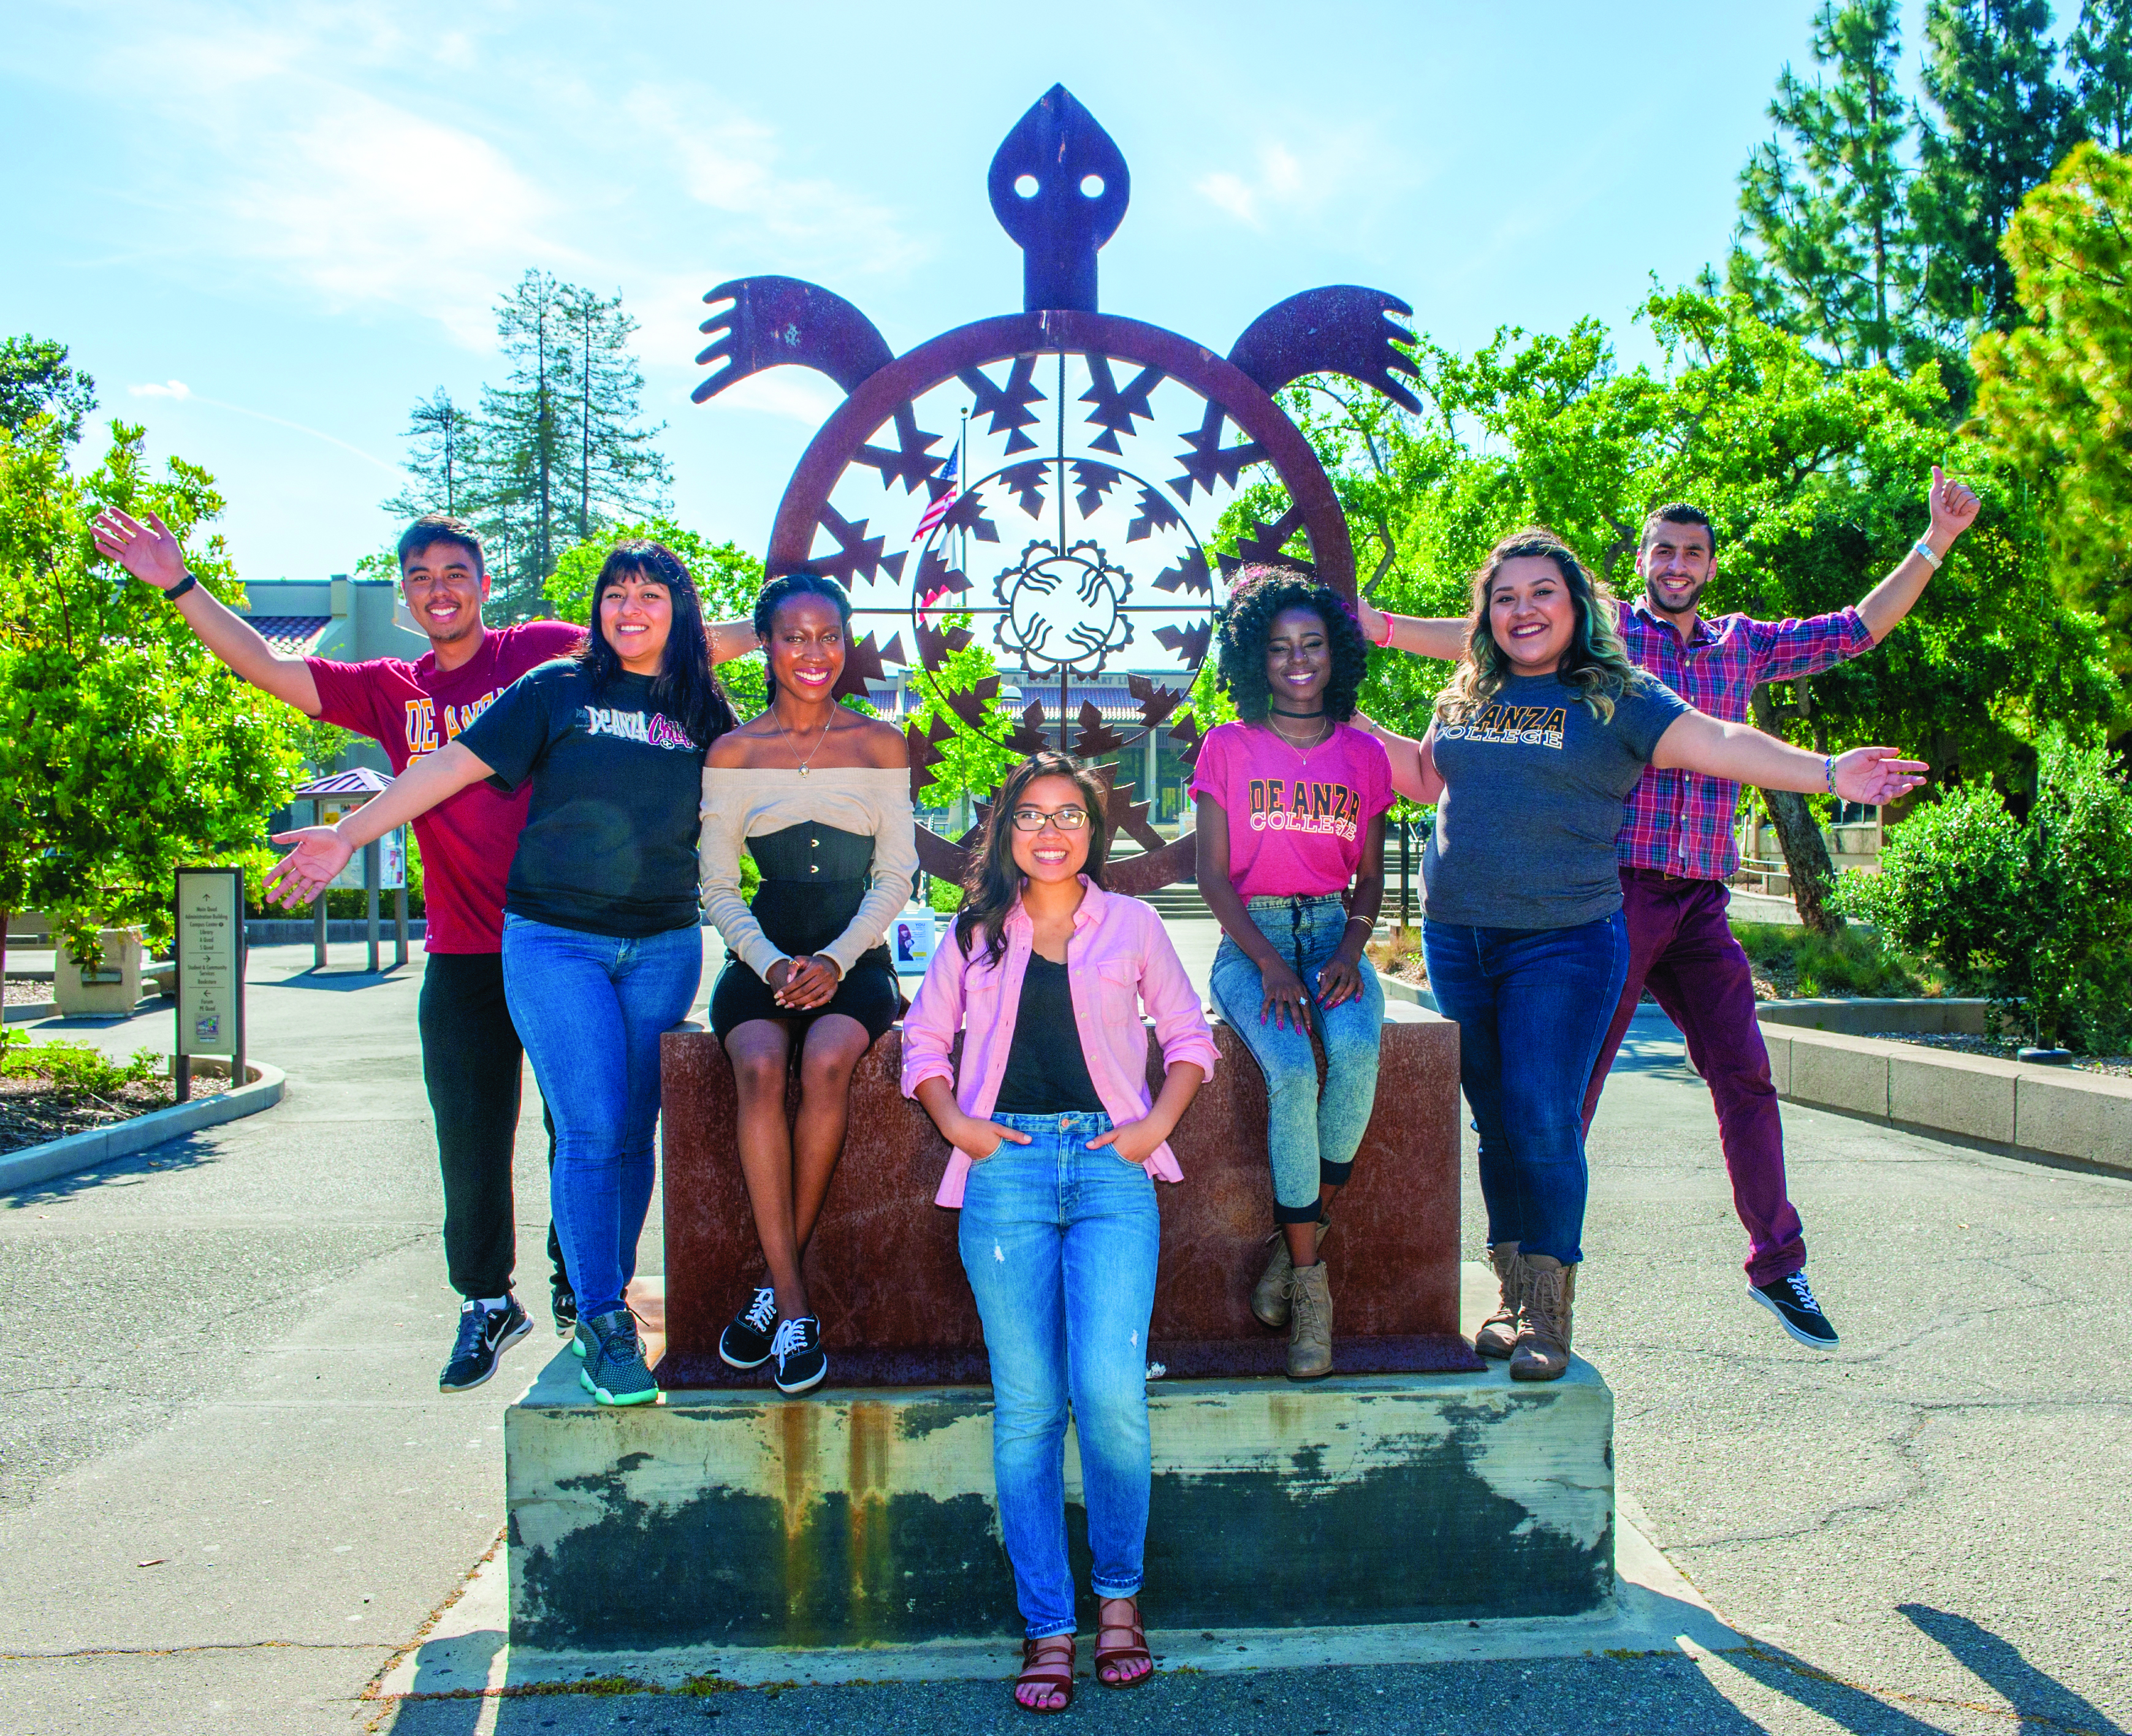
Student Support – Academic Support
Learning Communities
Cohort groups provide supportive networks for students to connect with classmates, instructors and staff
12 different programs, each based on a common interest or area of focus
Activities held over the summer to help students feel connected before fall
First Year Experience • Honors • Humanities Mellon Scholars • IMPACT AAPI • Latinx Empowerment at De Anza • Learning in Communities • Math Performance Success • Men of Color Community • Puente • REACH • Umoja • VIDA

Slide 15

Student Support – Academic Support
Student Success Center
Peer tutoring on variety of subjects
Retrained 145 student workers in first two weeks of spring quarter, to provide ongoing peer assistance via Zoom

Slide 16
Student Support – Online Support
Library Tech Support
Assists students with use of instructional software, including Canvas and Zoom
Available via live chat and email
Student Resource Hub
One-stop website with guides and video tips for online learning
Online Spring (Summer, Fall) Webpages
Comprehensive webpages featuring academic resources as well as food, shelter and technology assistance for students facing financial challenges due to coronavirus

Slide 17
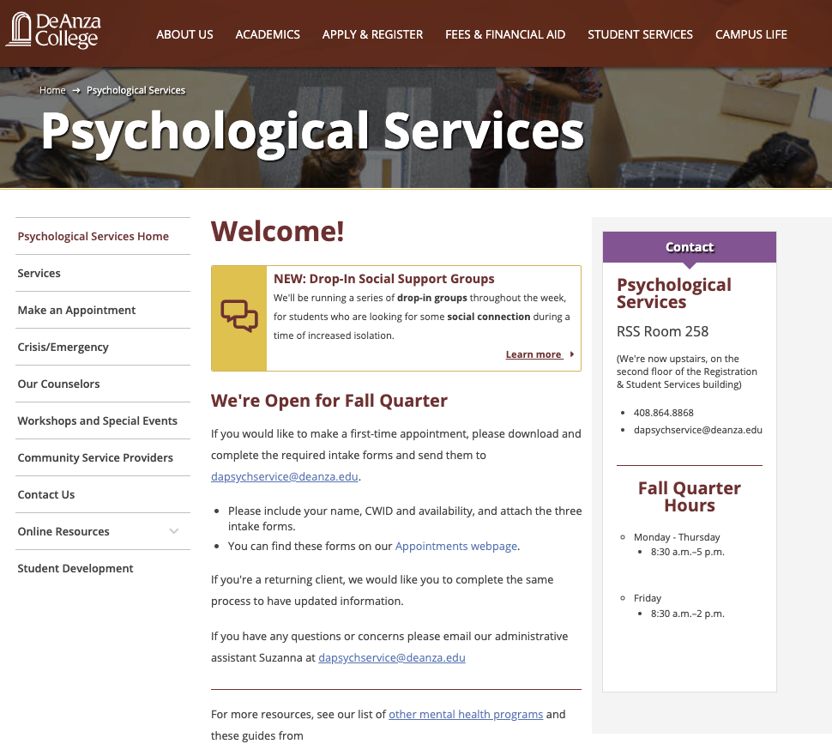
Student Support – Expansion of Services
All student services continued to be available by phone and online video
Counseling and Advising Center added new drop-in hours and group sessions via Zoom (in addition to 1:1 appointments)
Admissions and Records added new drop-in sessions via Zoom
Financial Aid offered workshops via Zoom
Psychological Services offered 1:1 counseling and group sessions via Zoom

Slide 18
Student Support – Financial Assistance
Emergency Financial Grants
Online application for funds to purchase computers or other necessities
Made available in spring, later augmented by CARES funding
Grocery Cards
Online application for students needing help with food –
a temporary service while campus Food Pantry is closed
Mobile food pantry still visits twice monthly

Slide 19

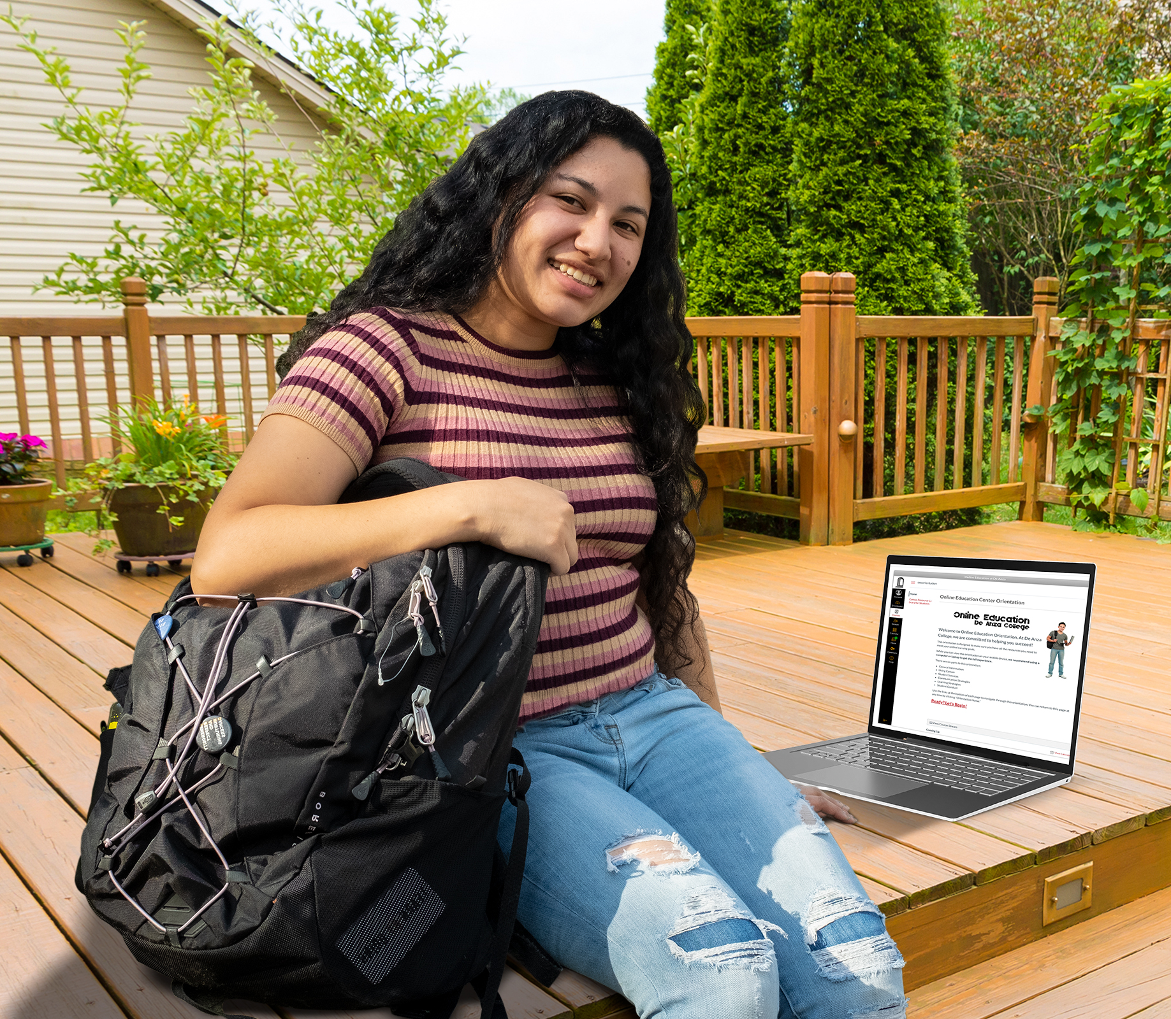
STUDENT OUTREACH
AND COMMUNICATION

Slide 20
Student Outreach and Communication
Office of Outreach adapted its established and exceptionally well-developed regional efforts – including outreach to historically underrepresented populations
Spring application workshops and orientation sessions held via Zoom
New info sessions covered enrollment steps and De Anza College Promise
Maintained consistent contact with high school partners

Slide 21
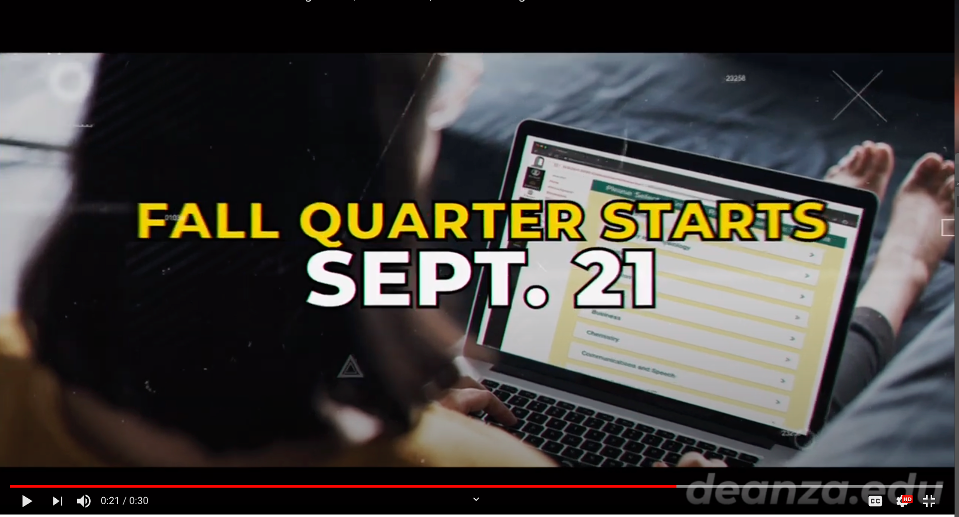
Student Communication – Ongoing
Extensive communication with students about the shift to online instruction
Emails, text messages and social media reminded students about online resources and checking schedule notes about whether there were synchronous meetings
Spring, summer and fall marketing focused on video and digital ads, emphasizing online learning and the college’s reputation for being Tops in Transfer
From fall quarter video ad

Slide 22
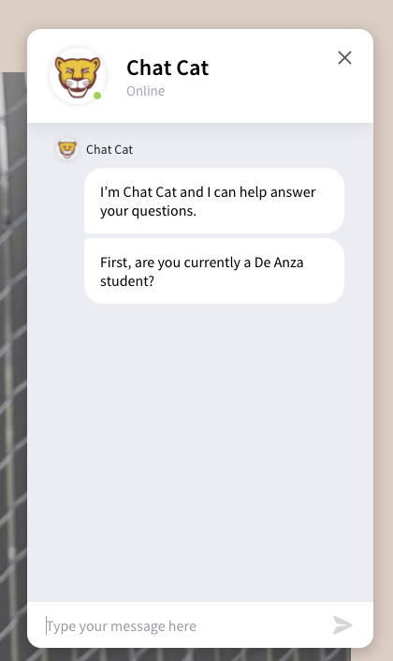
Student Communication – Ongoing
Quick Help button added to website in spring
Office of Communications answered almost 5,000 questions about application, registration and other key steps
More than half were from new or prospective students
Replaced in July with Chat Cat – online answers powered by a chat bot drawing from a continuously updated database

Slide 23

Student Communication – Ongoing
Virtual Welcome Day
Held online on the Friday before fall classes began
Separate sites where students could meet faculty and staff from more than 40 programs
Students could also speak with counselors and registration experts

Slide 24

Questions?
Ask Us!

Slide 25
STUDENT-CENTERED
ENROLLMENT PRACTICES
Nov. 18, 2020

