Slide 1

NONCREDIT CURRICULUM TRAINING
Management Team Meeting
February 13, 2025
Dr. Omar Torres, President

Slide 2


LEARNING OUTCOMES
During this training you will…
Explore the basics of noncredit curriculum, including an introduction to terms like Career Development and College Preparation (CDCP) noncredit and the ten instructional categories
Discuss considerations for incorporating noncredit courses and programs into curriculum offerings
Discover the possibilities for integrating noncredit into instructional programs
Identify practical tips for understanding noncredit curriculum
and much more!

Slide 3

BACKGROUND
The past few years have seen a noticeable increase in noncredit education in the California community college system. While noncredit programs have been advocated as a promising way to address educational equity, there are varied topics of noncredit education to explore. Today, we will discuss the basics including the categories of noncredit, mirrored classes, noncredit course completion factors, and local/state compliance.

Slide 4

WHAT IS NONCREDIT?
A BRIEF HISTORY AND GUIDING PHILOSOPHY
First adult school in California in 1865
Important contributor to “open access” for students with diverse backgrounds
Tuition free
Can be a first point of entry
Transition point to credit instruction and the workforce
Courses focus on skill attainment, not grades or units
Flexible course scheduling

Slide 5
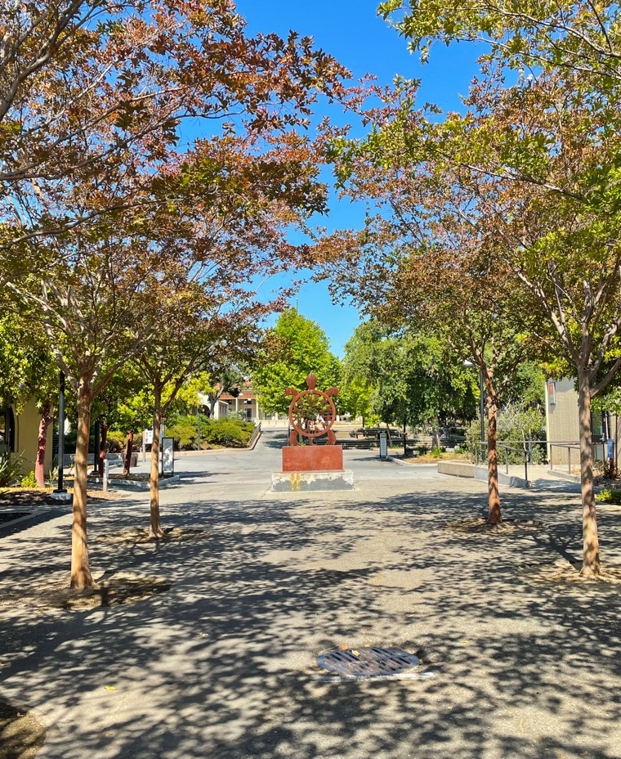
WHAT IS NONCREDIT?
GUIDING PHILOSOPHY
Flexible
Equity Centered
Competency Focused
  Flexible course scheduling
  Open Entry/Open Exit
  Open Access
  First point of entry for underserved students
  Low and no-cost courses
  Prepares students for credit instruction and workforce opportunities
  Focus is on skill attainment, not grades or units
  Upskilling and reskilling

Slide 6

NONCREDIT CURRICULUM BASICS
1. English as A Second Language (ESL)
2. Immigrant Courses
3. Elementary and Secondary Basic Skills
4. Health and Safety
5. Substantial Disabilities
6. Parenting
7. Home Economics or Family and Consumer Sciences
8. Courses for Older Adults
9. Short-term Vocational Programs
10. Workforce Preparation

Slide 7
NONCREDIT INSTRUCTIONAL CATEGORIES ELIGIBLE FOR APPORTIONMENT
[EC § 84757; Title 5 § 58160] | [CDCP: EC § 84760.5; Title 5 § 55151]
ESL
Immigrant Education
Workforce Preparation
STREAMLINED APPROVAL!
Noncredit courses are approved by districts and “chaptered” by CCCCO via the CO Curriculum Inventory (COCI)
Short-term Vocational
Elementary and Secondary Basic Skills
Noncredit Course Categories
Note: A noncredit instructional category that is outlined/circled in red denotes an instructional category in which eligible noncredit courses may be sequenced to lead to a Career Development and College Preparation (CDCP) (“enhanced funding”) certificate program, pursuant to
Ed Code § 84760.5.
Older Adults
Health and Safety
Refer to PCAH for specific curriculum submission requirements applicable to each category
Home Economics
Parenting
Substantial Disabilities

Slide 8
NONCREDIT PROGRAMS
STREAMLINED APPROVAL!
Noncredit programs are approved by districts and “chaptered” by CCCCO via the CO Curriculum Inventory (COCI). Streamlined approval does not include CDCP programs in the instructional domain of “short-term vocational with high employment potential”; CCCCO review and approval is required
Note:
Programs circled in red are CDCP (Career Development and College Preparation).
CO “approval” is currently required for CDCP programs in the instructional domain of short-term vocational with high employment potential. The short-term vocational CDCP program is in the certificate of completion group
[References: EC 84760.5; Title 5, 55151]
The underlined programs are eligible for CDCP enhanced funding, EDC 84760.5 (b)

Slide 9
CAREER DEVELOPMENT AND COLLEGE
PREPARATION (CDCP) PROGRAMS
Edu Code 84760.5 (b) -
Limits CDCP eligibility to courses in the following instructional domains:
Workforce Preparation
* Short-term Vocational
With High Employment Potential
Elementary and Secondary Basic Skills
English as a second language (ESL) and
vocational English as a second language
*CCCCO approval is required
Career Development
Certificate of Completion
Title 5,
§ 55151(h)
Certificate of Competency
Title 5,
§ 55151(i)
College Preparation

Slide 10

LABOR MARKET INFORMATION FOR SHORT-TERM VOCATIONAL PROGRAMS
For short-term vocational program proposals faculty must provide evidence of high employment potential in one of two ways:
They can identify the area of instruction on the list of occupational titles with high employment potential (http://www.labormarketinfo.ca.gov) or attach another data source containing current labor market or job availability data with an explanation of how the data is verified.
If LMI is limited or not available, other data sources may include:
Recent employer surveys
Industry studies
Regional economic studies
Letters from employers attesting to the service area need
Minutes of industry advisory committee meetings (beyond required advisory committee meeting minutes)
Job advertisements for positions in the individual college’s service area
Newspaper or magazine articles on industry or employment trends
Applicable studies or data from licensing agencies or professional associations

Slide 11

NONCREDIT COURSE OUTLINE OF RECORD (COR)
All courses are required to have an official course outline of record
Current CORs must be maintained in the official college files (paper or electronic database) and made available to each instructor.
COR must meet standards in title 5, § 55002 (c) and contain components described in subsection (2):
  “[(2)] Course Outline of Record. The course is described in a course outline of record that shall be maintained in the official college files and made available to each instructor. The course outline of record shall specify the number of contact hours normally required for a student to complete the course, the catalog description, the objectives, contents in terms of a specific body of knowledge, instructional methodology, examples of assignments and/or activities, and methods of evaluation.”
The COR of noncredit distance education courses must specify the expected hours of outside-of-class student work if trying to collect apportionment for those hours.

Slide 12
SIDE-BY-SIDE COMPARISON OF COR REQUIREMENTS
CREDIT
NONCREDIT
Unit value
Total contact hours for course
Conditions of enrollment: requisites, advisories, other conditions
Catalog description
Objectives
Content (typically in outline form)
Reading and Writing Assignments
Other outside-of-class assignments
Methods of instruction
Methods of evaluation/grading policy
Unit value
Total contact hours for course
Conditions of enrollment: requisites, advisories, other conditions
Catalog description
Objectives
Content (typically in outline form)
Reading and Writing Assignments
Other outside-of-class assignments/hours
Methods of instruction
Methods of evaluation/grading policy
*All noncredit courses mirrored with credit will need to conform to all credit requirements

Slide 13
NONCREDIT CURRICULUM CONSIDERATIONS
While there are no registration fees for noncredit courses, other fees may be charged such as textbooks.
Noncredit courses may require textbooks, but many colleges consider no- and low-cost alternatives:
Classroom sets
OER
Lending library
Grant funding

Slide 14

MINIMUM QUALIFICATIONS FOR NONCREDIT
Title 5 § 53412 lists the minimum qualifications (MQs) to teach noncredit. Although some MQs are the same as for credit instruction (i.e., §53410), some areas have different MQs including: Basic skills mathematics and English, English as a Second Language, health and safety, citizenship, home economics and older adults.
The Minimum Qualifications Handbook (also called the Disciplines List) details the requirements.

Slide 15
TEACHING CONSIDERATIONS
Unique challenges
Open-entry/open exit environment
Varying gaps in the academic knowledge
Pedagogy becomes increasingly important
  Scaffold lessons
Faculty who understand noncredit students

Slide 16
COLLABORATION BETWEEN CREDIT AND NONCREDIT
Noncredit Support Courses. These courses are designed together with credit faculty to support students who are currently enrolled or are preparing to enroll in credit courses.
Some options include
  Corequisite support courses
  Modularized support courses
  Intensive review courses
  Mirrored courses (more on this on the next slide)
Partnerships between credit and noncredit faculty can be an effective way to help students meet their educational goals
Courses that build bridges between credit and noncredit can be a way to introduce noncredit offerings to faculty that typically teach credit courses

Slide 17
MIRRORED CREDIT AND NONCREDIT COURSES
Credit and noncredit course with identical course outline of record.
Usually seen in ESL and short-term vocational classes.
Creates pathways for the adult noncredit learners.
Courses are scheduled at the same time with one instructor teaching all students.
Sections are typically crossed listed with a specified amount of seats in the credit and noncredit sections.
Noncredit students attend all class sessions and complete the same work as the credit students.
Noncredit students cannot earn units for successfully completing the course, but they can earn a certificate

Slide 18
MIRRORED COURSES (CONT.)
Helpful for students that are transitioning from noncredit to credit.
Low-stakes option for students who want to:
    attempt a course
    need extra time mastering the content
    don’t qualify for financial aid
Provides a unique opportunity for students to explore the rigor and expectation of credit courses without the pressure of
    tuition fees
    failing grade
    repeatability restrictions
Credit for Prior Learning (CPL) can be used to earn units at a later time.

Slide 19
NONCREDIT AT DE ANZA (TO DATE)
The following restrictions have been placed on Noncredit development at De Anza College to date:
  Noncredit courses must be mirrored from a credit course
  Noncredit courses must belong on a noncredit certificate
  Noncredit courses must be in CTE or Basic Skills
  Noncredit courses have no load and no seat count
  Noncredit courses must hold the same delivery modes as the credit course
  Noncredit courses will be placed on the same review cycle as the credit course if the noncredit course is created with a different effective year
  Requisites and advisories need to be specified in the COR of the credit and noncredit courses to reflect if the noncredit and credit are to be listed (ex. “Prerequisite: AUTO 50 or AUTO 350”)

Slide 20
NONCREDIT AT DE ANZA (MOVING FORWARD)
The following are now approved moving forward:
Noncredit courses must be mirrored from a credit course
Noncredit courses must belong on a noncredit certificate
Noncredit courses must be in CTE or Basic Skills
For noncredit mirrored courses, noncredit courses have no load and no seat count; no restrictions if not mirrored.
For noncredit mirrored courses, noncredit courses must hold the same delivery modes as the credit course; no restrictions if not mirrored.
For noncredit mirrored courses, noncredit courses will be placed on the same review cycle as the credit course if the noncredit course is created with a different effective year; no restrictions if not mirrored.
For noncredit mirrored courses, requisites and advisories need to be specified in the COR of the credit and noncredit courses to reflect if the noncredit and credit are to be listed (ex. “Prerequisite: AUTO 50 or AUTO 350”); no restrictions if not mirrored.

Slide 21
FROM NONCREDIT TO CREDIT: PROVIDING
A GUIDED PATHWAY FOR STUDENTS
For noncredit students seeking to transition into credit programs transition specialists can provide an important safety net.
Some crucial areas of support include:
  Career and academic counseling
  Financial aid services
  Academic support including tutoring
  Supportive Services such as CalWORKs, CAEP, EOPS and DSS

Slide 22
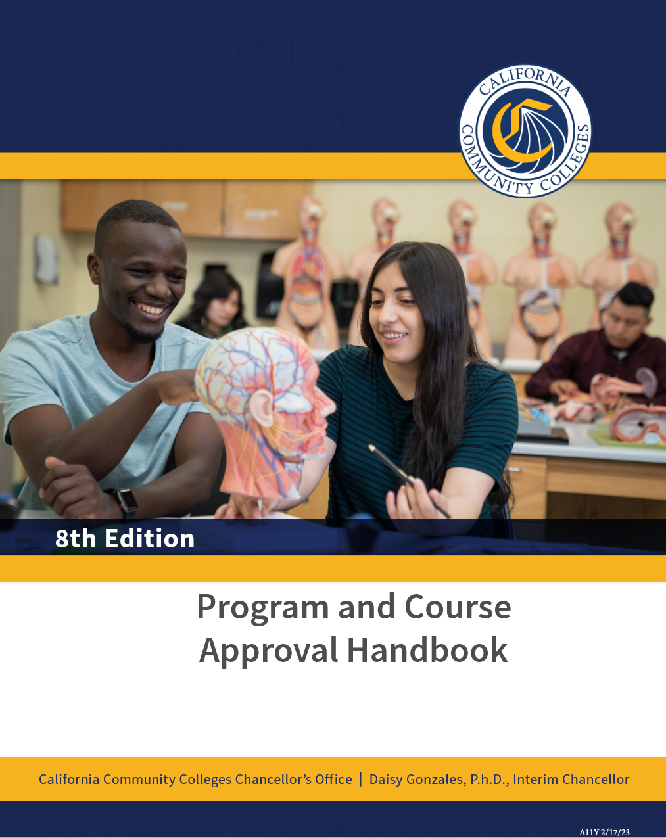
READ THE PCAH! SPECIFICALLY, PAGES 103-145

Slide 23
TOP CODES AND EXISTING CURRICULUM
There are specific TOP codes that must be used for each category of noncredit.
Being familiar with TOP Codes helps determine which category of noncredit is most appropriate for the curriculum being developed
What noncredit curriculum currently exists at De Anza College?
  See spreadsheet for existing 90 enhanced (blue) and 5 non-enhanced active NC courses at DAC
What noncredit curriculum currently exists at other colleges?
  COCI 2.0 and our Curriculum Coordinator can answer that question ☺
  Also see suggested college districts on slide 25.

Slide 24
LMI: QUANTITATIVE AND QUALITATIVE
Labor Market Information (required from EDD)
  onetonline.org
  EDD’s LMI System: http://www.labormarketinfo.edd.ca.gov
  Centers of Excellence for Labor Market Research: http://coeccc.net/Supply-and-Demand.aspx
Advisory board meetings (Not required)
  What short-term vocational programs can increase the employability of students?
  What skill gaps can be covered in noncredit?

Slide 25
WHAT IS OUT THERE, AND YOUR IDEAS?
Mt. San Antonio College School of Continuing Education
San Diego College of Continuing Education
Santa Ana College School of Continuing Education
North Orange Continuing Education
College of the Canyons School of Personal & Professional Learning
See spreadsheet for existing 90 enhanced (blue) and 5 non-enhanced active NC courses at DAC
What ideas do you have for the development of new continuing education (noncredit) courses? Please email the CEO, VPI, and AVPI your new “top 10” ideas (course and NC category) by Friday, 2/21/25.

Slide 26
Other Noncredit Resources
Academic Senate CCC http://asccc.org
CCC Chancellor’s Office http://cccco.edu
Vision Resource Center https://visionresourcecenter.cccco.edu/
California Adult Education Program https://caladulted.org/
Association of Community and Continuing Education (ACCE) http://www.acceonline.org/
California Council of Adult Educators (CCAE) https://www.ccaestate.org/
DataVista https://datavista.cccco.edu/

Slide 27


