Slide 1

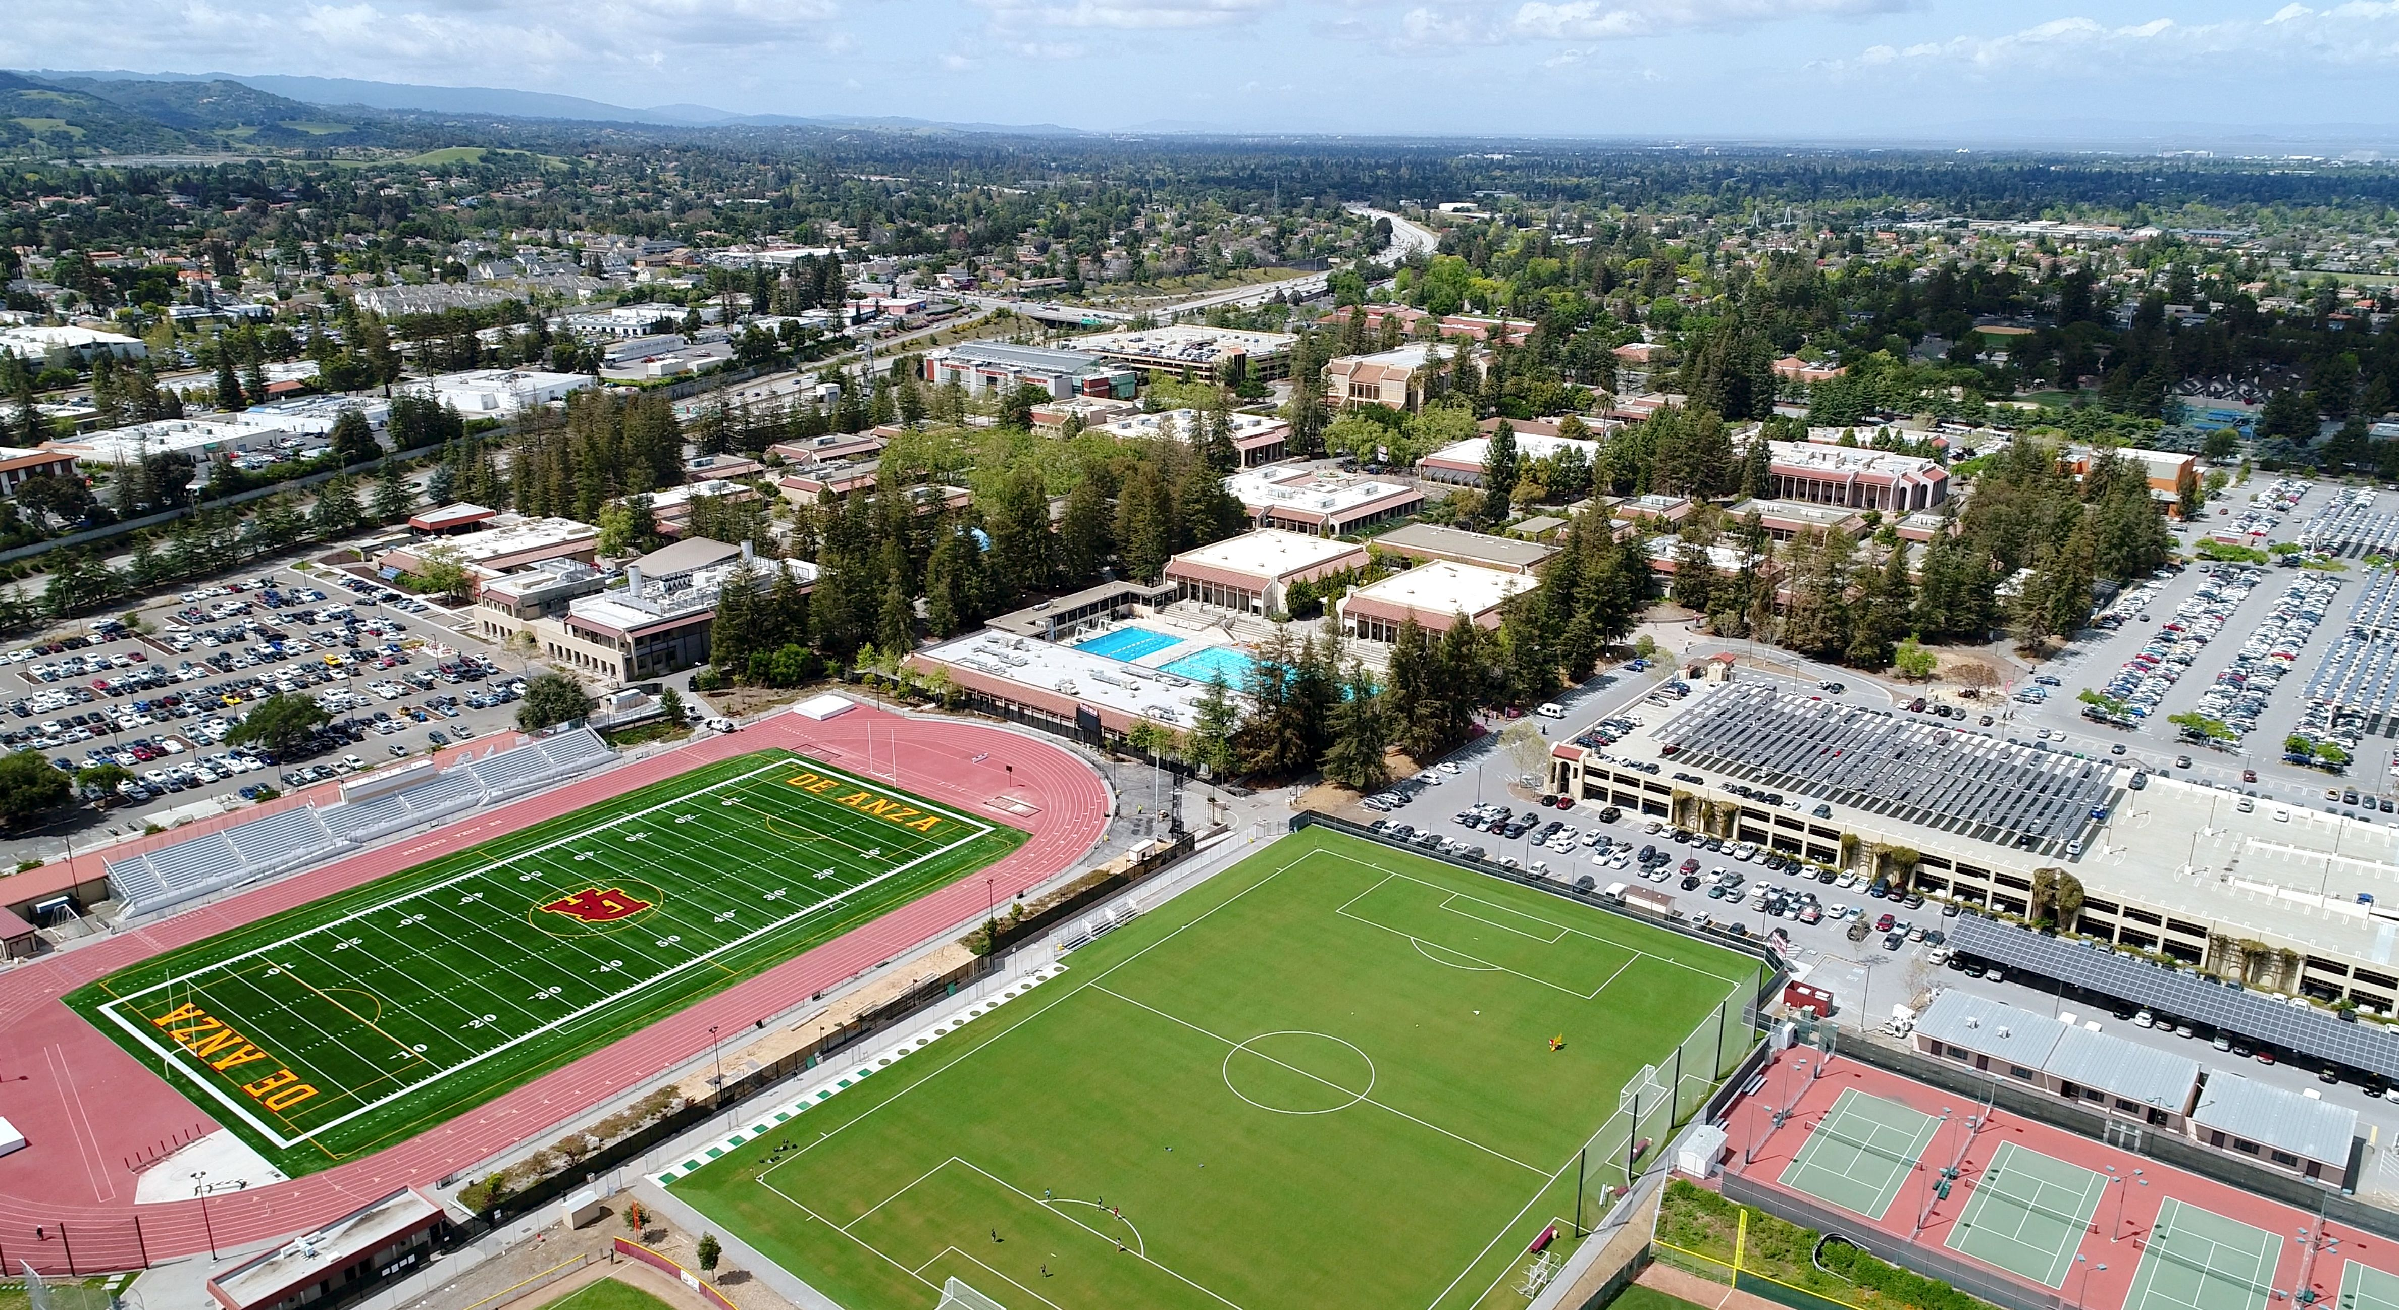
Governor’s January budget 2025-2026
Management Team Meeting January 16, 2025

Slide 2
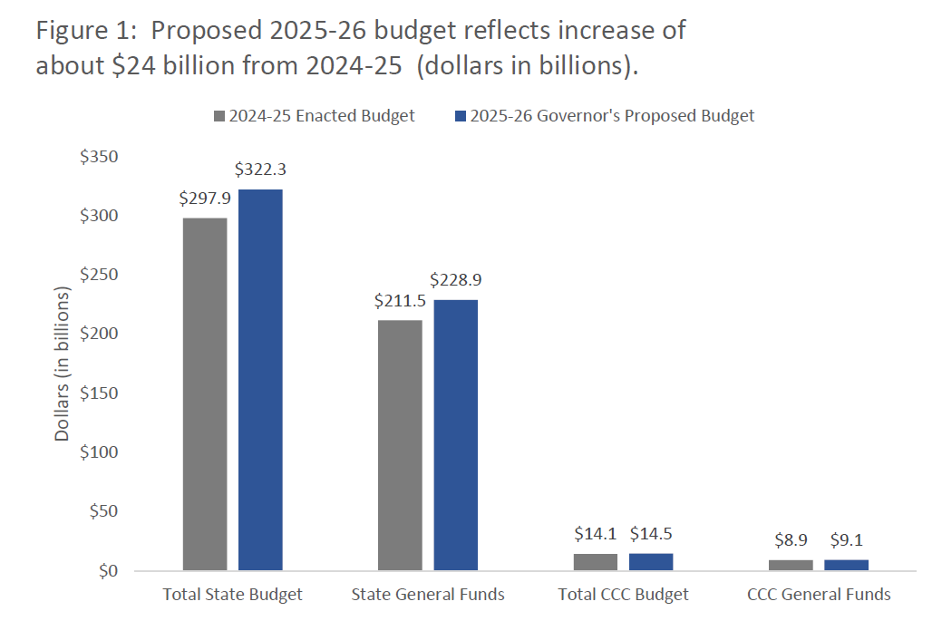
Governor’s January budget 2025-2026

Slide 3
Governor’s January budget 2025-2026
The budget proposal for the California Community Colleges reflects a significant focus on the Master Plan for Career Education and includes a vision of a Career Passport that would follow a student's educational journey.
The proposal for additional ongoing spending includes $230.4 million for a 2.43% cost-of-living adjustment (COLA) for community college apportionments, $28.7 million for COLAs and adjustments to certain categorical programs, and $30.4 million for systemwide enrollment growth of 0.5%.
One-time $133.5 million and ongoing $29 million funding in the proposal is dedicated to the establishment of a Systemwide Common Data Platform that would integrate a suite of technology tools, including e-Transcripts, the Mapping Articulated Pathways platform, and Program Pathways Mapper.
The proposal also includes $168 million one time to complete the Statewide Technology Transformation, which would standardize and streamline data collection to support more seamless educational and career transfers.
One-time $93 million and ongoing $7 million funding in the proposal is dedicated to scaling up Credit for Prior Learning policies.
The Governor's proposal includes capital outlay funds from Proposition 51 and Proposition 2 to support 31 projects, including De Anza’s Physical Education Complex Renovation.

Slide 4
Governor’s January budget 2025-2026

Slide 5
Proposed 2025-2026 SCFF Rates
*Ten districts receive higher credit FTES rates, as specified in statute.

Slide 6
student centered funding formula basics
California community colleges are funded annually by 3 separate allocations:
70% Base allocation (FTES + campus & center allocation)
  Credit FTES (three-year average; 70%)
  Special Admit, Incarcerated, and CDCP Noncredit (no three-year average; 100%)
  Non-enhanced Noncredit

Slide 7
student centered funding formula basics
California community colleges are funded annually by 3 separate allocations:
20% Supplemental allocation (low-income student population)
Allocated to each district based on total points calculated annually
  1 point for each student who receives financial aid (Pell)
  1 point for each student who is granted an exemption for non-resident tuition (AB 540)
    Non-resident student who attended a CA high school for at least 3 years & earned diploma
  1 point for each student who receives a California College Promise/formerly Board Of Governors (BOG) fee waiver

Slide 8
student centered funding formula basics
California community colleges are funded annually by 3 separate allocations:
10% Student success allocation (completion metrics)
Success Metrics averaged over three years
Only highest degree/award counted
Transfer based on UC/CSU criteria and only awarded to one District with 12+ units in prior year
  ADT
  AA/AS
  Baccalaureate
  Credit Certificates (16+ units)
  Completion of Math and English (year 1)
  Transfer to 4-year university
  Completion of 9+ CTE units
  Attainment of Regional Living Wage

Slide 9
Apportionment Reports
www.cccco.edu
CO Divisions under the “About Us” tab
College Finance and Facilities Planning
Apportionment Reports
Take your pick (P1, P2, R1) on the State General Apportionment Report by District, Exhibit C
Example: https://www.cccco.edu/-/media/CCCCO-Website/docs/apportionment/2023-24r1-exhibitc-sept2024.pdf?la=en&hash=56A4923DA4CFC7341BE7B9AB351BAFC5FEB64EF5
2023-2024 Recalculation September 2024 FTES total: 21,576.46
2024-2025 P1 January 2025 (estimated) FTES total: 21,398.35

Slide 10
SCFF Dashboards
www.cccco.edu
CO Divisions under the “About Us” tab
College Finance and Facilities Planning
SCFF Resources and Tools
SCFF Data Trends and Insights
https://www.cccco.edu/About-Us/Chancellors-Office/Divisions/College-Finance-and-Facilities-Planning/scff-dashboard/phase-2
When selecting FY 2023-2024, we can visualize district-wide data from FY 2020-2021, FY 2021-2022, and FY 2022-2023.
Overall, Pell has remained flat, AB 540 slightly declined, and we see a drop in College Promise.

Slide 11


