Slide 1
We’re on the Web!
www.deanza.edu/slo/
Welcome to the 3rd Annual
SLO Convocation
Welcome from the SLO Team:
Randy Bryant, Jim Haynes, Anu Khanna, Coleen Lee-Wheat, Mary Pape, Toño Ramirez
Assisted by:
Cynthia Kaufman, Veronica Neal, Jackie Reza
SLOAC

Slide 2
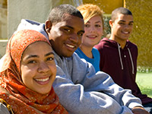
De Anza College provides an academically rich, multicultural learning environment that challenges students of every background to develop their intellect, character and abilities; to realize their goals; and to be socially responsible leaders in their communities, the nation and the world.
Our Mission

Slide 3
De Anza College fulfills its mission by engaging students in creative work that demonstrates the knowledge, skills and attitudes contained within the college’s Institutional Core Competencies:
Our Mission
Critical thinking Assessed 2012-13
Communication and expression
Information literacy
Physical/mental wellness and personal responsibility
Global, cultural, social and environmental awareness

Slide 4
Characteristics of Global, cultural, social and environmental awareness
Students will:
Recognize their role as local, national, and global citizens
Participate in a democratic process
Respect social and cultural diversity
Appreciate the complexity of the physical world
Understand the significance of both environmental sustainability and social justice

Slide 5
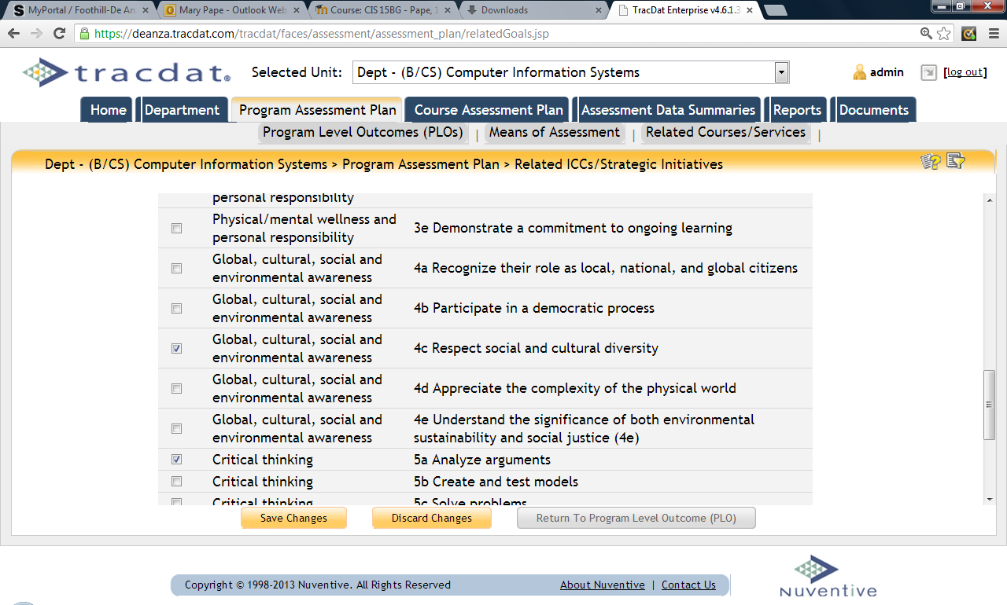
Mapping Program Level Outcomes Global, cultural, social and environmental awareness

Slide 6
Timeliness – point #1
Student Respondents to the Community College Engagement Survey stated their experience at De Anza “very much” or “quite a bit” increased their ability to:
Information Literacy: able to recognize when additional information is needed to complete an assignment | 65%
Critical Thinking: able to evaluate conclusions to ensure they make sense | 63%
GCSEA: work effectively individually and collaboratively on projects | 57%
GCSEA: participate in a democratic process | 38%
GCSEA: understand the significance of both environmental sustainability and social justice | 52%

Slide 7
Timeliness – point #2
The most recent Accountability Reporting for the Community Colleges (ARCC) report showed that we have lost ground in closing the gap for the underrepresented.
See slide 9 at http://www.research.fhda.edu/documents/2012ARCCBoardPresentationv3.pdf

Slide 8
Growing Equity Gap

Slide 9
Timeliness – point #3
Campus Climate survey will be conducted in Spring 2013

Slide 10
GLOBAL AWARENESS

Slide 11
GLOBAL AWARENESS
CULTURAL AWARENESS

Slide 12
GLOBAL AWARENESS
CULTURAL AWARENESS
SOCIAL AWARENESS

Slide 13
GLOBAL AWARENESS
CULTURAL AWARENESS
SOCIAL AWARENESS
ENVIRONMENTAL
AWARENESS

Slide 14
GLOBAL AWARENESS
CULTURAL AWARENESS
Civic Capacity for Equity and Social Justice
SOCIAL AWARENESS
ENVIRONMENTAL
AWARENESS

Slide 15
Civic Capacity for Equity and Social Justice in the areas of...
Environmental Awareness
Social Awareness:
Global Aware-ness
Cultural Aware-ness

Slide 16
Faculty & Staff Focused Objective: Deepen faculty and staff understanding of global, cultural, social, and environmental awareness seen through the lens of civic capacity for equity and social justice.

Slide 17
Student Focused Objective: Assess that our students are deepening their awareness in regards to global, cultural, social and environmental issues as seen through the lens of civic capacity for equity and social justice

Slide 18
Civic Capacity for Equity and Social Justice in the areas of...
Environmental Awareness:
How do we understand the significance of environmental sustainability? How does environmental sustainability relate to my discipline or work area?
Social Awareness:
How do we understand the problems different communities face? How do we understand ways these problems impact and are impacted by our disciplines and/or our work?
Global Awareness: How do we understand the ways our disciplines or work areas impact and are impacted by global processes? How do we recognize our roles as local, national, and global citizens?
Cultural Awareness:
In what ways do we respect social and cultural diversity intrapersonally, interpersonally, and institutionally? How does culture shape our pedagogy?

Slide 19
Civic Capacity
Equity Equality
Socially Just Diversity
Inclusion

Slide 20
Panel of Practice: What some of our own faculty and staff are already doing.
Panelists:
Lori Clinchard (Instructor--Humanities)
Jeff Schinske (Instructor--Biology)
Matt Trosper (Academic Advisor—Athletics)

Slide 21
Three key questions in the assessment process:
What do we see/have we seen that indicates an opportunity for improving student learning?
What might we change in our own campus work in order to improve student learning?
What results do we observe after making this change?

Slide 22
Division__________________ Department/Service Area _____________________
In the table below choose one or more characteristics of this ICC and write what you currently do or what you propose to do in your class(es) or service area.
ICC Characteristic | Where in your campus work have you observed that your students’ (Global/Cultural/Social/Environmental) engagement could be further deepened?? | Describe the experiment/assessment that you have tried or (will try) in order to deepen your students’ Global/Cultural/Social/Environmental) engagement.) | How will you know that students “got it”? ((i.e. That your students’ Global/Cultural/Social/Environmental engagement has deepened)
Global Awareness
Cultural Awareness
Social Awareness
Environmental Awareness
Name: ____________________ (Optional but we would really appreciate it!)

Slide 23
We’re on the Web!
www.deanza.edu/slo/
Thank you
SLO Convocation
Outcome #2 | Faculty will dialog on SLO work at course and program level
1:00—3:00 pm | - Individual Department work: SLOs, SLOACs, PLOACs, APRU - Drop-in Help available in ADM 102
SLOAC

