Slide 1
Accreditation Affirmed with Recommendations
Mary Pape
Toño Ramirez

Slide 2
Accreditation Affirmed
with Recommendations

Slide 3
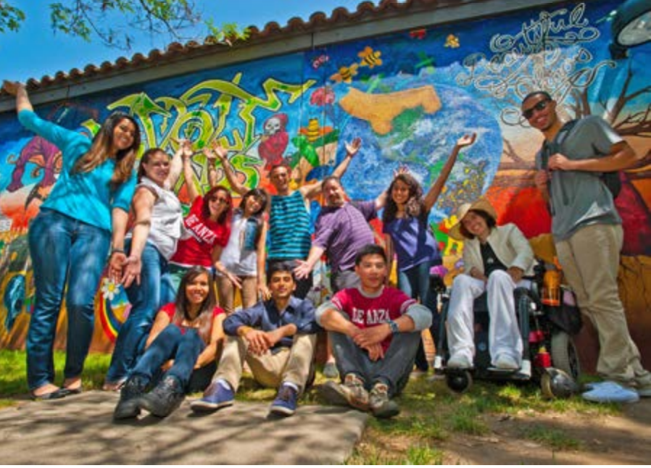
It’s about Compliance

Slide 4
Recommendation 2
In order to meet the standard, the College should ensure that in every class section students receive a course syllabus that includes learning outcomes from the institution's officially approved course outline.
(Standard 11.A.2, 11.A.3)

Slide 5
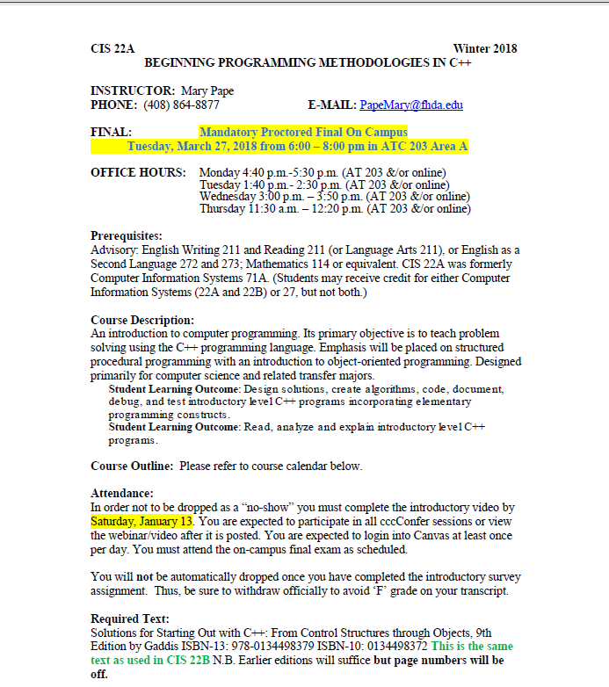
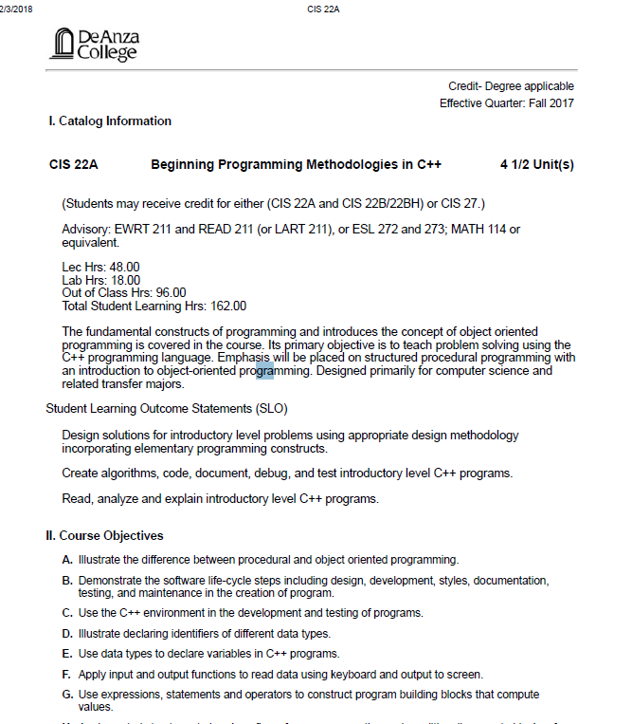

Recommendation 2

Slide 6
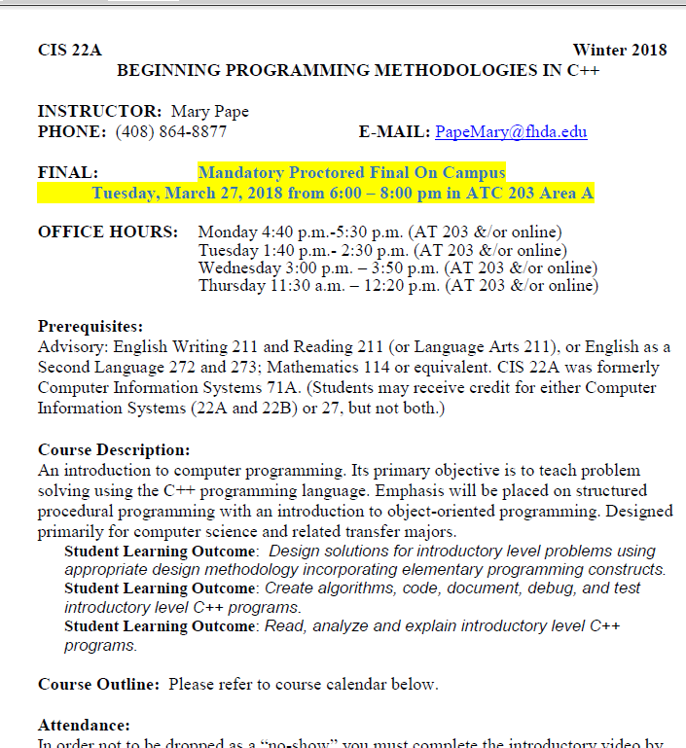

Recommendation 2

Slide 7
Recommendation 2
Solution to Immediately Implement:
Each and every faculty must update current syllabus to use the word “Outcome” and list the student learning outcome(s) exactly as they appear on the course outline of record. The official list of SLOs for each course are also posted by Divisions at deanza.edu/slo

Slide 8
Recommendation 2
Solution to Immediately Implement : (continued)
Each and every faculty member needs to update with new syllabus:
Division Office
Canvas site
Online Education (Jenny Vela)
Your website
. . .

Slide 9
Recommendation 2
Solution Implemented :
Improve (formerly TracDat) has been updated to have all Active outcomes changed to agree with course outline of record.
Only SLO Coordinators can change, delete, add course level Student Learning Outcomes.
If “Archived SLO” but still on COR then now “Active Pending Revision”. So “Active” but does not trigger a flag.
If SLO “Active” but not on COR now “COR Revision Needed” which keeps “credit” for assessment.

Slide 10
Recommendation 1
In order to meet the standard, the College should regularly assess all course, program, and institution-level SLOs and report the findings of articulated learning outcomes and ensure the College documents the use of the assessment of these outcomes for improvement and planning.
(Standard I.B.1, I.B.2, I.B.4, I.B.5, I.C. l, I.C.2, I.C.3, II.A.1, 11.A.2, 11.A.3, 11.B.3, 11.C.2)

Slide 11
Recommendation 1
Solution One: Proposed Curriculum Process :
Initiators will include a signature form involving Student Learning Outcomes.
Start date: For 2019 Curriculum deadline (involving revisions effective Fall 2020)
Form requires signature of SLO Instructional Coordinator
I. New Course - For each outcome (minimum one):
SLO Statement
Anticipated assessment method
Anticipated quarter to be assessed

Slide 12
Recommendation 1
Solution One: Proposed Curriculum Process: (continued)
II. 5-year Revision –
For each of the SLOs in your course, attach documentation for at least one assessment cycle that has been conducted during the last 5 years. Your documentation should clearly indicate:
The SLO Statement
The assessment method used
The year and quarter the assessment took place
A summary of the data collected
Any enhancements planned in light of the assessment
  Note: Enhancement can come in the form of a change to the SLO statement, a change to the assessment method, or a change in the content or pedagogy used in the course itself
Improve -> Reports -> Standard Reports -> click on Courses/services selected Choose just the one course

Slide 13
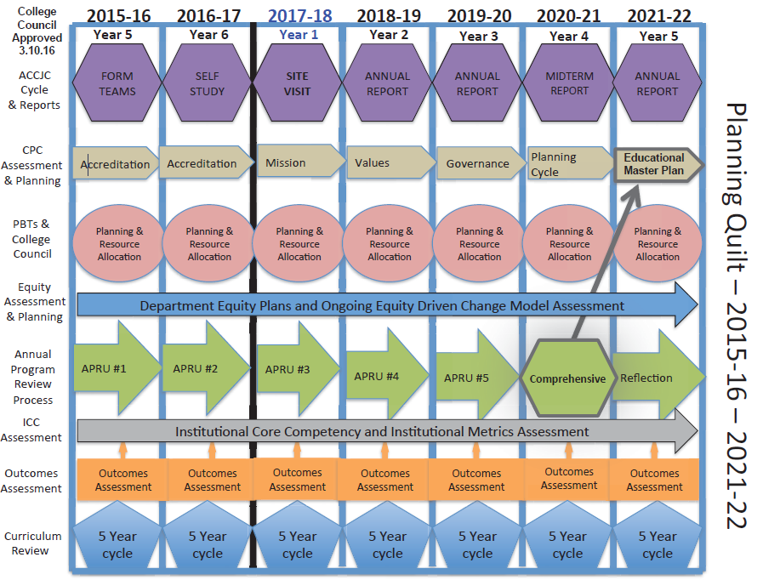
Recommendation 1

Slide 14
Recommendation 3
In order to meet the standard and comply with federal regulation 602.17(g) in distance education courses as defined in 602.3, the College should implement processes and structures to ensure regular and substantive interaction with the instructor and initiated by the instructor.
Guidelines for fulfilling the charge for “Regular, Timely and Effective Student/Faculty Contact”

Slide 15

THE RACE IS ON

Slide 16
>= 70%
Honor Roll
BHES:
Biology
Health Technologies
Medical Laboratory Technician
Nursing
BUS/CS/AT
Accounting
Auto
Business
Rea Estate
Creative Arts
Film/TV
Photography
IIS
Korean
Mandarin
Language Arts
Communication Studies
English
PE
Athletics (Hybrid)
Kinesiology
Massage Therapy
Physical Education
PSME
Mathematics
Meteorology
SSH
Anthropology
Economics
Geography

Slide 17

SLO Office Hours
SLO Process Drop-In Help in Academic Senate Office (Admin 117)
Wednesdays 4:00 – 5:00 pm
Thursdays 10:00 – 11:00 am

Slide 18

What the future holds…
March 1, 2018
Deadline

