Slide 1

Welcome to the Student Learning Outcome Process
Veronica Avila
Mary Pape
Tono Ramirez
SLO/SSLO/AUO Coordinators

Slide 2
Contents
Our Road to “Proficiency”
6-year planning cycle document
There will be a test at the end of this presentation for Jackie Reza only.

Slide 3
Why Student Learning Outcome Process?
Culture of inquiry
Accreditation by ACCJC (Accrediting Commission for Community & Junior Colleges)
Stakeholders demand assessment
Notes:
Should note that for the SLO process, faculty are in charge. Faculty decide how it will be assessed and what the target or bench mark should be.

Slide 4
Improving the Student Experience
Student Learning Outcomes
Course Level
Program Level
Institutional Level
Student Services Learning Outcomes
Administrative Unit Outcomes

Slide 5
Improving the Student Experience
Student Learning Outcomes
Course Level
What the student will be able to do at the end of the course.

Slide 6
Improving the Student Experience
Student Learning Outcomes
Course Level
Design mobile applications using object-oriented methodology and advanced Objective C concepts using iOS Development Kit. (CIS 55)

Slide 7
Improving the Student Experience
Student Learning Outcomes
Program Level
What the student will be able to do after completing a certain certificate/degree or just after completing courses within your department.

Slide 8
Improving the Student Experience
Student Learning Outcomes
Program Level
Develop a critical way of thinking with the goal of optimal decision- making in everyday life using marginal benefit and marginal cost concepts. (Economics Department PLO_1)

Slide 9
Improving the Student Experience
Student Learning Outcomes
Institutional Level
(Institutional Core Competencies)
Communication and expression
Information literacy
Physical/mental wellness and personal responsibility
Civic capacity for global, cultural, social and environmental justice
Critical thinking

Slide 10
Improving the Student Experience
Student Services Learning Outcomes are overarching, clear, and assessable statements that identify and define what a student will be able to know, do, or feel at the successful completion of a specific program, activity, or process.

Slide 11
Improving the Student Experience
Student Services Learning Outcomes
Incoming new international students will be aware that in ISP orientation program provides information on such topics as: health, banking, transportation, housing, immigration, cultural adjustment, and medical insurance. (Dept SS – Coun – International Student Program)

Slide 12
Improving the Student Experience
Administrative Unit Outcomes are overarching, clear, and assessable statements that identify and define what a client/customer/student will be able to know, do, or feel at the successful completion of a specific activity or process.

Slide 13
Improving the Student Experience
Administrative Unit Outcomes
Students will report they can obtain all of their textbooks and supplies at any given point. (Dept FER – ER – Bookstore)

Slide 14
Outcome Defined
(Redefined)
Conduct assessments
Summarizing data
Reflection
Enhancement
Plan methods of assessment

Slide 15
I. Our Road to “Proficiency”

Slide 16
Institutional
Level Outcomes
Program Level Outomes & Assessments
SLOACs/SSLOACs/AUOACs

Slide 17
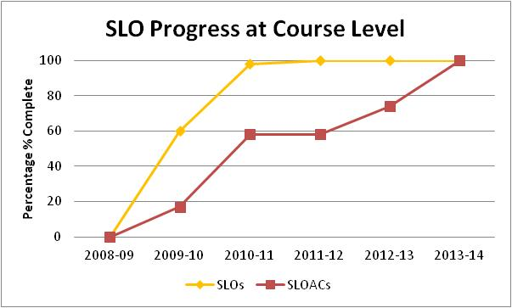
Our Progress ->

Slide 18
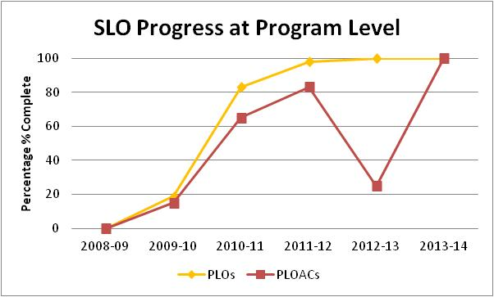
Our Progress ->

Slide 19
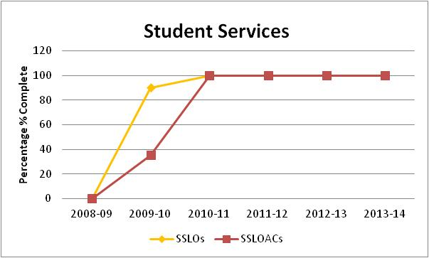
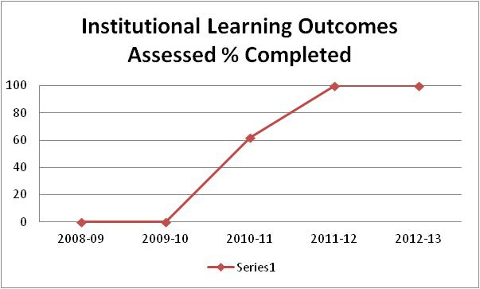
->ACCJC Report on 2012 Follow-Up Visit
“The team found evidence that the College is at proficiency level for SLOs”

Slide 20
Accounting *** Astronomy *** Automotive Technology *** Business *** Cantonese *** Chemistry *** Child Development *** Computer Aided Design and Digital Imaging *** Economics *** Geology *** Italian *** Japanese *** Library *** Mandarin *** Manufacturing & CNC Technology *** Mathematics *** Photography *** Physics *** Political Science *** Real Estate *** Sociology *** Student Success Center ***
100% SLO Club

Slide 21
Accounting *** Anthropology *** Automotive Technology *** Business *** Child Development *** Economics *** Engineering *** English *** English as a Second Language *** French *** Geography *** History *** Humanities *** Massage Therapy *** Mathematics *** Music *** Nursing *** Philosophy *** Photography *** Physical Education *** Political Science *** Reading *** Real Estate *** Spanish *** Speech Communication *** Student Success Center ***
100% PLO Club

Slide 22

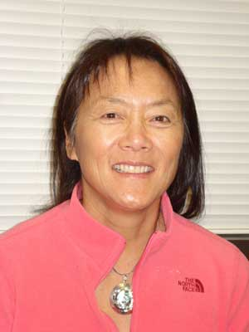
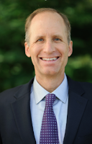

Academic Senate
Support from Presidents and Vice Presidents of Academic Senate:

Slide 23
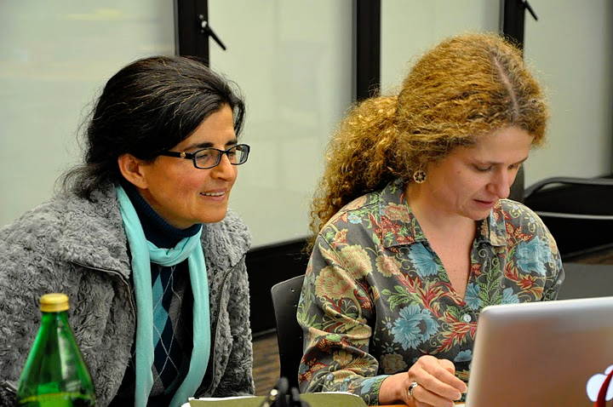
Leadership Structure
- Faculty Driven

Slide 24
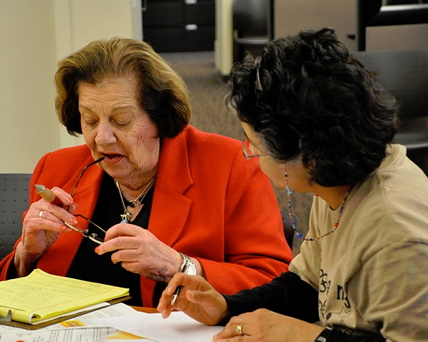

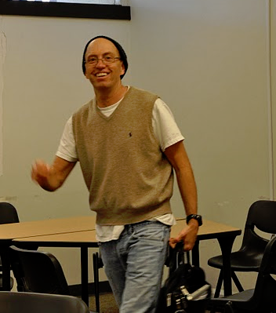


Slide 25

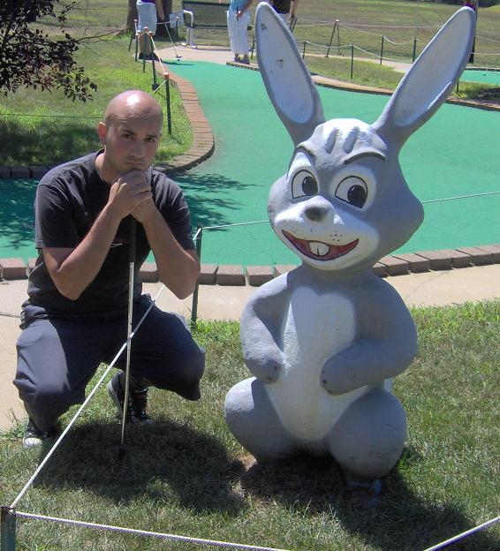
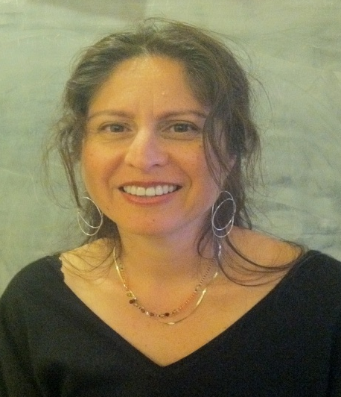
SLO Core Team
Student Services & Administrative Units Coordinator:
Veronica Avila
Instructional Coordinators:
Mary Pape & Toño Ramirez
Randy Bryant ** Anu Khanna ** Coleen Lee-Wheat ** Mallory Newll

Slide 26


SLO Core Team
Jeff Schinske
Amy Leonard

Slide 27
SLO Steering Committee
Administrators:
VP, Instruction
VP, Finance & Educational Resources
Director, Institutional Research
Director, Marketing
Associate VP, Instruction
Dean, PE & Athletics

Slide 28



Division SLO Liaisons
Language Arts
Physical Science/
Math/
Engineering
Business/
Computer
Systems
Student Service:
Counselor

Slide 29
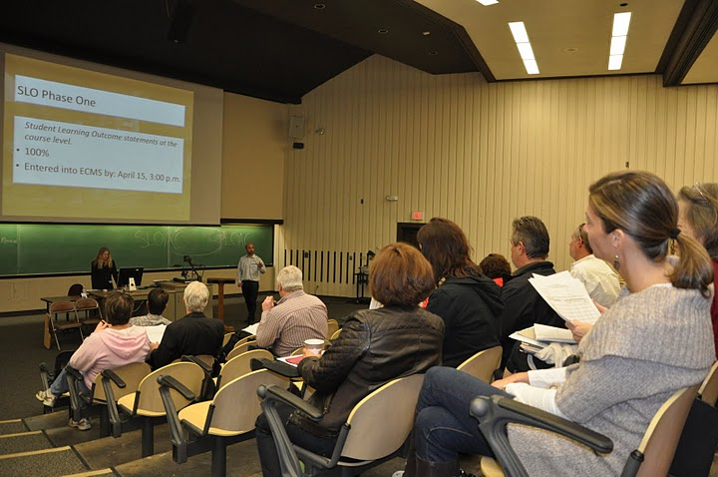
Dialog - Annual Convocation

Slide 30

Dialog - Workshops

Slide 31
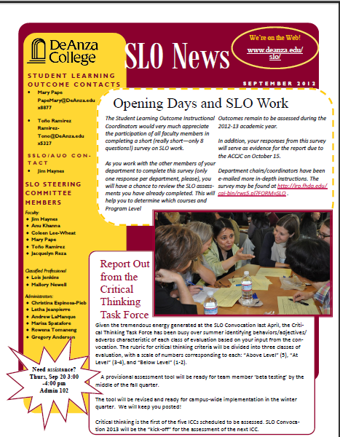
Dialog - SLO Newsletter

Slide 32
II. Developing Our Institution’s Planning Cycle

Slide 33
Our Mantra
It’s one thing to have De Anza College fully engaged in writing outcome statements, performing assessments, and documenting results for the purpose of improving student learning and achievements, but if all that work does not drive our Institutional Planning at all levels of the College we will not have met the expectations of the ACCJC Institutional Planning and Program Review Standards.

Slide 34
SLOAC
Resource
Needs
SSLOAC
Resource Needs
AUOAC
Resource
Needs
Identify

Slide 35
Divisional
prioritization
Divisional
prioritization
Divisional
prioritization
SLOAC
Resource
Needs
SSLOAC
Resource Needs
AUOAC
Resource
Needs
Identify

Slide 36
Instructional
Program Reviews
Student Services
Program Reviews
Finance & Resources
Program Reviews
Affirm
Divisional
prioritization
Divisional
prioritization
Divisional
prioritization
SLOAC
Resource
Needs
SSLOAC
Resource Needs
AUOAC
Resource
Needs
Identify

Slide 37
Focus
Focus and Alignment Lens
Mission – Strategic Initiatives – ICCs – Educational Master Plan
Instructional
Program Reviews
Student Services
Program Reviews
Finance & Resources
Program Reviews
Affirm
Divisional
prioritization
Divisional
prioritization
Divisional
prioritization
SLOAC
Resource
Needs
SSLOAC
Resource Needs
AUOAC
Resource
Needs
Identify

Slide 38
IPBT
SSPBT
FRPBT
Focus
Focus and Alignment Lens
Mission – Strategic Initiatives – ICCs – Educational Master Plan
Instructional
Program Reviews
Student Services
Program Reviews
Finance & Resources
Program Reviews
Affirm
Divisional
prioritization
Divisional
prioritization
Divisional
prioritization
SLOAC
Resource
Needs
SSLOAC
Resource Needs
AUOAC
Resource
Needs
Identify

Slide 39
COLLEGE COUNCIL
Allocate
IPBT
SSPBT
FRPBT
Focus
Focus and Alignment Lens
Mission – Strategic Initiatives – ICCs – Educational Master Plan
Instructional
Program Reviews
Student Services
Program Reviews
Finance & Resources
Program Reviews
Affirm
Divisional
prioritization
Divisional
prioritization
Divisional
prioritization
SLOAC
Resource
Needs
SSLOAC
Resource Needs
AUOAC
Resource
Needs
Identify

Slide 40
College Planning Committee
5/15/13
2011-12
2012-13
2013-14
2014-15
2015-16
2016-17
2017-18
Year 1
Year 2
Year 3
Year 4
Year 5
Year 6
Year 1
SITE
VISIT
Follow-up Site Visit
(Recs #1,#2,#3)
Follow-up Letter
(Rec #1)
MID-TERM
REPORT
Form Teams
SELF
STUDY
SITE
VISIT
ACCJC
Cycles/
Reports
Ongoing Preparation and Submission of ACCJC Reports
CPC
Assessment/
Planning
Governance
Review
Values
Review
Mission
Review
EMP
REVIEW
“Quilt”
Review
Outcomes
Review
Governance
Review
Ongoing Assessment of Governance (annual survey)
PBTs &
College
Council
Planning & Resource
Allocation
(PRA)
Planning & Resource
Allocation
(PRA)
Planning & Resource
Allocation
(PRA)
Planning & Resource
Allocation
(PRA)
Planning & Resource
Allocation
(PRA)
Planning & Resource
Allocation
(PRA)
Planning & Resource
Allocation
(PRA)
Equity
Assessment/
Planning
Ongoing Development and Assessment of Student Equity Plans
DAC - Detailed Planning Cycle - 2011 - 2017
APRU # 3
APRU #4
CPR
&
5-Year
Plan
Reflect
APRU #1
APRU #2
APRU #2
Six-Year Program Review Process
ICC/GE
Assessment
Cycles
Critical Thinking
GCS&E
3rd ICC
4th ICC
5th ICC
Critical Thinking
Outcomes
Assessment Cycles
Outcomes
Assessment Cycles
PLOAC
CLOAC
DLOAC
Outcomes
Assessment Cycles
Outcomes
Assessment Cycles
CLOAC
DLOAC
PLOAC
Outcomes
Assessment Cycles
Outcome/
Assessment
Cycles
Curriculum
Review
Cycles
5 Year cycle
5 Year cycle
5 Year cycle
5 Year cycle
5 Year cycle
5 Year cycle
5 Year cycle
Notes:
40

