Slide 1
Program Review Workshop
Making the most of the Program Review

Slide 2
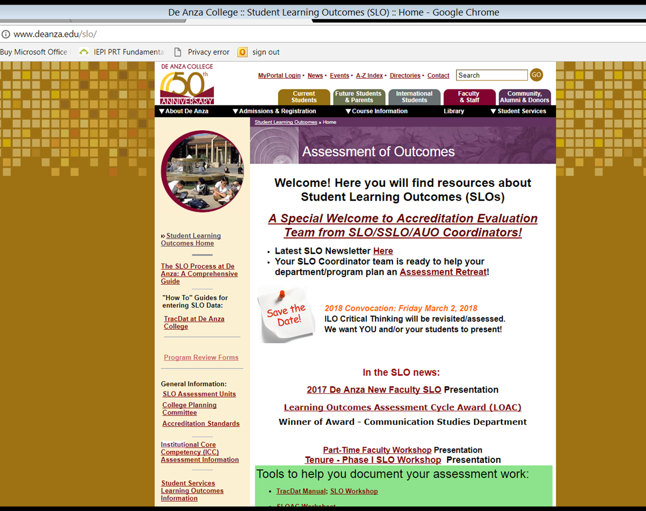
deanza.edu/slo

Slide 3
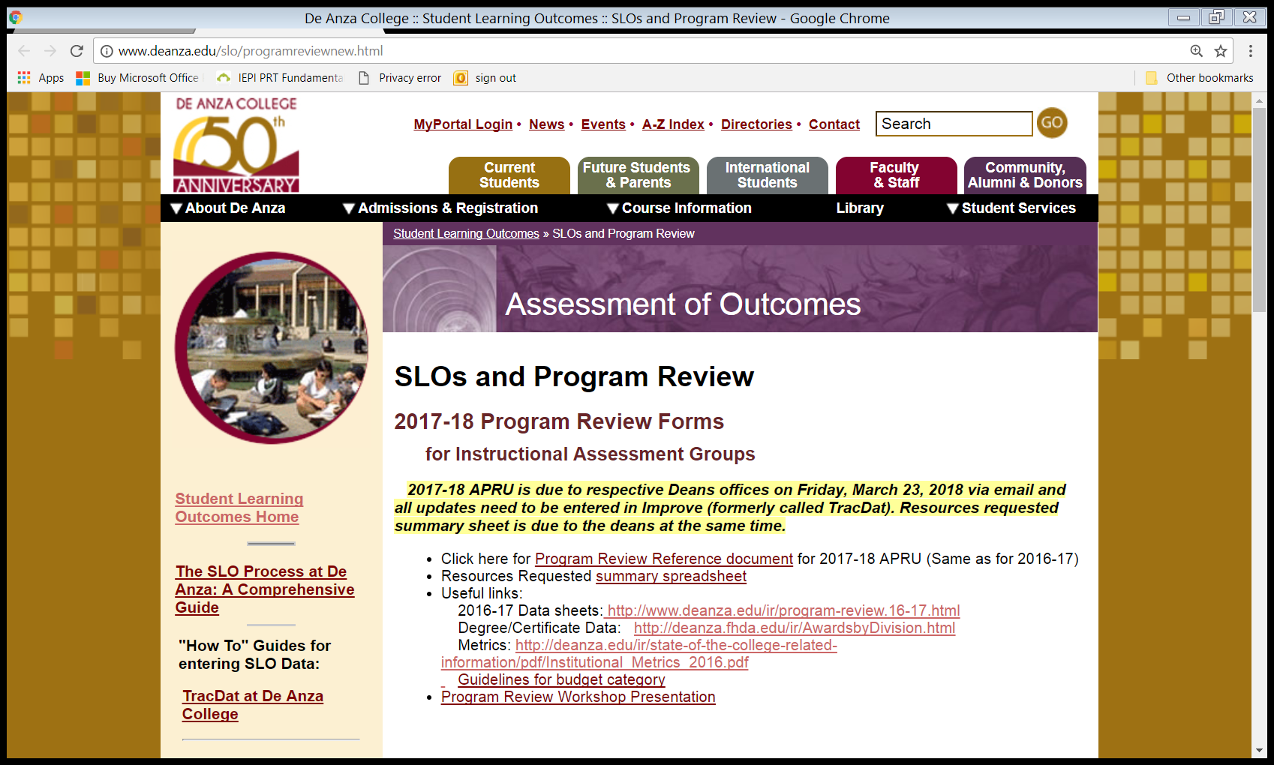
All the forms & info

Slide 4
Agenda
Desired outcome
The document itself
  Program Description
  Enrollment
  Equity
  Assessment Cycle
  Resource Requests
So now you are ready for Improve

Slide 5
Desired Outcome
If your department thinks it might need a resource (faculty, staff, facility, staff development, other) it must be mentioned in the Program Review and supported by data.
Support data includes but is not limited to SLO/PLO assessments, responses on program review, …

Slide 6
The Document Itself
I. Program Description
Faculty Information
http://www.deanza.edu/ir/program-review.16-17.html
Certificate/Degree Information
http://deanza.edu/ir/AwardsbyDivision.html

Slide 7
The Document Itself
II. Enrollment
Enrollment
http://www.deanza.edu/ir/program-review.16-17.html

Slide 8
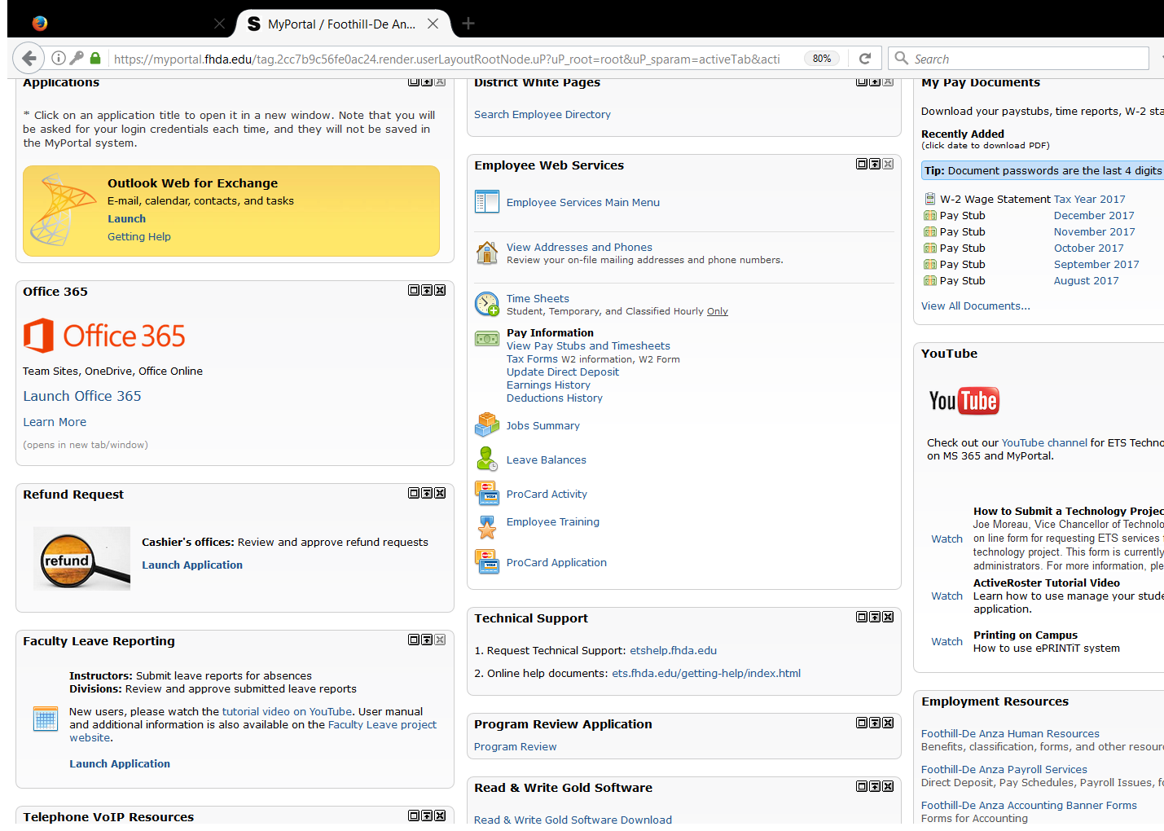
New Tool now on MyPortal
Employees Tab

Slide 9
The Document Itself
III. Equity
 | Equity
III.A | Growth and Decline of Targeted Student Populations | Briefly, address student enrollment data relative to your program’s growth or decline in targeted populations: African Americans, Latinos, Filipinos. (Refer to http://www.deanza.edu/ir/program-review.16-17.html )
III.B | Closing the Student Equity Gap: | What progress or achievement has the program made relative to the plans stated in your program’s 2013 -14 Comprehensive Program Review, Section II.A.3, towards decreasing the student equity gap? See IPBT website for past program review documentation: http://deanza.edu/gov/IPBT/program_review_files.html
III.C | Plan if Success Rate of Targeted Group(s) is Below 60% | In accordance with ACCJC requirements, the college has adopted an institutional standard for successful course completion at or above 60% http://deanza.edu/ir/state-of-the-college-related-information/pdf/Institutional_Metrics_2016.pdf Are success rates of targeted groups at or above 60%? If not, what are the department’s plans to bring the success rates of the group(s) up to this level? This applies to African American, Latino/a and Filipino students.
III.D | Departmental Equity Planning and Progress | What progress or achievement has the program made relative to the plans stated in your departmental 2014-15 Equity Plan?
Point of Information:
Success rate for each group and the department is >60%
Gap between non-target group and targeted group < 5%

Slide 10
The Document Itself
III. Equity
Enrollment
http://www.deanza.edu/ir/program-review.16-17.html
Last Comprehensive Program Review
http://www.deanza.edu/ir/program-review.16-17.html
Point of Information:
Success rate for each group and the department is >60%
Gap between non-target group and targeted group < 5%

Slide 11
The Document Itself
IV. Assessment Cycles
IV.A | Cycle 2 PLOAC Summary | Give the percentage of Program Level Outcome statements assessed since June 30, 2014. Run Ad Hoc report entitled “Cycle 2 XXX PLOAC Work” and scroll to the bottom of the report for count. Then calculate #Reflections & Analysis/#PLO statements times 100. All program level outcomes are to be assessed at least once between Fall 2014 and end of Winter 2019.
IV.B | Cycle 2 SLOAC Summary | Give the percentage of Student Level Outcome statements assessed since June 30, 2014. Run Ad Hoc report titled “Cycle 2 XXX SLOAC work- Active Only” and scroll to the bottom of the report for count. Then calculate #Reflections & Analysis /#SLO statements times 100. All course level outcomes are to be assessed at least once between Fall 2014 and end of Winter 2019.

Slide 12
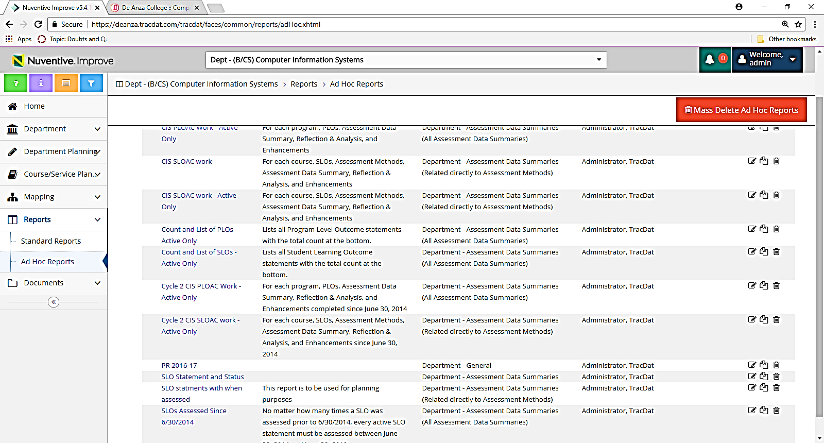
The Document Itself
IV. Assessment Cycles

Slide 13
The Document Itself
V. Resource Requests
Possible data sources
Read report TracDat -> Reports > Standard Reports and choose “Assessment: Department Four Column”
Read report TracDat -> Reports > Standard Reports and choose “Assessment: Course/Service Four Column”
Advisory Group input
Department minutes
Survey
Certificate/Degree Information
http://deanza.fhda.edu/ir/AwardsbyDivision.html
Demographic/Success Data
http://www.deanza.edu/ir/program-review.16-17.html
The new tool that is on MyPortal -> Employee Tab

Slide 14
The Document Itself
V. Resource Requests
V.C.2 Justification for Faculty Position(s):
Between 2012-13 and 2014-15 our department enrollment has grown by 2780 students (60%) while number of full-time faculty during this same period has grown by 2.2 (1.3 from CAOS; one new hire).
In addition we have created new certicficate and new area: security. Furthermore, we would like to add MIS program including certificate, degree and A-D-T degree.

Slide 15
The Document Itself
V. Resource Requests
V.D.2 Justification for Staff Position(s):
Survey indicates that students wish for longer lab hours and more support.

Slide 16
The Document Itself
V. Resource Requests
V.E.3 Equipment Justification:
AT 205 needs redesign of student desks. Assessments of SLOs (e.g. SLOAC for CIS22A_SLO_2) indicate “Students need more in class time to complete assignments. … “(12/17/2014)

Slide 17
The Document Itself
V. Resource Requests
V.F.2 Facility Justification:
CIS program is growing each year. This growth can only be sustained if we can offer more classes from 6:00 pm to 7:50 pm. A focus group assessment with students conducted Winter 2015 revealed that the later time frame, 8:00 - 9:50 pm is extremely difficult for our students who depend on public transportation.

Slide 18
The Document Itself
V. Resource Requests
V.F.2 Facility Justification:
Assessments of SLOs (e.g. SLOAC for CIS22A_SLO_2) Students need more in class time to complete assignments. That is, there needs to be more "flipping" of the classroom to accommodate the many issues that students are striving against: other difficult classes, work, poor study habits, lower than anticipated problem solving skills. This will make the class more equitable for all. (12/17/2014)

Slide 19
The Document Itself
V. Resource Requests
V.K.2 Staff Development Needs Justification: …we would like to be among the colleges offering OEI courses in the second round. In Winter 2015 we offered 23 sections of these C-ID courses with (See document on TracDat "Growth of C-ID classes.xlsx") total enrollment of 899. In Winter of 2016 this increased to 29 sections for a combined enrollment of 1087.
This data is from Year to Year Enrollment Report -- Estimated WSCH - By Section released by Institution Research and Planning on 1/6/2016.

Slide 20
The Document Itself
V. Resource Requests
V.K.2 Staff Development Needs Justification:
The department is anxious and willing (department meeting minutes of 1/13/2016) to move from Catalyst and individually chosen sites to Canvas in order to align ourselves for OEI acceptance. Since few of us are experts at creating courses to be delivered online, we would progress with authoring OEI accepted courses if there was a consultant to help us with this.

Slide 21
The Document Itself
V. Resource Requests
V.K.2 Staff Development Needs Justification:
. . . The Filipino group grew in numbers from 87 in 2012-13 to 255 in 2014-15. Their success grew from 53% (below acceptable) to 65%. Likewise, the Pacific Islander success rate jumped from 50% to 76% as their enrollment approximately tripled. Subjectively considering these statistics would sense that sense of community plays an important role. . .

Slide 22
The Document Itself
V. Resource Requests
V.L Closing the Loop: Two main methods for assessment:
1) Increase success rates
2) Increase number of certificates and degrees awarded

Slide 23
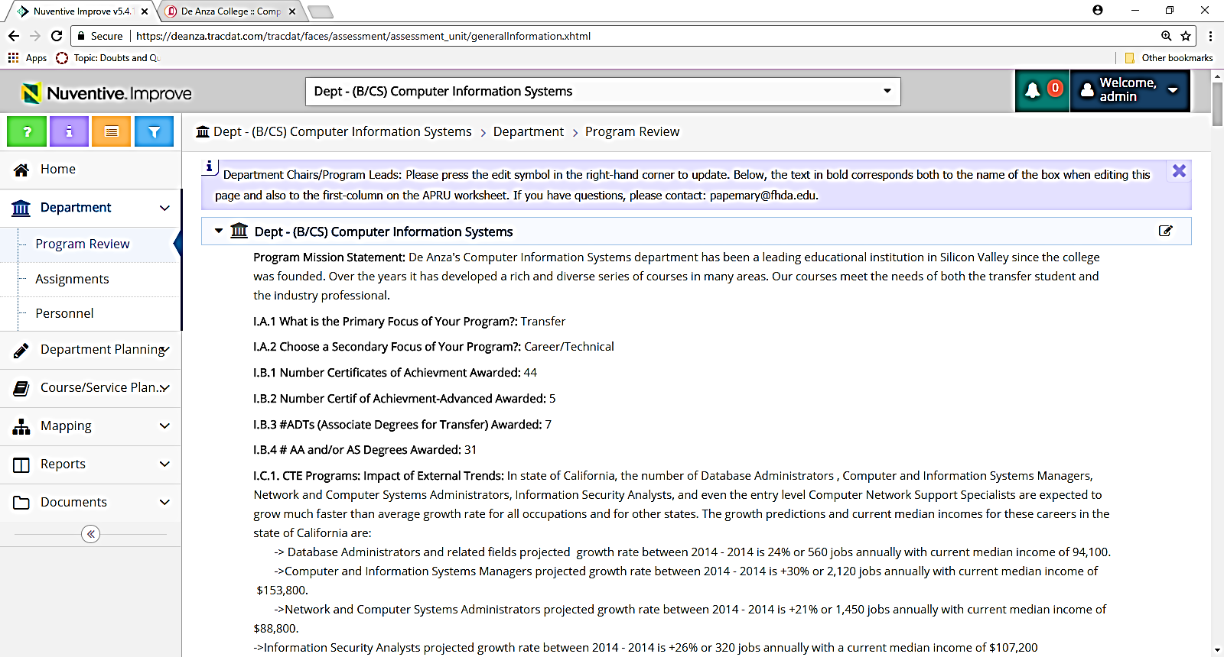
So now you are ready for Improve

Slide 24
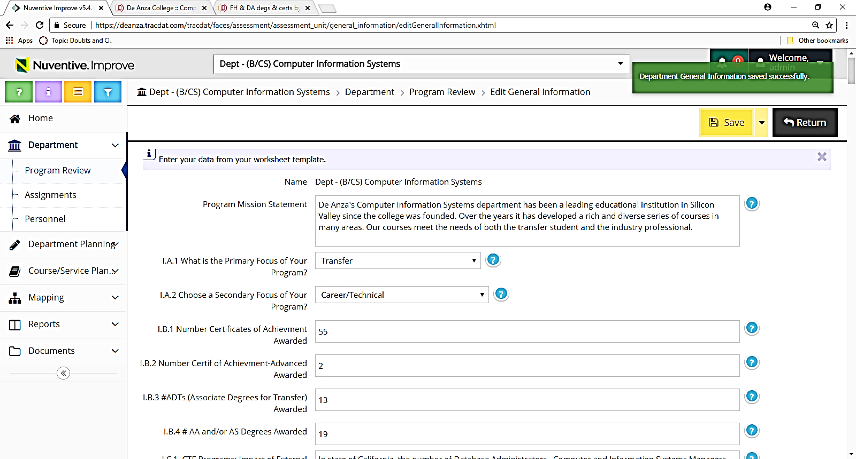
Update boxes as necessary
Save Often
Save Often
Make sure you see the green box
Or it is not really saved

Slide 25
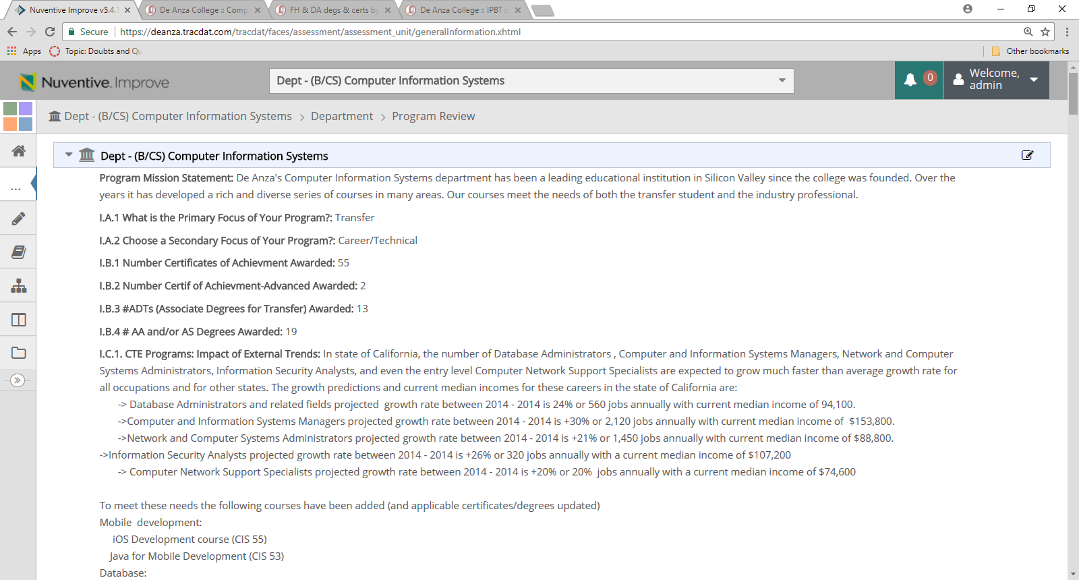
Save as pdf
N.B.
Close sidebar
Close purple instruction box at top

Slide 26
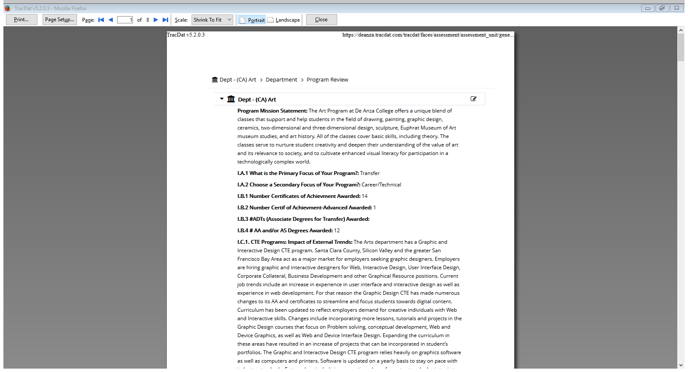
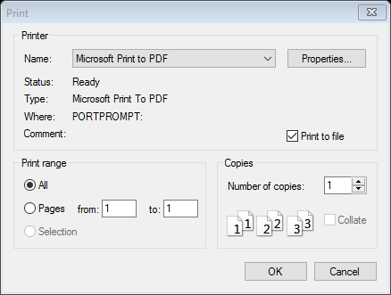
Save by “Print” from browser

Slide 27
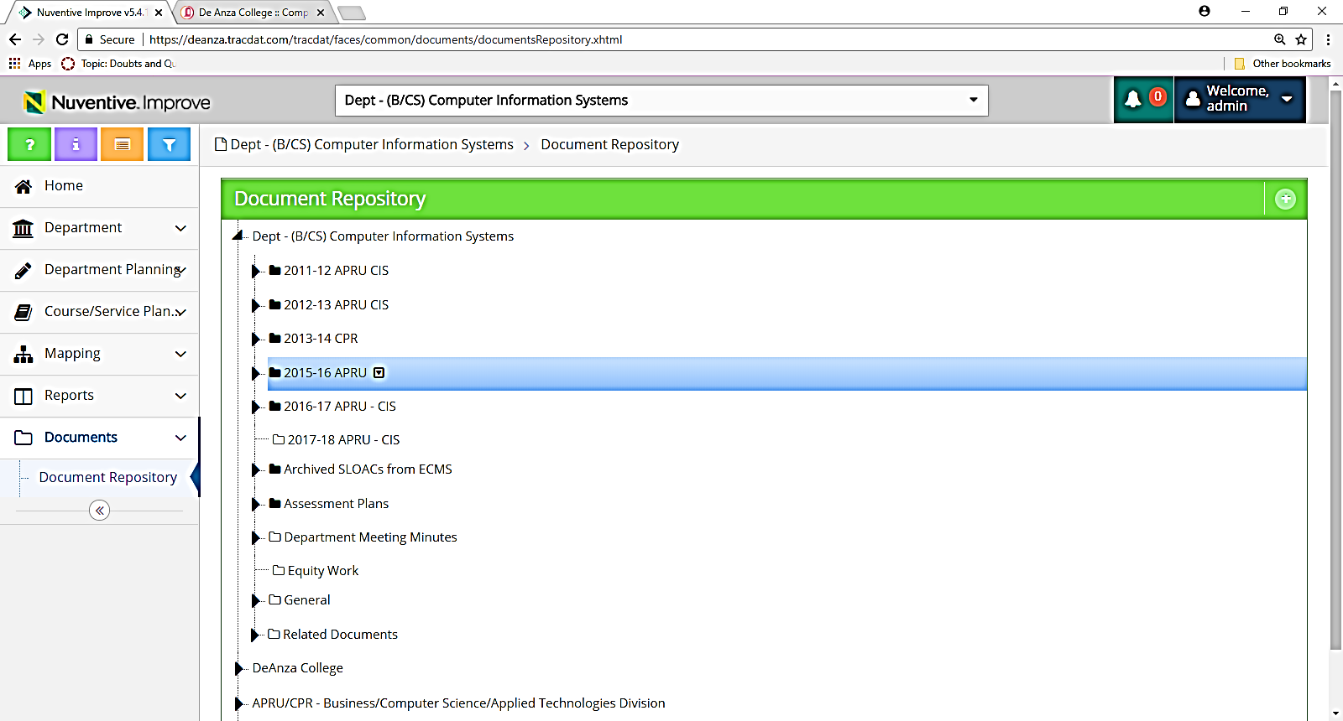
Upload documents – step 1
Choose “2017-18 APRU”

Slide 28
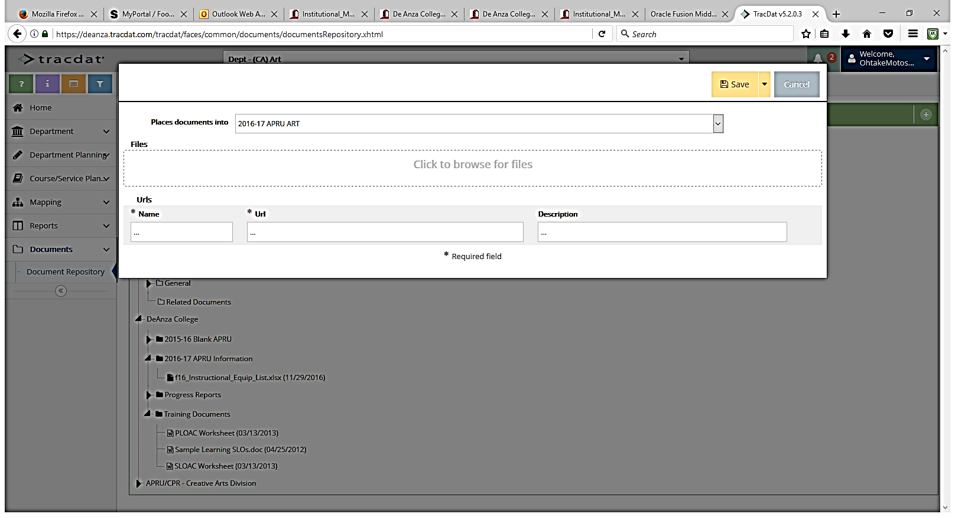
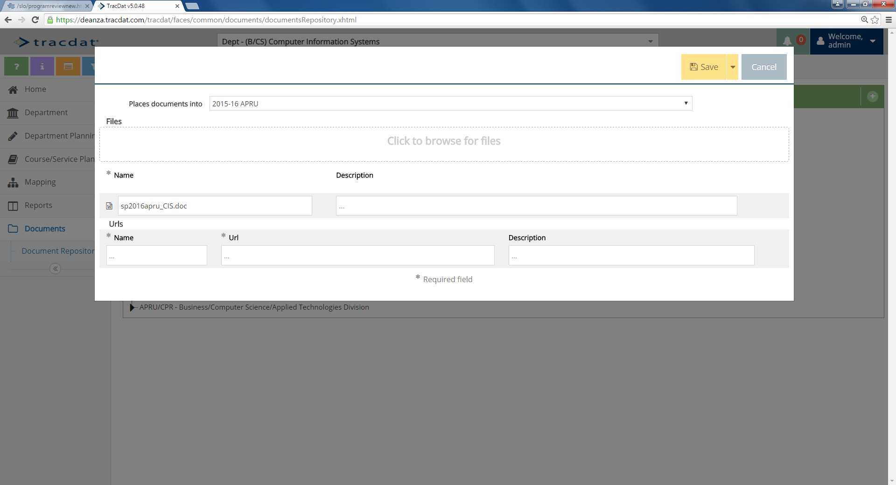
Upload document – step 2
Upload
pdf document that you made from Department -> Program Review tab in Tracdat
Equipment Excel file

