Slide 1

Student Outcomes Update
Your SLO Coordinators:
Veronica Avila
Mary Pape

Slide 2

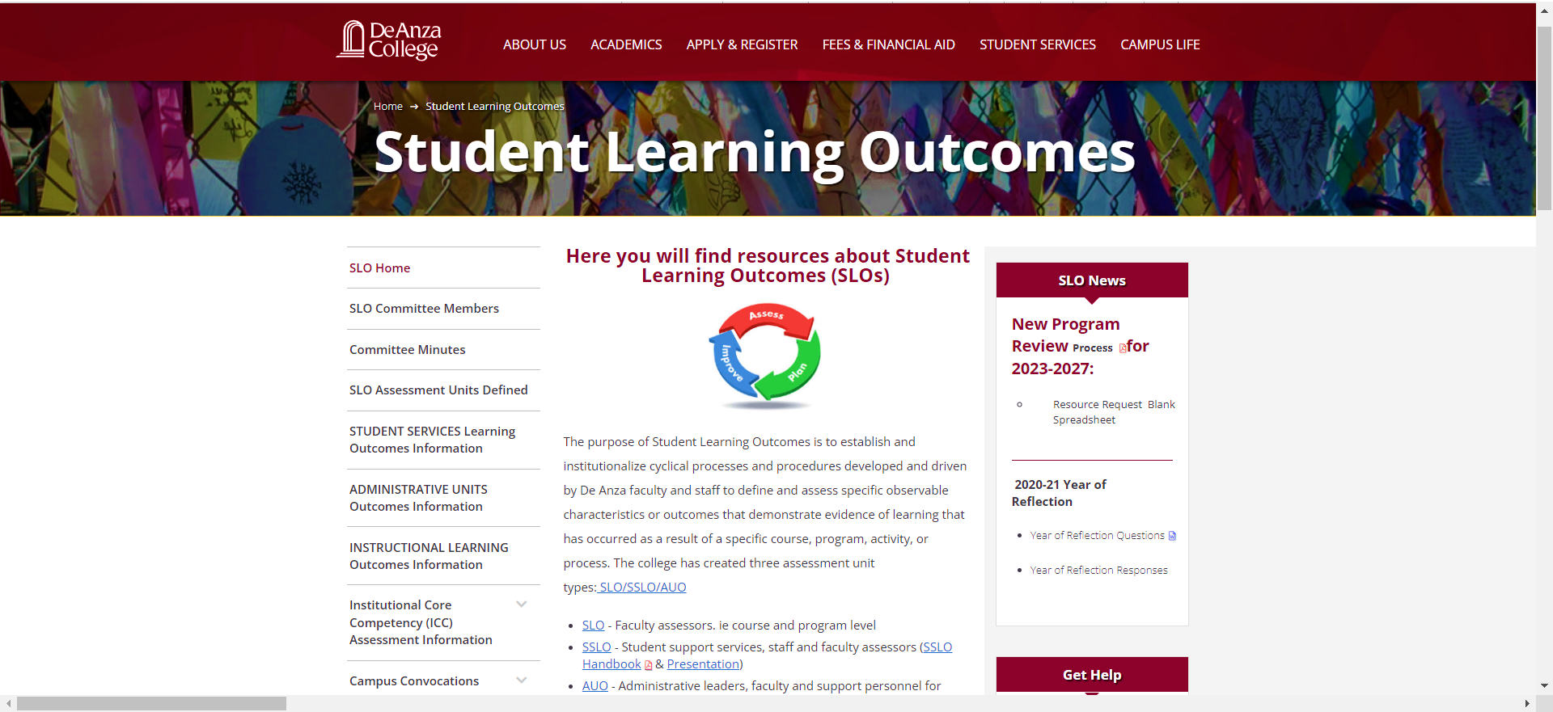
Website has new design/organization

Slide 3
Most Frequently Asked Questions:
How often outcomes for a course need to be assessed?
  Once every five years. That is at least once before the next time it is revised.
  Assess more often if it is one of the most frequently taught courses in your department.
No one size fits all due to differing number of courses per department: Biology (28), CIS (90), Economics (8), English (26), Math (56), Psychology (21)

Slide 4

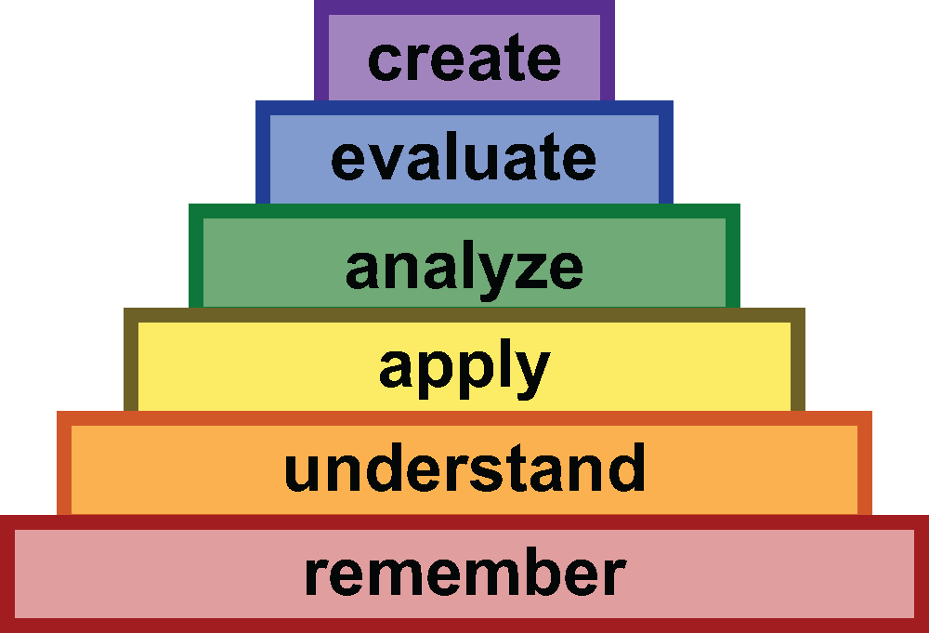
Crafting an Outcome Statement
[The student will be able to] Bloom’s Taxonomy word . . .
Make the outcome pleasant to read: Apply fundamental constructs as they apply to coding solutions for introductory level programming problems.

Slide 5
Crafting an Outcome Statement
[The student will be able to] Bloom’s Taxonomy word . . .
Apply fundamental constructs as they apply to coding solutions for introductory level programming problems.

Slide 6
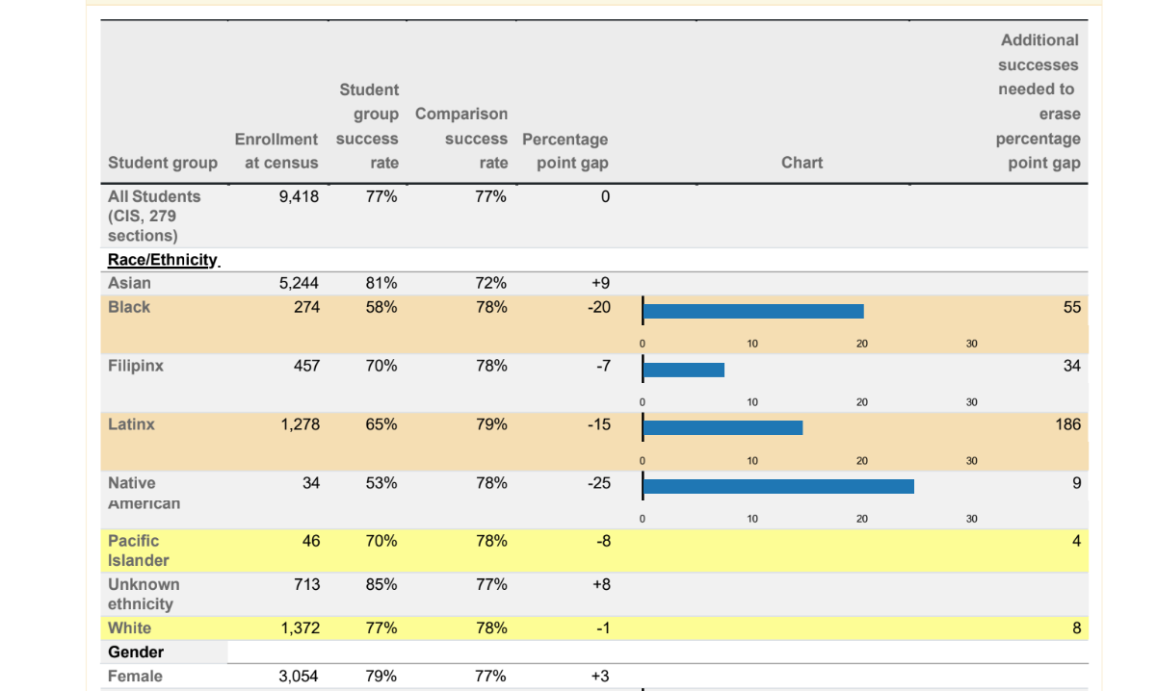
Disaggregated Data

Slide 7
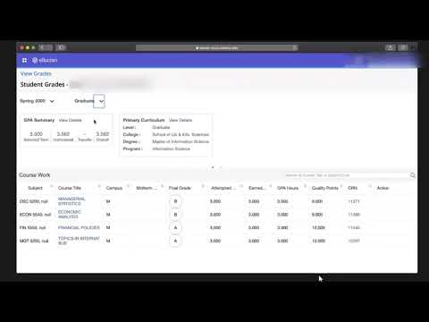
In Banner 9 there is a column available (currently hidden labled ‘Midterm’.
It could be used to indicate “Student met SLO Outcomes”, “Student did not meet outcomes”, “N/A”
FHDA Faculty Association and both Foothill Academic Senate and De Anza Academic Senate would need to agree to use it. Faculty would need to use it on a quarterly basis.

