Slide 1


Student Learning Outcome Process
Rebuild
Veronica Avila
Mary Pape
SLO/SSLO/AUO Coordinators
Visit us at deanza.edu/slo/

Slide 2
Outcomes
Attendees will be able to guide others to complete an assessment

Slide 3
Contents
Entering an assessment ASAP
Review and renaming of outcome types
First task on eLumen

Slide 4
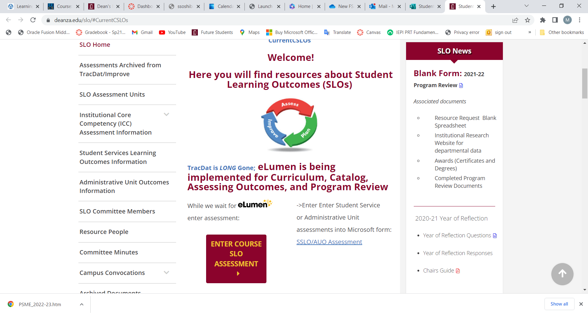
I. How do document an assessment

Slide 5
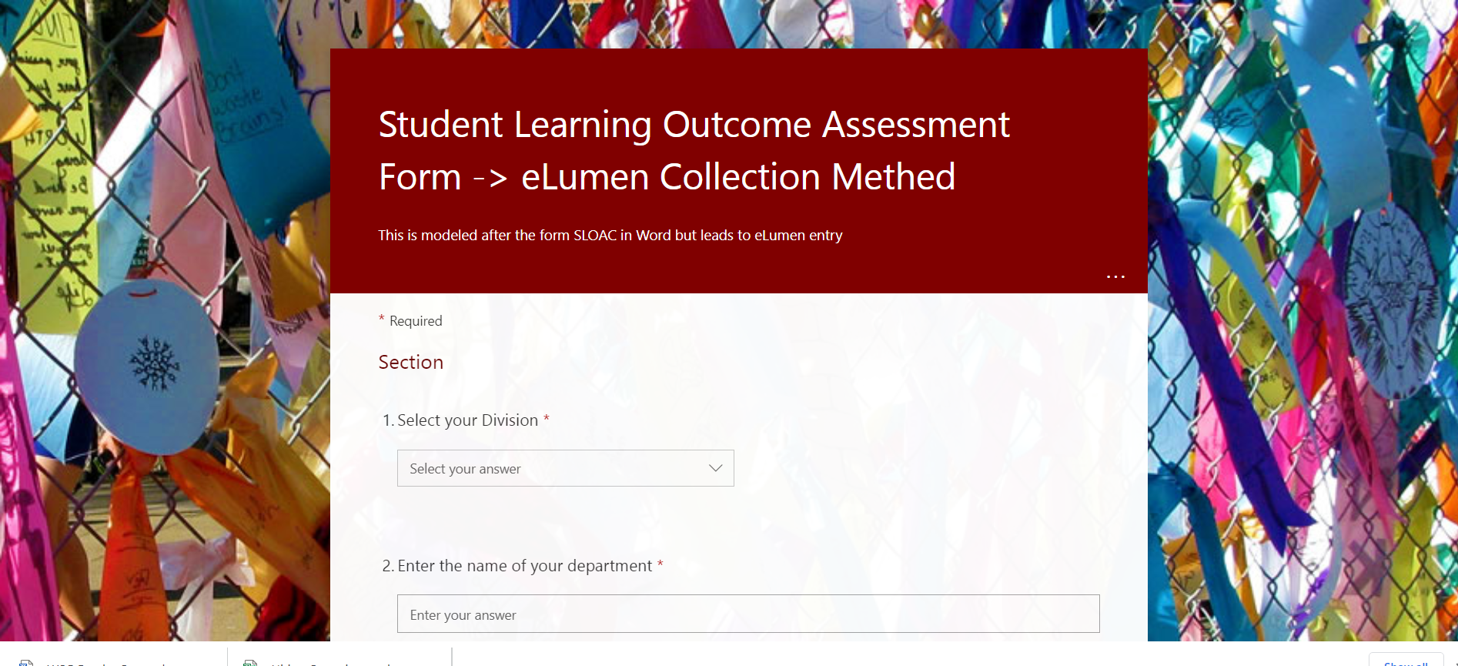

Slide 6
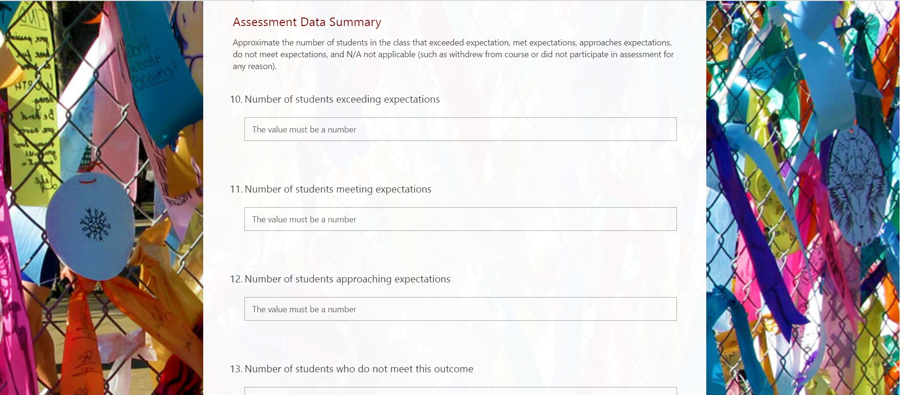

Slide 7
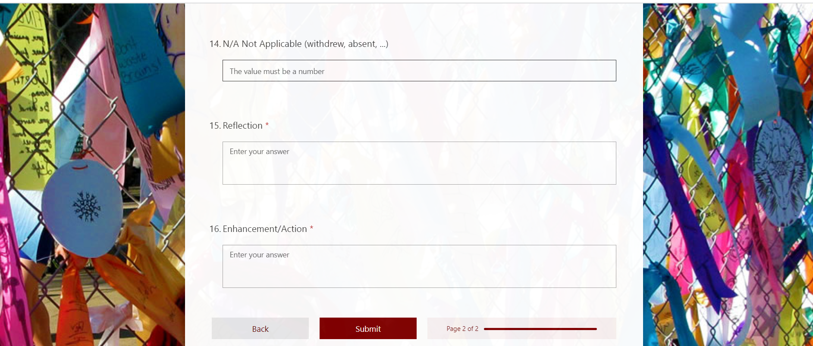

Slide 8
II. Review and renaming of outcome types

Slide 9
LEARNING OUTCOMES - TYPES
Student Learning Outcomes
Course Level (CSLO)
Program Level (PSLO)
Institutional Level (ISLO)
Student Services Learning Outcomes
Administrative Unit Outcomes

Slide 10
II.Student Services Learning Outcomes
SSLOs are overarching, clear, and assessable statements that identify and define what a student will be able to know, do, or feel at the successful completion of a specific program, activity, or process.

Slide 11
Example SSLO
Upon completion of intake and orientation CalWORKs students will be able to demonstrate their ability to identify and access services available through the Financial Aid system.(Dept SS – Occupational Training Institute)
Assessments based on CAS Standards

Slide 12
III. Administrative Unit Outcomes
AUOs are overarching, clear, and assessable statements that identify and define what a client/customer/student will be able to know, do, or feel at the successful completion of a specific activity or process.

Slide 13
Example AUO
Our goal is to provide the necessary information for clubs to carry out proper cash handling and submit supporting documentation to account for all money received documenting an audit trail.(Dept FER – FIN – Student Accounts)

Slide 14
I. Student Learning Outcomes
Course Level
Attainment of skills and competencies at the end of the course.
Design mobile applications using object-oriented methodology and advanced Java concepts using Android Development Kit. (CIS 37)

Slide 15
II. Student Learning Outcomes
Program Level
Attainment of skills and competencies at the after completing a certain certificate/degree.
Design Java programs for the Android platform. (CIS: Programming in Java Certificate of Achievement)

Slide 16
III. Student Learning Outcomes
Institutional Level (Institutional Core Competencies)
Communication and expression
Information literacy
Physical/mental wellness and personal responsibility
Civic capacity for global, cultural, social and environmental justice
Critical thinking

Slide 17
III. First task on eLumen

Slide 18
Mapping
Critical
thinking
Communication and expression
Design Java programs for the Android platform.
Design mobile applications using object-oriented methodology and advanced Java concepts using Android Development Kit.

Slide 19
Outcome Defined
(Redefined)
Conduct assessments
Summarizing data
Reflection
Enhancement
Plan methods of assessment

Slide 20
Outcome Defined
(Redefined)
Conduct assessments
Summarizing data
Reflection
Enhancement
Plan methods of assessment
Assess each course at least once per revision cycle = once every five years minimum*
*Core courses should be assessed continually

Slide 21
Your Assignment
Must use the Student Learning Outcome verbatim from the Course Outline of Record
Enter Assessment directly into Microsoft form: SLO Course Assessment

Slide 22
Your Assignment
Select your Division *
Enter the name of your department *
Enter the name of the course with section. For example, MATH 22-50Z *
Enter CRN# for course *
Enter SLO Statement(s) As it (they) appear on the Course Outline of Record. You may assess one or more at a time. *
Academic Year *
Quarter of Assessment *
Modality of class *
Method of Assessment *
Elaborate on Assessment Method *

Slide 23
Your Assignment
Assessment Data Summary
Approximate the number of students in the class that exceeded expectation, met expectations, approaches expectations, do not meet expectations, and N/A not applicable (such as withdrew from course or did not participate in assessment for any reason)

Slide 24
Your Assignment
11. Number of students exceeding expectations
12. Number of students meeting expectations
13. Number of students approaching expectations
14. Number of students who do not meet this/these outcome(s)
15. N/A Not Applicable (withdrew, absent, ...)
16. Reflection *
17. Enhancement/Action *

