Slide 1

Student Outcomes Update
Your SLO Coordinators:
Veronica Avila
Mary Pape

Slide 2

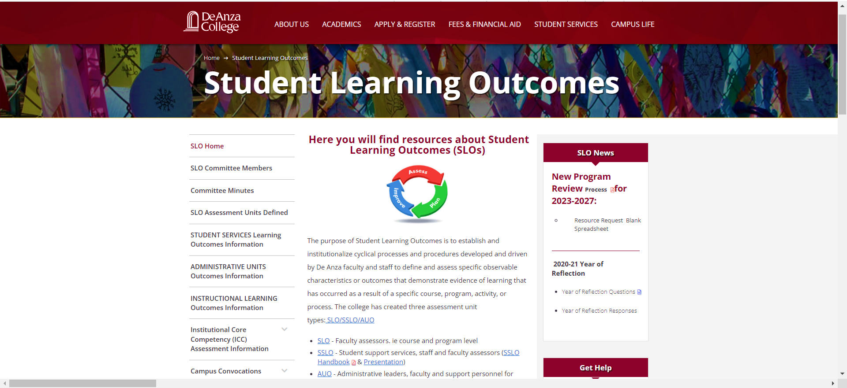
Website has new design/organization

Slide 3

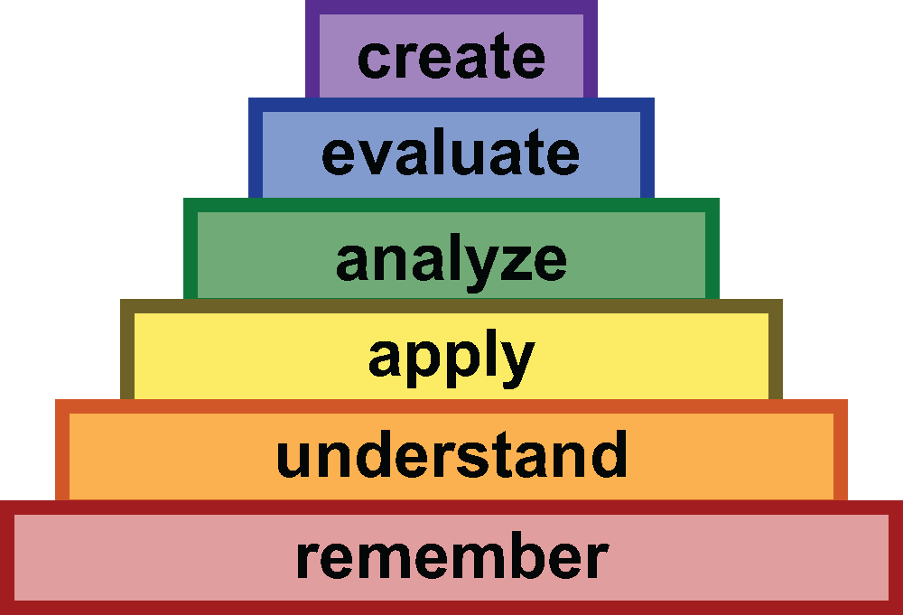
Crafting an Outcome Statement
[The student will be able to] Bloom’s Taxonomy word . . .
At the course level (CSLO) a student learning outcome describes the specific knowledge, skills, abilities or attitudes that students are expected to attain by the end of the course.

Slide 4
Why Course Level Student learning Outcomes:
Instructor: Course level student learning outcomes guide the design of the course including topics covered and activities.
Students: When students understand the reason for, and value of, what they are doing they will be motivated. Clear learning outcomes help students understand why and how specific activities will contribute to their learning. When made aware of their achievement a student’s confidence grows and they are energized to continue on their academic pathway.

Slide 5
Characteristics of Student Learning Outcomes:
Measurable: Outcomes need to be observable and assessable.
Specific: Clearly define what students are expected to learn.
Clarity: Clear and precise language students and all other stakeholders can understand.
Attainable: Set realistic expectations for student achievement

Slide 6
On the point of clarity:
Make the outcome pleasant to read: Apply fundamental constructs as they apply to coding solutions for introductory level programming problems.
Make the outcome pleasant to read: Apply fundamental constructs as they apply to coding solutions for introductory level programming problems.

Slide 7
Most Frequently Asked Questions:
How often outcomes for a course need to be assessed?
  Once every five years. That is at least once before the next time it is revised.
  Assess more often if it is one of the most frequently taught courses in your department.
No one size fits all due to differing number of courses per department: Biology (28), CIS (90), Economics (8), English (26), Math (56), Psychology (21)

Slide 8
Sample CSLOs:
Remember: List key events from the American Civil War.
Understand: Describe the cause-and-effect relationships in an ecological system.
Apply: Using relevant theories, construct a marketing strategy for a new product.
Analyze: Given a data set, summarize trends and patterns.
Evaluate: Critique a piece of artwork using principles of art criticism.
Create: Compose an original short story incorporating literary elements studied in class.

