Slide 1

Program Review Workshop, Fall 2023
Making it Meaningful: Program Review – Mission and Goals
Mary Pape, Veronica Avilla, Mallory Newell
Notes:
Veronica

Slide 2

Outcomes and Objectives
Objective for Today’s Workshop
Attendees will be prepared to craft their department’s mission statement and draft 1-3 goals.
Outcomes
  Review, revise or draft a mission statement
  Create 1-3 goals for 2023-24 through 2026-27 to be evaluated yearly in the annual program review.
Notes:
Veronica

Slide 3

The Deeper Purpose Behind Program Review and Student Learning Outcomes
Notes:
Mallory

Slide 4
Purpose for Program Review
What program review was:
  A headache
  Last minute effort to complete
  Completed by the department chair alone
  A waste of time
  Not used for anything
What program review should be:
  Thoughtful
  Inspire Collaboration
  Reflective
  Forward looking
  A tool for program improvement
  A tool for resource allocation decisions
Notes:
Mallory

Slide 5
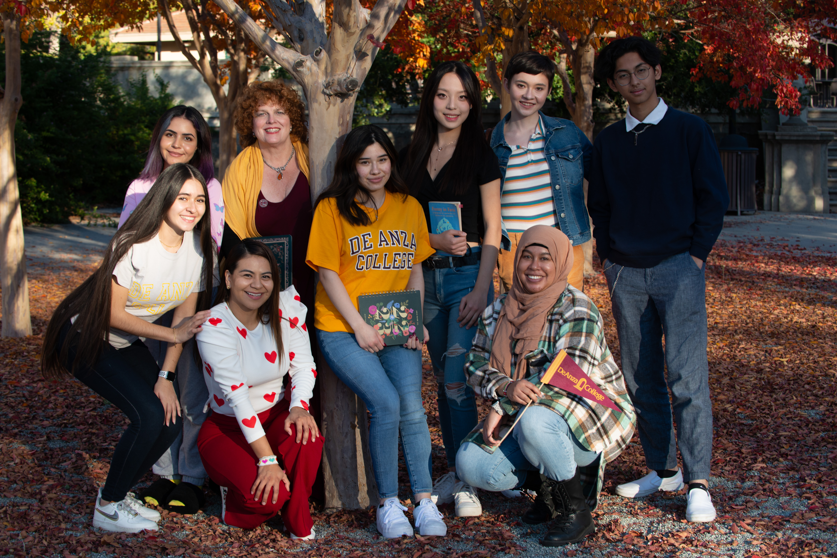
De Anza College Vision
Vision
Empower all students to attain their educational goals, develop an equity-based mindset and become civic leaders in their communities.
Notes:
Mallory

Slide 6
Today’s Agenda
I. Review vollege Vision, Mission, Values
II. Review, revise or draft a mission statement for your department
III. Craft 1- 3 goals for your department
Notes:
Mallory

Slide 7
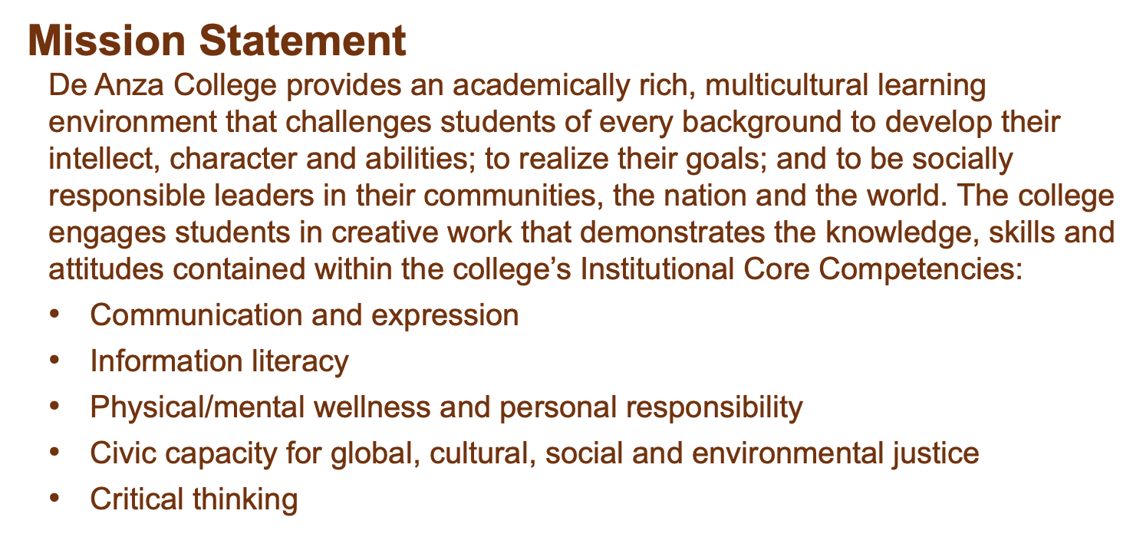
De Anza College Mission
Notes:
Mallory

Slide 8
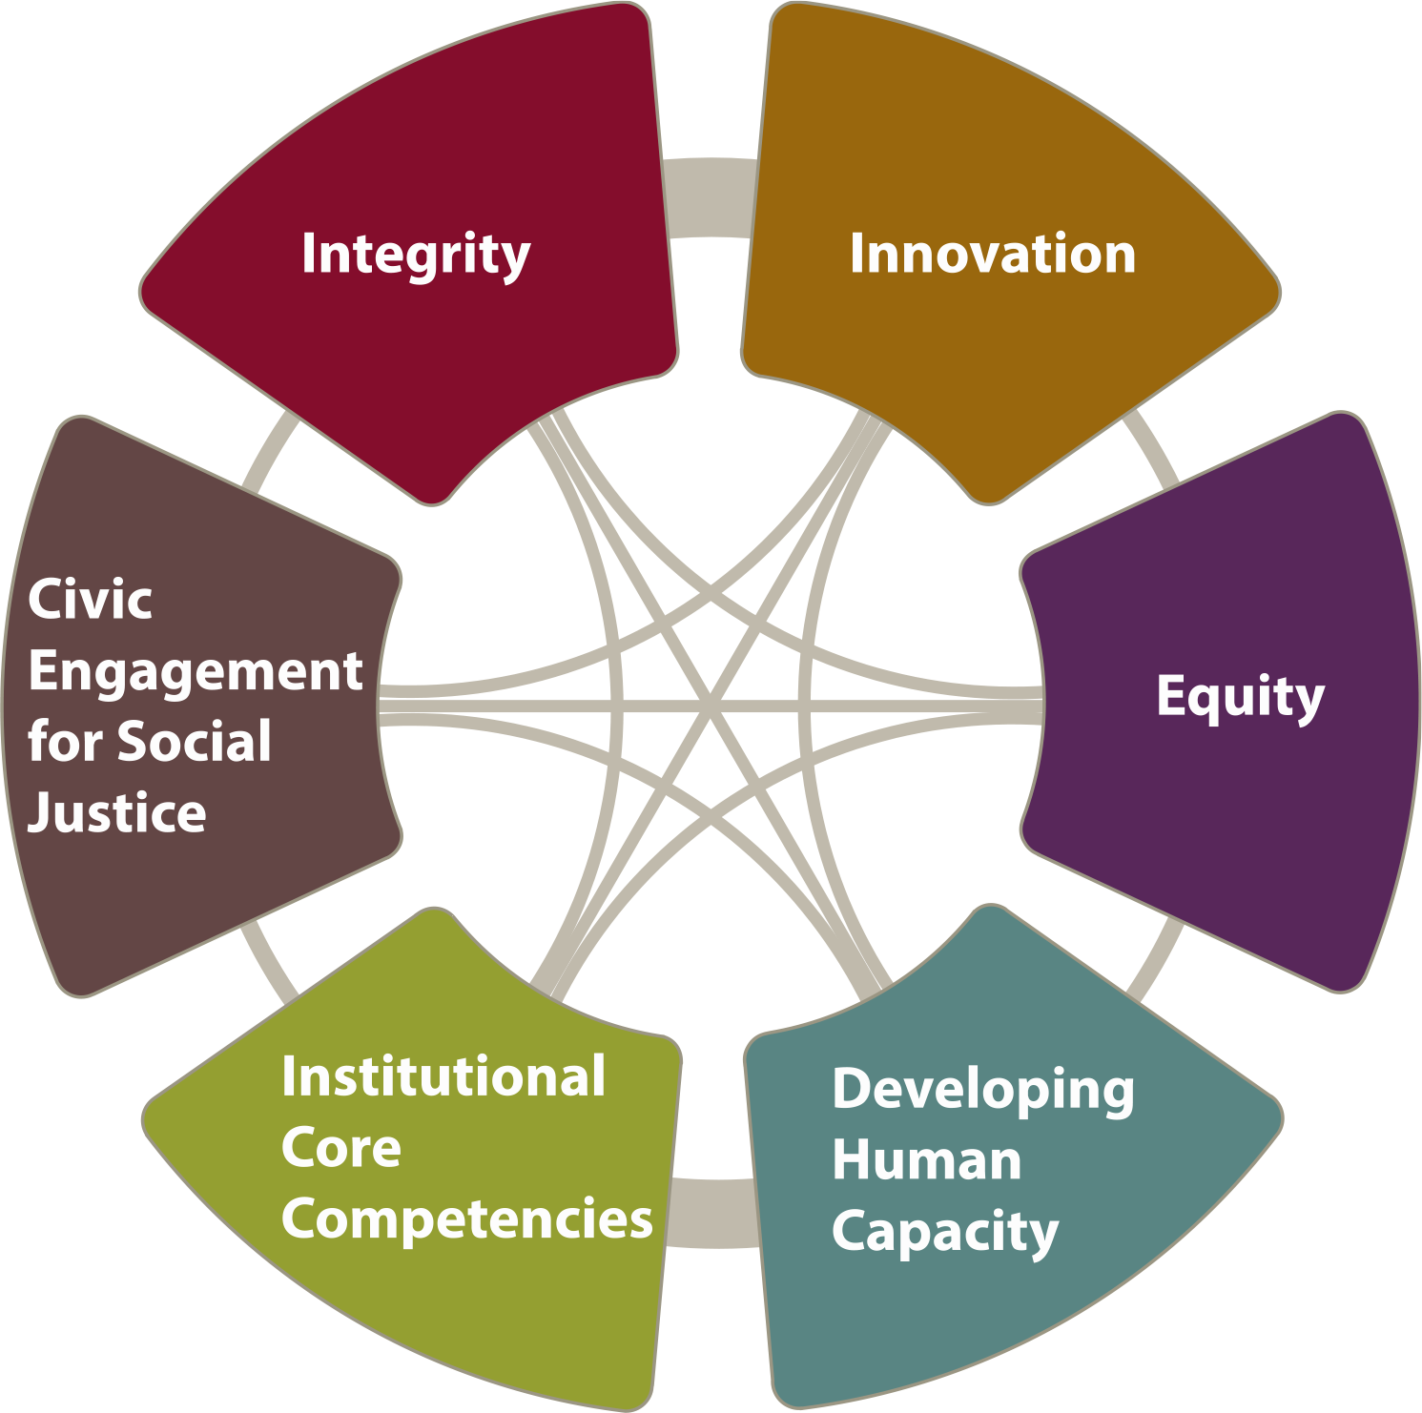
De Anza College Values
Notes:
Mallory

Slide 9
Student Success Factors
We will provide support in six key factors of student success. Our students will be:
Directed, with a goal and the knowledge of how to achieve it.
Focused, staying on track to achieve that goal.
Nurtured, feeling that we want to, and do, help them to succeed.
Engaged, actively participating in class and extracurricular activities.
Connected, feeling that they are part of the college community.
Valued, with their skills, talents and abilities recognized, and with opportunities to contribute on campus and feel that their contributions are appreciated.
Notes:
Veronica

Slide 10
Mission Statements
Notes:
Mary

Slide 11
Crafting a Meaningful Mission
A mission statement is at the core or your area and defines its purpose.
A clear mission statement should capture the essence of the area. It should:
  Define its purpose
  Outline its primary objectives
  Clearly state why it exists
  Invoke enthusiasm and excitement for your area
A mission statement should guide the actions of your area and include a focus on your learning outcomes.
A well-crafted mission provides the focus for your area goals and learning outcomes.
Notes:
Mary

Slide 12
Considerations for Crafting a Mission
The statement should be in the present tense.
It should be short, clear and powerful.
It should use simple and concise terminology.
It should speak loudly and clearly.
Notes:
Mary

Slide 13
Steps for Crafting a Mission
Step 1: Decide on information to include
Who are we?
What do we do?
What are our goals?
Who do we serve?
What are our values?
Notes:
Mary

Slide 14
Steps for Crafting a Mission
Step 2: Define the Purpose:
What is the department's core academic focus?
What knowledge or skills does the department aim to impart?
Notes:
Mary

Slide 15
Steps for Crafting a Mission
Step 3: Identify Goals/Objectives:
Outline your department’s present goal(s) but include the “reimagination” goal(s)
Notes:
Mary

Slide 16
Steps for Crafting a Mission
Step 4: Include values:
Describe the values and principles that shape the department's decision-making processes.
Notes:
Mallory
2 minutes

Slide 17
Steps for Crafting a Mission
Step 5: Excitement
Can your department get excited or energized by the department’s mission statement?
Does the statement describe the uniqueness of your department?
Does it show how your department is different from the one at another college?
Notes:
Mallory
2 minutes

Slide 18
Steps for Crafting a Mission
Step 6: Seek Input
Review and revise
Include faculty/staff in the department/area potentially including the dean, division assistant and students (this is NOT a solo discussion between the department chair and themselves!).
Notes:
Mary - As I wrote in a recent email “All I know as a department chair is that I do not wish to be the solo writer of the department's mission and goals. For the rest of the program review questions I can illicit ideas from my departmental colleagues in department or smaller subject emphasis area meetings. Not so with mission and goals.”
2 minutes

Slide 19
Mission Review
Let's review a few mission statements.
Take a look to see if they include:
who they are
what they do
who they serve
their goals and values
It's exciting
Notes:
Mallory
2 minutes

Slide 20
Mission Review
The mission of our lower division classes is to develop students' sociological imagination and deepen their awareness and understanding of the social world.
Art classes serve to nurture student creativity and deepen students’ understanding of the ways art shapes society, and to cultivate enhanced visual literacy for participation in a technologically complex world.
Notes:
Mallory

Slide 21
Mission Review
To provide De Anza’s students, faculty, staff and the public with a clean, safe, and sanitary environment for learning and teaching throughout the campus
The mission of the De Anza Library is to provide students with the information skills they need to be successful at De Anza as well as in upper division courses, in the job market and as information consumers and creators throughout their lives.
Notes:
Mallory
2 minutes

Slide 22
Tri-share
Use your device to navigate to your area’s webpage and try to find its mission statement.
  Analyze
  Revise
  Share
Notes:
Mallory
15 minutes

Slide 23
Example Language
The [department] at De Anza College is
dedicated/devoted/inspired/committed to [Purpose].
Our mission is to empower [students] with the skills, knowledge, and critical thinking abilities needed to excel [].
We are guided by/driven by/focused upon a passion/desire [value 1, value 2, commitment to diversity and inclusiveness = value].
Notes:
Mallory
15 minutes

Slide 24
Goal Setting
Notes:
Veronica

Slide 25
Purpose of Goals
Goals are the targets, aspirations, or milestones set to guide achievement of course, program or institutional outcomes.
Goals should be aligned with your area mission and help it achieve its learning outcomes.
Goals should lead to a prioritization of resources to be requested through the program review process.
Notes:
Mary
emphasize as goals are part of the new accreditation Standards
2 minutes

Slide 26
Considerations in Setting Goals
Goals should be SMART:
Specific, try focusing on only one area at a time with a clear outcome.
Measurable and allow you to track progress.
Achievable, identify what you need to do to make it happen.
Realistic, possible to achieve given the current resources.
Time-bound, set a time for achieving the outcome and seeing results
Smarter Goal
Notes:
Veronica
2 minutes

Slide 27
The Ask
Draft 1-3 goals for your department to be achieved by spring 2027.
Each goal should be aligned to your department's mission and the college mission.
All resource requests and personnel requests should be aligned with your program's mission and goals.
Each annual reflection will ask your department to report on progress in meeting your goals.
Goal title | Goal description | Responsible parties | Collaboration with | Guided Pathways engagement | What evidence will be used to monitor progress? | How will you assess achievement of the goal?
The ask as it appears in program review.
Notes:
Veronica
2 minutes

Slide 28
Tri-share
Draft 1-3 goals for your department to be achieved by spring 2027.
Share one goal you listed.
If you have time, discuss ideas on how you would go about evaluating the achievement of one of the goals.
Notes:
Veronica
5 minutes

Slide 29
Program Review
Accessing the form
Notes:
Mallory

Slide 30
Comprehensive Program Review
All programs and areas will engage in a Comprehensive program review in fall 2023
Forms are now available on the RAPP website: https://www.deanza.edu/gov/rapp/program_review.html
Instructional Programs Comprehensive Program Review Form (example)*
Student Services Comprehensive Program Review Form (CAS example)
Academic Services Comprehensive Program Review Form (example)*
Collegwide Service Areas Comprehensive Program Review Form
Notes:
Mallory – demo new tool and promote program review workshop on Friday 2-3 p.m. Hyflex Classroom, MLC
2 minutes

Slide 31

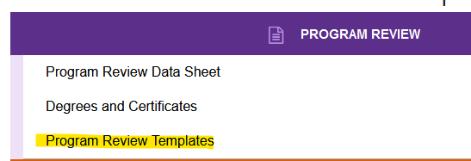
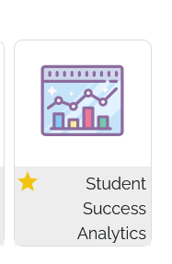
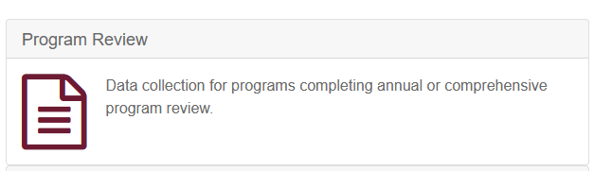
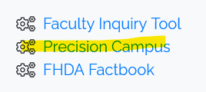
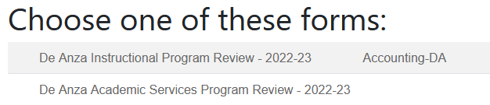
Comprehensive Program Review
Notes:
Mallory – demo new tool and promote program review workshop on Friday 2-3 p.m. Hyflex Classroom, MLC
5 minutes
1:40 if we keep to the timing, gives us time to go over here and there.

