Slide 1

Meaningful Assessment of Classroom Practices to Close the Equity Gap
FHDA District Opening Day Workshop – October 2, 2020
Karen Chow, Academic Senate President & English Faculty | Mallory Newell, Office of Institutional Research and Planning
Mae Lee, Intercultural Studies Faculty | Dawn Lee Tu, Faculty Director, Professional & Organizational Development
Mary Pape, Academic Senate Vice President and Computer Information Systems Faculty | Veronica Acevedo Avila, LEAD Co-Coordinator & English Faculty

Slide 2
Objective and Problem Statement
Notes:
Mary

Slide 3
Objective: How do we use meaningful assessments of our classroom practices to address success rates to increase successful outcomes for Black/African American, Latinx and Filipinx groups?
Problem statement: Too few students of color, specifically Black/African American, Latinx and Filipinx students, are successfully completing their courses. Collegewide success rates in 2018-19 for these student groups was 69% compared to 83% for White and Asian students. These long-standing equity gaps demand a close examination of how faculty can re-evaluate their practices so all students learn and succeed.
Notes:
Mary

Slide 4
Factors to Consider when Exploring Student Success and Equity Gaps
Notes:
Mary

Slide 5
1. Academic skills that students bring with them to the classroom:
We know that there is inequality in the Bay Area in "school quality" and "quality of preparation" for students AND that students in targeted groups attend those "poorer quality" schools, so what do we do in those situations?
2. Dynamics of engagement that happen in the classroom:
Feelings of belonging, confidence level, ability to make connections with fellow students in the classroom, interest level sparked by the curriculum content, and teaching manner
3. Outside stressors on the student that affect their ability to stay focused in the class and have the ability to finish the class:
Attention they can give to the class, freedom from financial obligations, ability to not be pulled by family responsibilities, mental and physical health issues, etc.
Notes:
Mary

Slide 6
Let's head over to the Jamboard for some interactive collaboration:
Jamboard #1
Enter response or copy and paste the link:
https://jamboard.google.com/d/1bYienRZdQmxUAibj14uFYxxm8AuuNztPNj8Bz4EoTYA/edit?usp=sharing
Notes:
Veronica and Mary

Slide 7
Defining Meaningful Assessment
Notes:
Dawn

Slide 8
What is Meaningful Assessment?
We envision two types of assessment:
Type 1. The skills a student acquires during the class and can exhibit at the end of the class.
Traditional assessment outcome: At the end of the course students will identify the critical points in American history as it relates to government and politics.
Type 2. How a student perceives themselves in the curriculum and the classroom environment, how they feel within the classroom community and how they learn the content.
Meaningful assessment outcome:
Notes:
Dawn

Slide 9
Reflection Questions
What were the life circumstances that your Latinx/Black Americans/Filipinx had when coming into your classrooms?
How did Latinx/Black Americans/Filipinx students perceive the content?
What were their feelings about the course and content shared?
How did they learn?
Notes:
Dawn
If you are or have taught, lets reflect and think through these questions. In your class....how do these questions resonate with you?

Slide 10
Let's head over to the Jamboard for additional interactive collaboration:
Jamboard #2
Enter response or copy and paste the link:
https://jamboard.google.com/d/1bYienRZdQmxUAibj14uFYxxm8AuuNztPNj8Bz4EoTYA/edit?usp=sharing
Notes:
Dawn and Veronica

Slide 11
Exploring Equity Gaps Using Section Level Data
Notes:
Mallory

Slide 12
Purpose and Intent of Section Level Data
As a college, we have a goal of closing the equity gap to no more than 5 percentage points between any student groups, this is at the institutional level NOT at the faculty level;
Section-level data may help faculty members gain knowledge about what affects their individual section's equity data;
We as a college recognize that structural racism exists both outside and inside the college and that we cannot erase all the impacts of structural racism on our campus and in the classroom;
Section-level data may help individual faculty members take notice of how the impact of structural racism manifest in the classroom in order to hold space for conversations around what to do;
As a college, there are no punitive repercussions for individual equity data. However, reviewing the data as a collective group allows us to find solutions to reduce and eventually close gap to no more than 5%.
-- Captured from meaningful dialogue about equity and institutional learning with Mae Lee
Notes:
Mallory

Slide 13
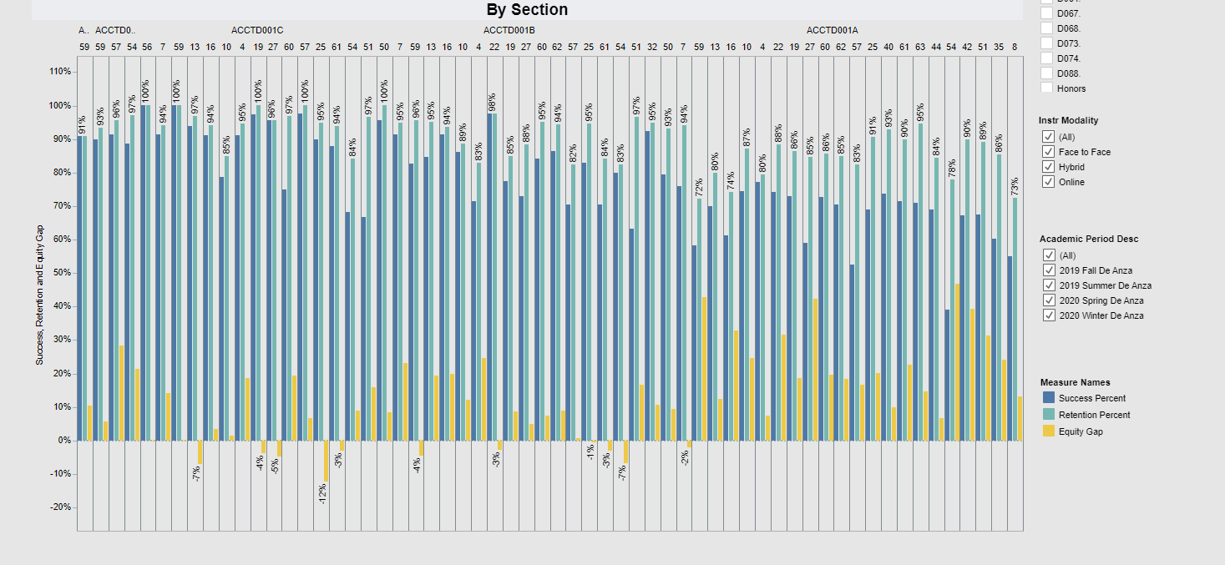
Success Rate Dashboard
Explore variations in success, retention and equity gaps.
http://bit.ly/SuccessDashboard

Slide 14
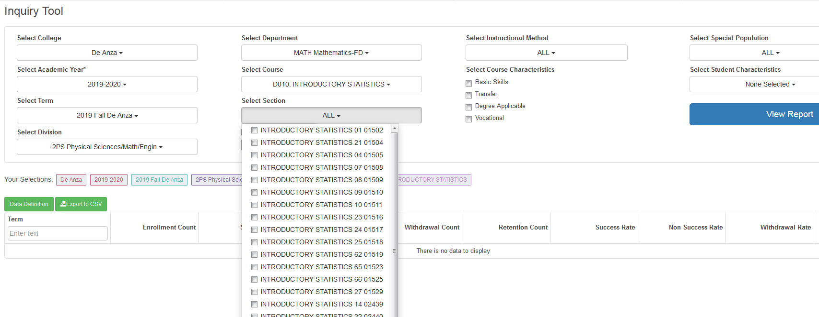
Inquiry Tool
Select your unique sections.
http://bit.ly/InquiryTool
Notes:
Mallory
This is our own in-house tool that we encourage faculty to use to access their own success rates by section and demographics.

Slide 15
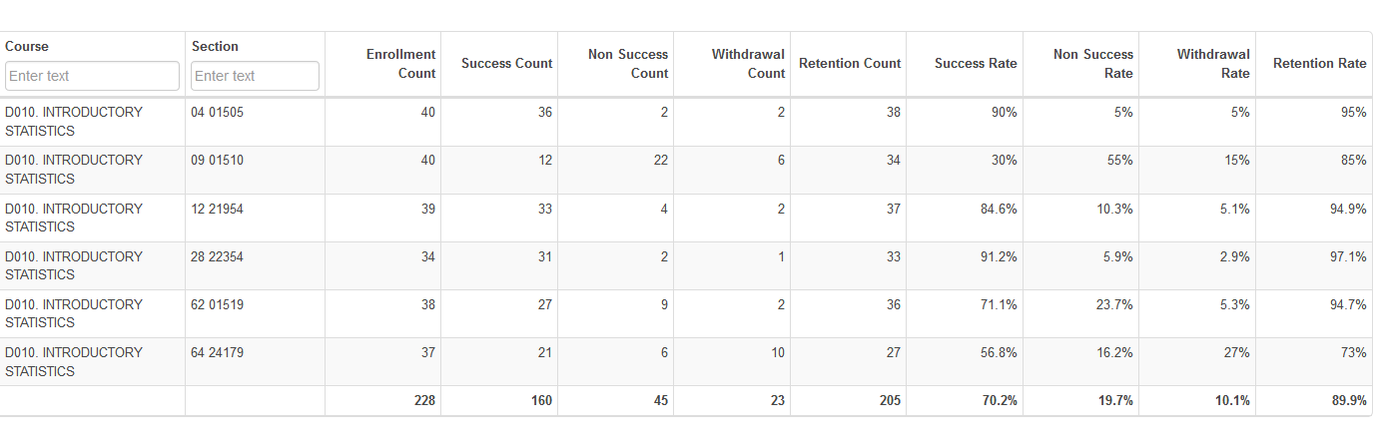
View success rates by your unique sections
01
02
03
04
05
06
Compare withdraw rates by sections
Notes:
Mallory

Slide 16
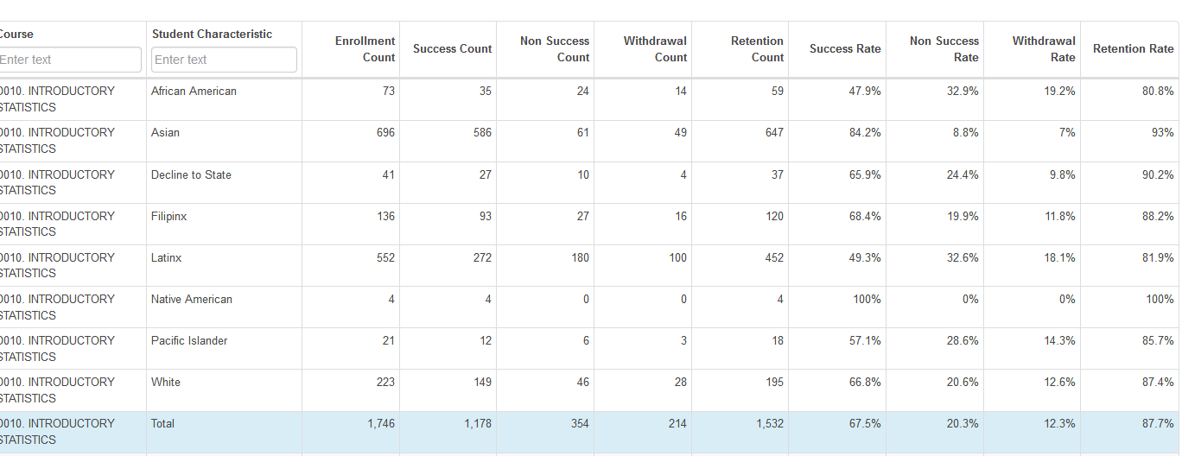
Compare success rates by race/ethnicity and other variables.
Notes:
Mallory

Slide 17
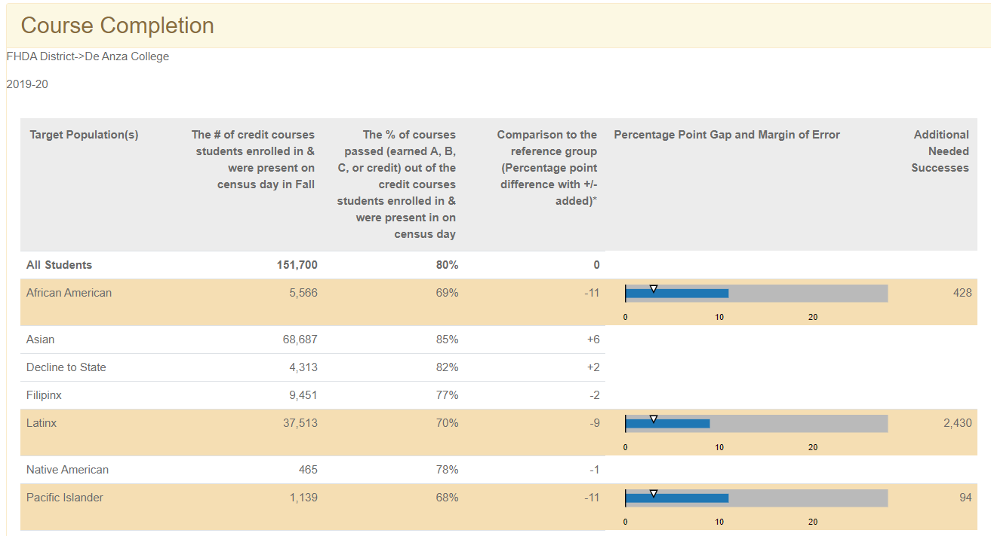
Disproportionate Impact Tool
http://bit.ly/DITool
Notes:
Mallory

Slide 18
Jamboard #3 and #4
Let's head back over to the Jamboard for additional interactive collaboration:
Enter response or copy and paste the link:
https://jamboard.google.com/d/1bYienRZdQmxUAibj14uFYxxm8AuuNztPNj8Bz4EoTYA/edit?usp=sharing
Notes:
Mallory and Veronica

Slide 19
Acknowledging the Challenges and Resource Needs to Do the Work
Notes:
Karen

Slide 20
Jamboard #5
Let's head to the Jamboard for the last interactive discussion:
Enter response or copy and paste the link:
https://jamboard.google.com/d/1bYienRZdQmxUAibj14uFYxxm8AuuNztPNj8Bz4EoTYA/edit?usp=sharing
Notes:
Karen

Slide 21

Thank You!

