Slide 1


Welcome to the Student Learning Outcome Process
Veronica Avila
Mary Pape
SLO/SSLO/AUO Coordinators
Visit us at deanza.edu/slo

Slide 2
Welcome
Rosanna Alvarez | Intercultural Studies
Andrew Lazar | Mathematics (MPS) Instructor
Tabia Lee | Director of of Equity, Social Justice and Multicultural Education
Leah Smith | EPS Counselor
Robert Unzueta | Chicanx/Latinx Studies Instructor
Amy Wang | IMPACT/AAPI Counselor

Slide 3
Outcomes
Attendees will be able to complete assessment summary.

Slide 4
Why Student Learning Outcome Process?
Culture of inquiry
Accreditation by ACCJC (Accrediting Commission for Community & Junior Colleges)
Stakeholders demand assessment
Notes:
Should note that for the SLO process, faculty are in charge. Faculty decide how it will be assessed and what the target or bench mark should be.

Slide 5
Contents
“You” and this process
6-year planning cycle document
Our Road to “Proficiency”

Slide 6
I. YOU in this process

Slide 7
Improving the Student Experience
Student Learning Outcomes
Course Level
Program Level
Institutional Level
Student Services Learning Outcomes
Administrative Unit Outcomes

Slide 8
Improving the Student Experience
Student Learning Outcomes
Course Level
What the student will be able to do at the end of the course.

Slide 9
Improving the Student Experience
Student Learning Outcomes
Course Level
Design mobile apps using object-oriented methodology and advanced Swift concepts using iOS Development Kit and APIs. (CIS 55)

Slide 10
Improving the Student Experience
Student Learning Outcomes
Program Level
What the student will be able to do after completing a certain certificate/degree.

Slide 11
Improving the Student Experience
Student Learning Outcomes
Program Level
Develop a critical way of thinking with the goal of optimal decision-making in everyday life using marginal benefit and marginal cost concepts. (Economics Department PLO_1)

Slide 12
Improving the Student Experience
Student Learning Outcomes
Institutional Level
(Institutional Core Competencies)
Communication and expression
Information literacy
Physical/mental wellness and personal responsibility
Civic capacity for global, cultural, social and environmental justice
Critical thinking

Slide 13
Improving the Student Experience
Student Services Learning Outcomes are overarching, clear, and assessable statements that identify and define what a student will be able to know, do, or feel at the successful completion of a specific program, activity, or process.

Slide 14
Improving the Student Experience
Administrative Unit Outcomes are overarching, clear, and assessable statements that identify and define what a client/customer/student will be able to know, do, or feel at the successful completion of a specific activity or process.

Slide 15
Improving the Student Experience
Administrative Unit Outcomes
Our goal is to provide the necessary information for clubs to carry out proper cash handling and submit supporting documentation to account for all money received documenting an audit trail.(Dept FER – FIN – Student Accounts)

Slide 16
Improving the Student Experience
Student Services Learning Outcomes
Upon completion of intake and orientation CalWORKs students will be able to demonstrate their ability to identify and access services available through the Financial Aid system.(Dept SS – Occupational Training Institute)

Slide 17
Outcome Defined
(Redefined)
Conduct assessments
Summarizing data
Reflection
Enhancement
Plan methods of assessment

Slide 18
Institutional
Level Outcomes
Program Level Outcomes & Assessments
SLOACs/SSLOACs/AUOACs

Slide 19
Your Assignment
Must use the Student Learning Outcome on the Course Outline of Record
Enter Assessment directly into Microsoft form: SLO Course Assessment

Slide 20
II. Developing Our Institution’s Planning Cycle

Slide 21
SLOAC
Resource
Needs
SSLOAC
Resource Needs
AUOAC
Resource
Needs
Identify

Slide 22
Divisional
prioritization
Divisional
prioritization
Divisional
prioritization
SLOAC
Resource
Needs
SSLOAC
Resource Needs
AUOAC
Resource
Needs
Identify

Slide 23
Instructional
Program Reviews
Student Services
Program Reviews
Finance & Resources
Program Reviews
Affirm
Divisional
prioritization
Divisional
prioritization
Divisional
prioritization
SLOAC
Resource
Needs
SSLOAC
Resource Needs
AUOAC
Resource
Needs
Identify

Slide 24
Focus
Focus and Alignment Lens
Mission – Strategic Initiatives – ICCs – Educational Master Plan
Instructional
Program Reviews
Student Services
Program Reviews
Finance & Resources
Program Reviews
Affirm
Divisional
prioritization
Divisional
prioritization
Divisional
prioritization
SLOAC
Resource
Needs
SSLOAC
Resource Needs
AUOAC
Resource
Needs
Identify

Slide 25
IPBT
SSPBT
FRPBT
Focus
Focus and Alignment Lens
Mission – Strategic Initiatives – ICCs – Educational Master Plan
Instructional
Program Reviews
Student Services
Program Reviews
Finance & Resources
Program Reviews
Affirm
Divisional
prioritization
Divisional
prioritization
Divisional
prioritization
SLOAC
Resource
Needs
SSLOAC
Resource Needs
AUOAC
Resource
Needs
Identify

Slide 26
COLLEGE COUNCIL
Allocate
IPBT
SSPBT
FRPBT
Focus
Focus and Alignment Lens
Mission – Strategic Initiatives – ICCs – Educational Master Plan
Instructional
Program Reviews
Student Services
Program Reviews
Finance & Resources
Program Reviews
Affirm
Divisional
prioritization
Divisional
prioritization
Divisional
prioritization
SLOAC
Resource
Needs
SSLOAC
Resource Needs
AUOAC
Resource
Needs
Identify

Slide 28
III. Our Road to “Proficiency”

Slide 29
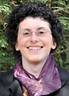
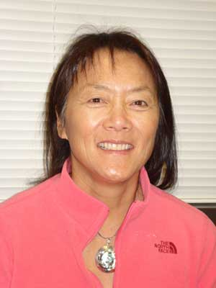
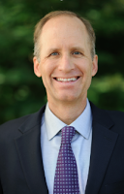
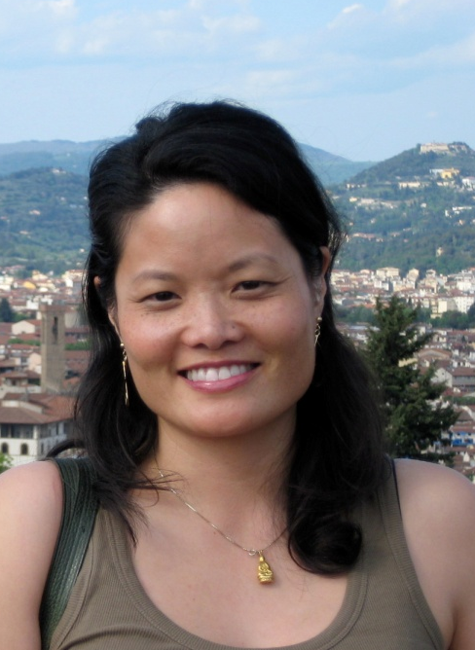
Academic Senate
Support from Presidents and Vice Presidents of Academic Senate:

Slide 30
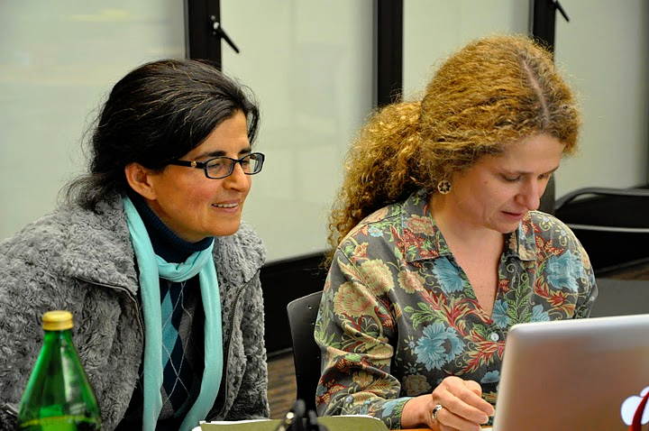
Leadership Structure
- Faculty Driven

Slide 31
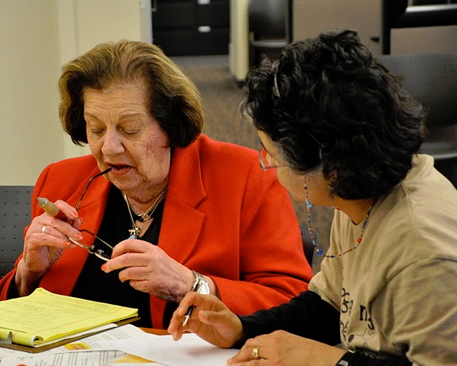

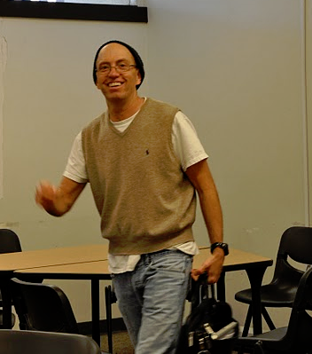
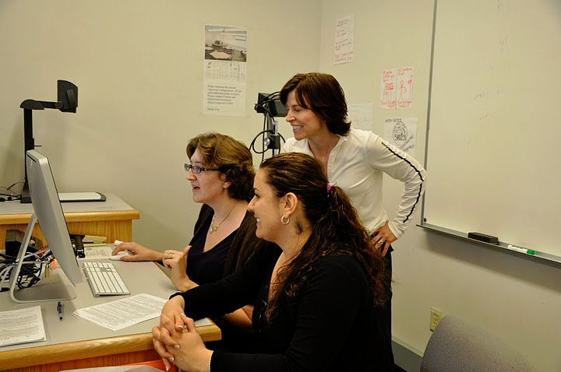

Slide 32

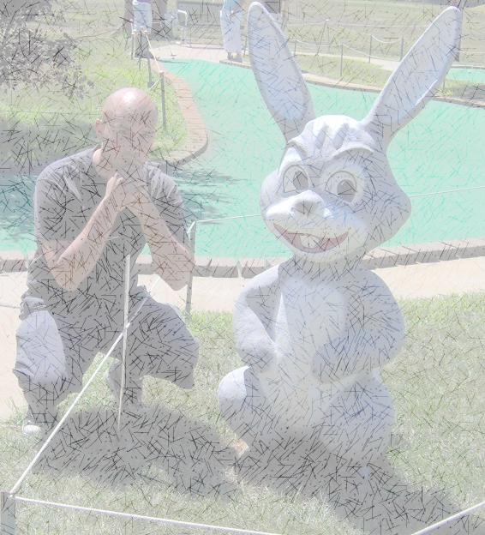
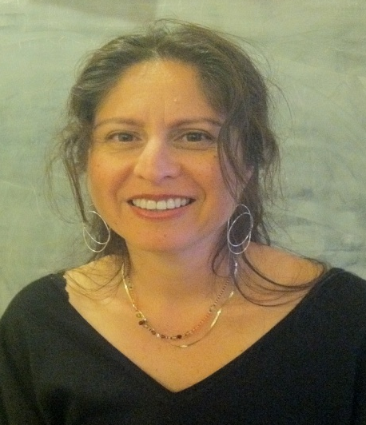
SLO Core Team
Student Services & Administrative Units Coordinator:
Veronica Acevedo Avila
Instructional Coordinator:
Mary Pape
Other SLO Core Team Members: Karen Chow ** Mae Lee **Mallory Newell ** Dawn Lee Tu**

Slide 33
SLO Steering Committee
Administrators:
VP, Instruction
VP, Finance & Educational Resources
Director, Institutional Research
Director, Marketing
Associate VP, Instruction
Dean, PE & Athletics
SLO/SSLO/AUO Coordinators

Slide 34
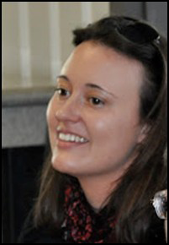

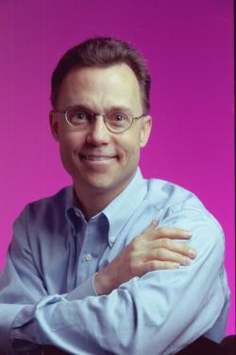
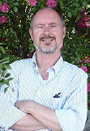
Division SLO Liaisons
Language Arts
Physical Science/
Math/
Engineering
Business/
Computer
Systems
Student Service:
Counselor

Slide 35
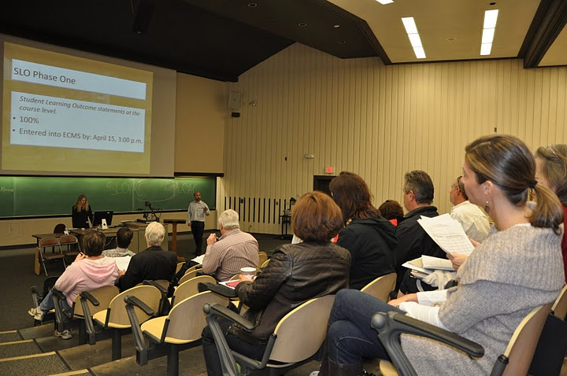
Dialog - Annual Convocation

Slide 36
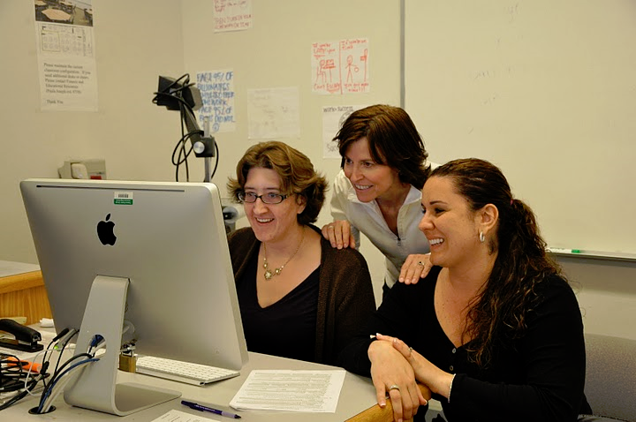
Dialog - Workshops

