Slide 1


Welcome to the Student Learning Outcome Process
Veronica Avila
Mary Pape
SLO/SSLO/AUO Coordinators
Visit us at deanza.edu/slo

Slide 2
Welcome
Angela Winch | Nursing
Caitlin Marie Kepple | Astronomy
Flora Payne | Counselor/Coord - Guardian Scholars Prog
Huy Le | Counselor, Learning Communities
Ivan Kojnok | Automotive Technology
James Adams | Library Services
Jamie Pelusi | Faculty Coordinator, PRIDE Center
Joe D'Agostino | Head Football Coach/FAST Coord
Lianna Wong | Biology
Manija Ansari | Counselor ISP
Mark Hamer | Film/TV Animation
Rachel Silveria | Film Production
Sheryl Bernardo | Paralegal
Sunghae Jung | Nursing
Thalia Bobadilla | Communications Studies
Vinh Kha Nguyen | Mathematics

Slide 3
Outcomes
Attendees will be able to complete assessment summary.

Slide 4
Why Student Learning Outcome Process?
Culture of inquiry
Stakeholders demand assessment
Accreditation by ACCJC (Accrediting Commission for Community & Junior Colleges)
Notes:
Should note that for the SLO process, faculty are in charge. Faculty decide how it will be assessed and what the target or bench mark should be.

Slide 5
Contents
“You” and this process
6-year planning cycle document
Our Road to “Proficiency”

Slide 6
I. YOU in this process

Slide 7
Improving the Student Experience
Student Learning Outcomes
Course Level (CSLO)
Program Level (PSLO)
Institutional Level (ISLO)
Student Services Learning Outcomes
Administrative Unit Outcomes

Slide 8
Institutional
Level Outcomes & Assessments
Program Level Outcomes & Assessments
SLOACs/SSLOACs/AUOACs

Slide 9
Improving the Student Experience
Student Learning Outcomes
Course Level
Attainment of skills and competencies at the end of the course.

Slide 10
Improving the Student Experience
Student Learning Outcomes
Course Level
Design mobile applications using object-oriented methodology and advanced Java concepts using Android Development Kit. (CIS 37)

Slide 11
Improving the Student Experience
Student Learning Outcomes
Program Level
What the student will be able to do after completing a certain certificate/degree.

Slide 12
Improving the Student Experience
Student Learning Outcomes
Program Level
Design Java programs for the Android platform. (CIS: Programming in Java Certificate of Achievement)

Slide 13
Improving the Student Experience
Student Learning Outcomes
Institutional Level
(Institutional Core Competencies)
Communication and expression
Information literacy
Physical/mental wellness and personal responsibility
Civic capacity for global, cultural, social and environmental justice
Critical thinking

Slide 14
Mapping
Critical
thinking
Communication and expression
Design Java programs for the Android platform.
Design mobile applications using object-oriented methodology and advanced Java concepts using Android Development Kit.

Slide 15
Improving the Student Experience
Student Services Learning Outcomes are overarching, clear, and assessable statements that identify and define what a student will be able to know, do, or feel at the successful completion of a specific program, activity, or process.

Slide 16
Improving the Student Experience
Student Services Learning Outcomes
Upon completion of intake and orientation CalWORKs students will be able to demonstrate their ability to identify and access services available through the Financial Aid system.(Dept SS – Occupational Training Institute)

Slide 17
Improving the Student Experience
Administrative Unit Outcomes are overarching, clear, and assessable statements that identify and define what a client/customer/student will be able to know, do, or feel at the successful completion of a specific activity or process.

Slide 18
Improving the Student Experience
Administrative Unit Outcomes
Our goal is to provide the necessary information for clubs to carry out proper cash handling and submit supporting documentation to account for all money received documenting an audit trail.(Dept FER – FIN – Student Accounts)

Slide 19
Your Assignment
Must use the Student Learning Outcome verbatim from the Course Outline of Record
Enter Assessment directly into Microsoft form: SLO Course Assessment

Slide 20
Your Assignment
Select your Division *
Enter the name of your department *
Enter the name of the course with section. For example, MATH 22-50Z *
Enter CRN# for course *
Enter SLO Statement(s) As it (they) appear on the Course Outline of Record. You may assess one or more at a time. *
Academic Year *
Quarter of Assessment *
Modality of class *
Method of Assessment *
Elaborate on Assessment Method *

Slide 21
Your Assignment
Assessment Data Summary
Approximate the number of students in the class that exceeded expectation, met expectations, approaches expectations, do not meet expectations, and N/A not applicable (such as withdrew from course or did not participate in assessment for any reason)

Slide 22
Your Assignment
11. Number of students exceeding expectations
12. Number of students meeting expectations
13. Number of students approaching expectations
14. Number of students who do not meet this/these outcome(s)
15. N/A Not Applicable (withdrew, absent, ...)
16. Reflection *
17. Enhancement/Action *

Slide 23
Outcome Defined
(Redefined)
Conduct assessments
Summarizing data
Reflection
Enhancement
Plan methods of assessment

Slide 24
Your Assignment
Must use the Student Learning Outcome on the Course Outline of Record
Enter Assessment directly into Microsoft form: SLO Course Assessment

Slide 25
II. Developing Our Institution’s Planning Cycle

Slide 26
SLOAC
Resource
Needs
SSLOAC
Resource Needs
AUOAC
Resource
Needs
Identify

Slide 27
Divisional
prioritization
Divisional
prioritization
Divisional
prioritization
SLOAC
Resource
Needs
SSLOAC
Resource Needs
AUOAC
Resource
Needs
Identify

Slide 28
Instructional
Program Reviews
Student Services
CAS Standards
Finance & Resources
Program Reviews
Affirm
Divisional
prioritization
Divisional
prioritization
Divisional
prioritization
SLOAC
Resource
Needs
SSLOAC
Resource Needs
AUOAC
Resource
Needs
Identify

Slide 29
Focus
Focus and Alignment Lens
Mission – Strategic Initiatives – ICCs – Educational Master Plan
Instructional
Program Reviews
Student Services
CAS Standards
Finance & Resources
Program Reviews
Affirm
Divisional
prioritization
Divisional
prioritization
Divisional
prioritization
SLOAC
Resource
Needs
SSLOAC
Resource Needs
AUOAC
Resource
Needs
Identify

Slide 30
PROGRAM ALLOCATION COMMITTEE (PAC)
Administrators, Affinity Groups, Classified Professionals, Faculty, Students
Focus
Focus and Alignment Lens
Mission – Strategic Initiatives – ICCs – Educational Master Plan
Instructional
Program Reviews
Student Services
CAS Standards
Finance & Resources
Program Reviews
Affirm
Divisional
prioritization
Divisional
prioritization
Divisional
prioritization
SLOAC
Resource
Needs
SSLOAC
Resource Needs
AUOAC
Resource
Needs
Identify

Slide 31
COLLEGE COUNCIL
Allocate
PROGRAM ALLOCATION COMMITTEE (PAC)
Focus
Focus and Alignment Lens
Mission – Strategic Initiatives – ICCs – Educational Master Plan
Instructional
Program Reviews
Student Services
CAS Standards
Finance & Resources
Program Reviews
Affirm
Divisional
prioritization
Divisional
prioritization
Divisional
prioritization
SLOAC
Resource
Needs
SSLOAC
Resource Needs
AUOAC
Resource
Needs
Identify

Slide 32
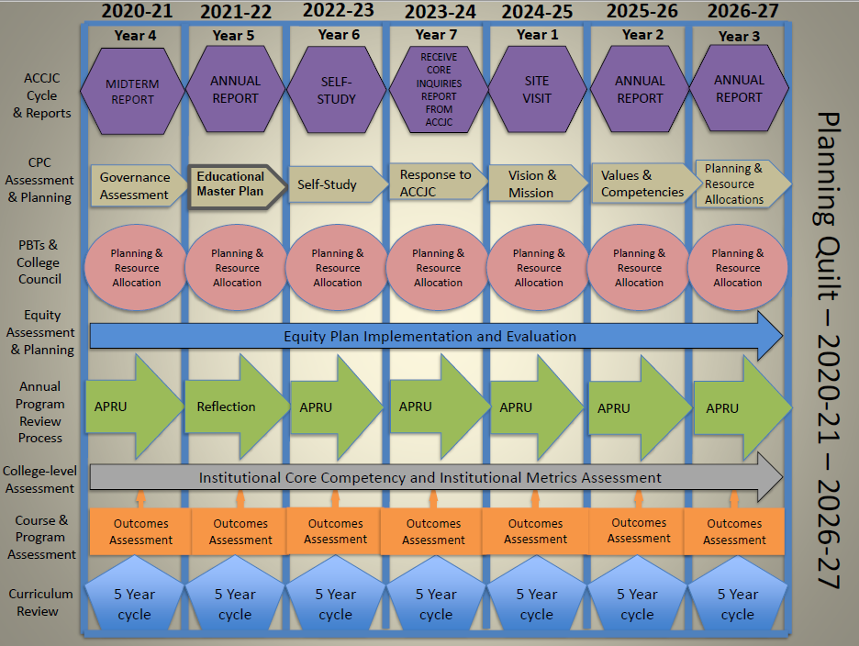

Slide 33
III. Our Road to “Proficiency”
A bit of Nostalgia

Slide 34
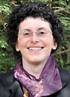
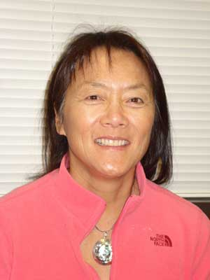
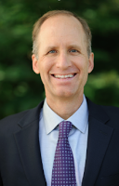

Academic Senate
Support from Presidents and Vice Presidents of Academic Senate:

Slide 35
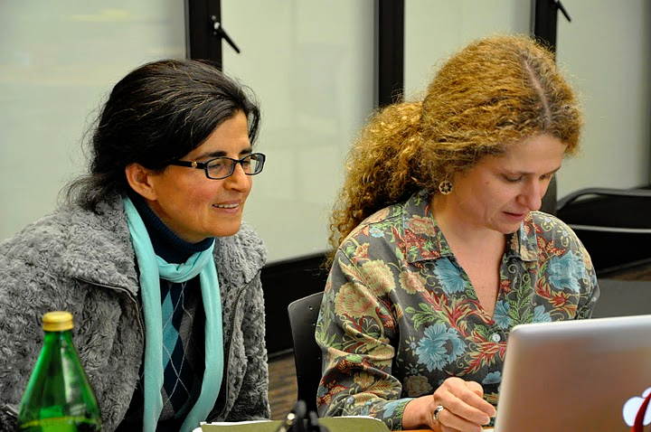
Leadership Structure
- Faculty Driven

Slide 36
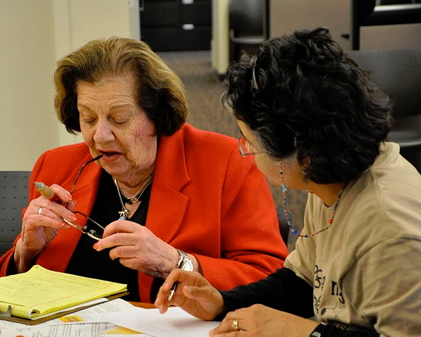

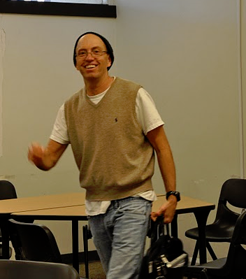
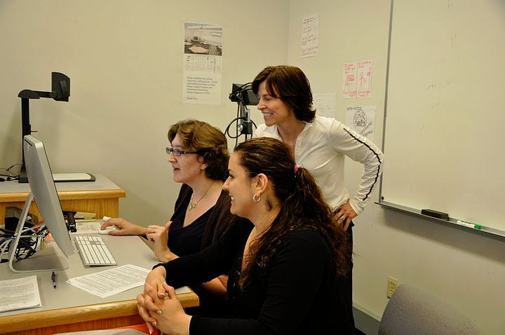

Slide 37

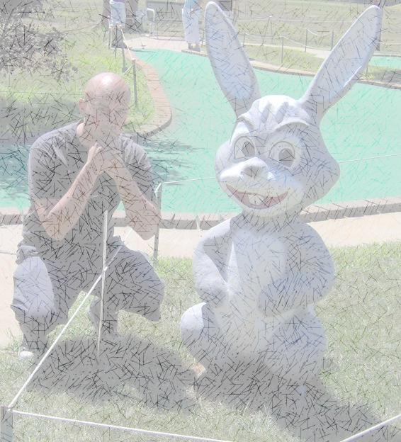
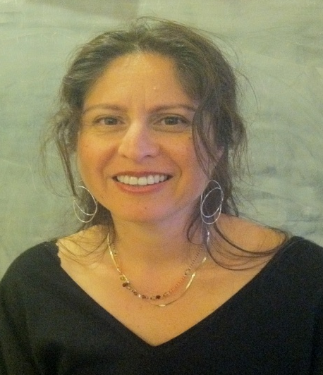
SLO Core Team
Student Services & Administrative Units Coordinator:
Veronica Acevedo Avila
Instructional Coordinator:
Mary Pape
Other SLO Core Team Members: Karen Chow ** Mae Lee **Mallory Newell ** Dawn Lee**

Slide 38
SLO Steering Committee
Administrators:
VP, Instruction
VP, Finance & Educational Resources
Director, Institutional Research
Director, Marketing
Associate VP, Instruction
Dean, PE & Athletics
SLO/SSLO/AUO Coordinators

Slide 39
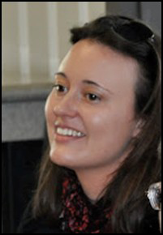



Division SLO Liaisons
Language Arts
Physical Science/
Math/
Engineering
Business/
Computer
Systems
Student Service:
Counselor

Slide 40
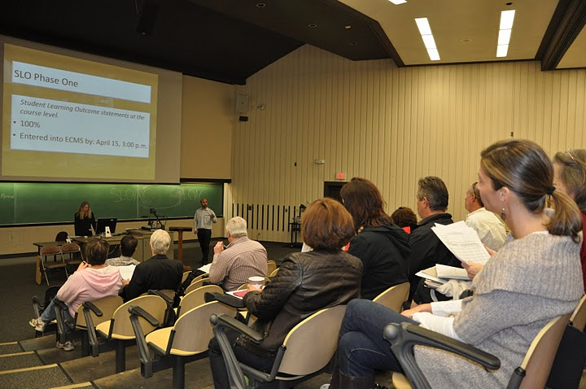
Dialog - Annual Convocation

Slide 41
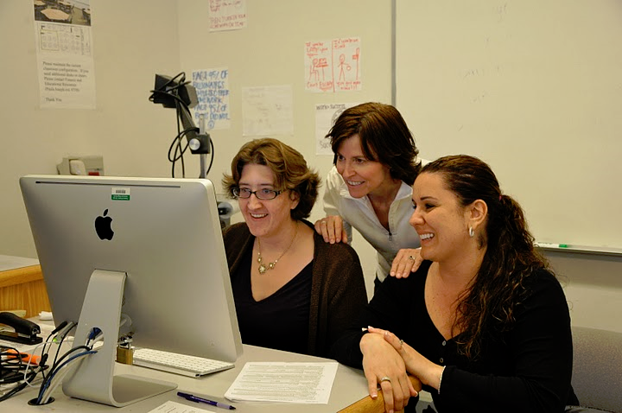
Dialog - Workshops

