Slide 1

SSRS RETREAT
SUPPORT AND SOLIDARITY
Notes:
Introduce self – counseling background, reading department, and recent grad work

Slide 2
TODAY’S ACTIVITIES
DRAFT CURRENT GOALS FOR YOUR AREA
FACULTY AND STAFF WILL REVIEW AND EXAMINE CURRENT SSRS MISSION STATEMENT
REVISE/EDIT MISSION STATEMENT
COMPARE AND CONTRAST MISSION STATEMENT TO PROGRAM LEARNING OBJECTIVES, THEN REVISE/EDIT LEARNING OUTCOMES
GAIN CLARITY AND DIRECTION

Slide 3
MISSION STATEMENT
WHY HAVE A MISSION STATEMENT? WHAT IS ITS PURPOSE?
FORMAL REASON: ACCREDITATION STANDARDS – The institution disaggregates and analyzes learning outcomes and achievement for subpopulations of students. When the institution identifies performance gaps, it implements strategies, which may include allocation of human, fiscal and other resources, to mitigate those gaps and evaluates the efficacy of those strategies (1.B.6).
NEW ACCREDITTAION SOCIAL JUSTICE POLICY

Slide 4

FREEWRITE & DREAM BIG
WHAT DO YOU WANT FOR YOUR AREA? HOW DO YOU ENVISION GROWTH? SUPPORT? FREEWRITE, or you can draw, WHAT THAT LOOKS LIKE…
WHAT ARE YOUR VALUES? IN OTHER WORDS, THINK ABOUT WHAT IS MOST IMPORTANT GIVEN YOUR WORK AT THE COLLEGE. (These are your non-negotiables.)
SHARE YOUR IDEAS, AMBITIONS, DIRECTION, THOUGHTS…WITH ANOTHER PERSON. IF YOU GET MORE IDEAS FROM YOUR COLLEAGUE/FRIEND, WRITE THEM DOWN.

Slide 5
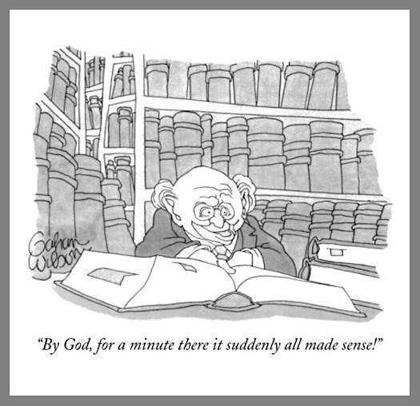
REVIEWING THE CURRENT SSRS MISSION STATEMENT
The mission of Student Success and Retention Services (SSRS) is to address historical and institutional inequities resulting in achievement gaps for underserved students by fostering a community of learners and leaders through innovative services and pedagogies that increase retention, persistence, graduation, and transfer rates.
SSRS provides academic enrichment and support services for
first-generation college students
students from groups that have been historically underrepresented in retention and transfer rates

Slide 6
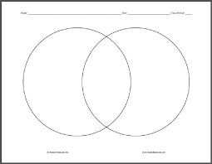
COMPARISONS AND CONTRAST
DID YOUR FREEWRITE HAVE PARALLELS TO THE MISSION STATEMENT?
WERE THERE SIMILARITIES?
WHAT DIFFERENCES DID YOU NOTICE?
WERE THERE COMMON THREADS WITH OTHER PROGRAMS?

Slide 7
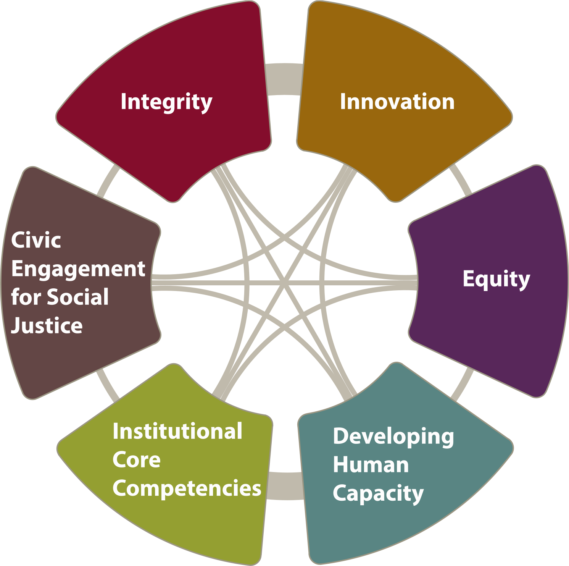
COLLEGE VALUES

Slide 8
STUDENTS SUCCESS FACTORS
Directed, with a goal and the knowledge of how to achieve it.
Focused, staying on track to achieve that goal.
Nurtured, feeling that we want to, and do, help them to succeed.
Engaged, actively participating in class and extracurricular activities.
Connected, feeling that they are part of the college community.
Valued, with their skills, talents and abilities recognized, and with opportunities to contribute on campus and feel that their contributions are appreciated.

Slide 9

CRAFTING A MISSION STATEMENT
DOES THE CURRENT MISSION STATEMENT ADDRESS THE CRUX OF SSRS?
DOES IT DEFINE THE PURPOSE OF SSRS?
IS IT CLEAR?
DOES IT MAKE YOU EXCITED? IS IT PASSIONATE? INVITING?
A MISSION STATEMENT SHOULD BE A GUIDE AND IT SHOULD BE THE OVERALL MESSAGE OF SSRS- AN ANCHOR FOR YOUR SERVICE AREA.

Slide 10

REVISING THE MISSION STATEMENT
Considerations when revising/improving your mission statement:
  Alignment with the college vision, mission, values and success factors
  Clearly describe what your area hopes to achieve
  Describe why your program is unique, important or valuable
  Invoke enthusiasm and excitement for your area

Slide 11
REVISED MISSION STATEMENT
WORKING IN PAIRS OF TWO, EXAMINE THE ORIGINAL MISSION STATEMENT-
INCLUDE YOUR STATEMENTS/IDEAS

Slide 12
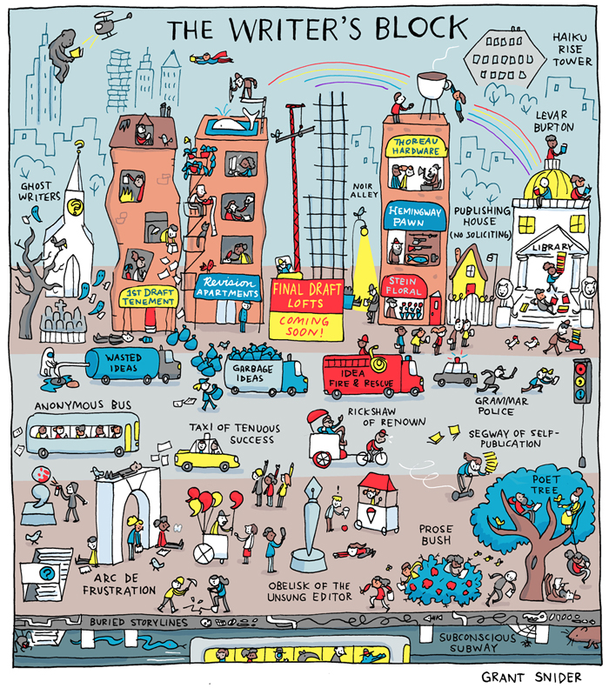
STUDENT LEARNING OUTCOMES
EXAMINING YOUR OUTCOMES…
DO YOUR OUTCOMES INFORM YOUR PARTICULAR PROGRAM?
DO YOUR OUTCOMES INFORM THE SERVICE YOU PROVIDE, HOW IT IS PROVIDED, WHEN AND IN WHAT FORMAT?
IS THE LEARNING OUTCOME ASSESSED, HOW, WHEN?
WHEN DOES SSRS DISCUSS AND REVISE LEARNING OUTCOMES?

Slide 13
What IS an outcome…
Student Learning Outcome defined: Specific observable or measurable results that are expected subsequent to a learning experience. These outcomes may involve knowledge (cognitive), skills (behavioral), or attitudes (affective) that provide evidence that learning has occurred as a result of specified course, program activity, or process.

Slide 14

BRAINSTORMING LEARNING OUTCOMES
SMART GOALS
SPECIFIC – FOCUS ON ONE OUTCOME
MEASURABLE – CONSIDER HOW YOU WILL TRACK YOUR PROGRESS
ACHIEVABLE – HOW WILL YOU MAKE THIS HAPPEN
REALISTIC – MAKE IT PRACTICAL GIVEN POSSIBLE LIMITED RESOURCES
TIME-BOUND – GIVE YOURSELF A TIME FRAME TO WORK WITHIN

Slide 15
PAIR SHARE
SHARE A NEW OR REVISED STUDENT LEARNING OUTCOME FOR YOUR AREA

Slide 16

FINAL THOUGHTS…
What surprised you?
What were some of your take-aways?
How will you move forward…

