Slide 1
Study Abroad in the Philippines
SUMMER 2019

Slide 2
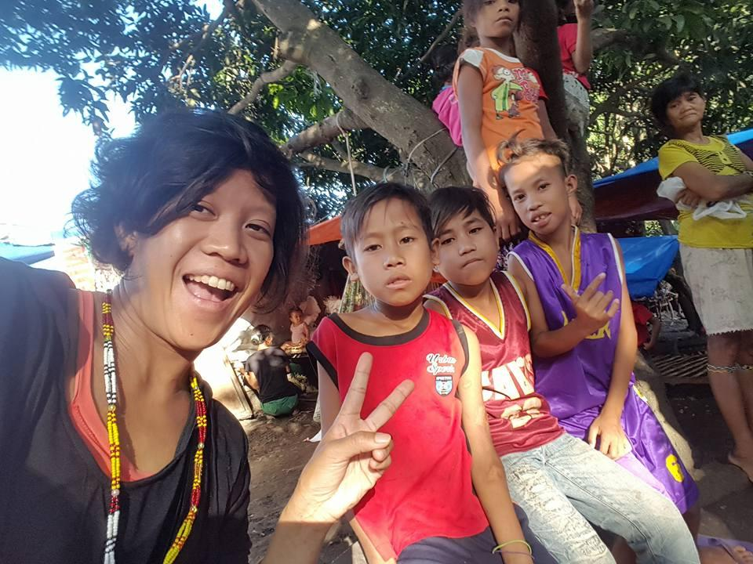
WHO WE ARE:
Noemi Teppang:
International Student Program Counselor
Contact Info:
teppangnoemi@fhda.edu
408.864.5813

Slide 3

WHO WE ARE
Chesa Caparas: Faculty in English and Intercultural Studies, Faculty Coordinator of the Jean Miller Resource Room for Women, Gender, and Sexuality
Contact info:
caparasfrancesca@fhda.edu
408.864.8540

Slide 4
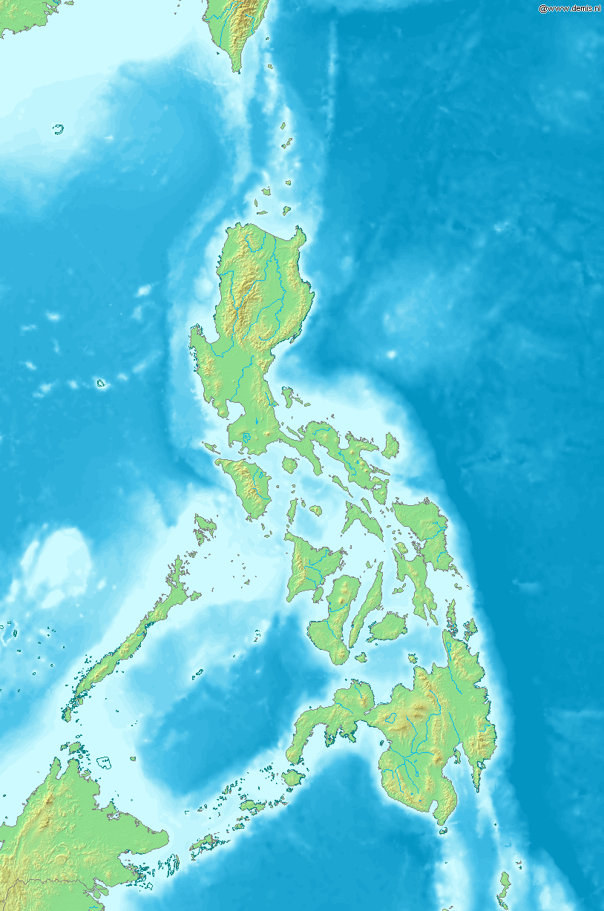
T H E P H I L I P P I N E S
Archipelago consisting of 7,107 islands
Located between South China Sea & Pacific Ocean
Population: 98,000,000+
120-175 dialects
Luzon, Visayas, Mindanao

Slide 5
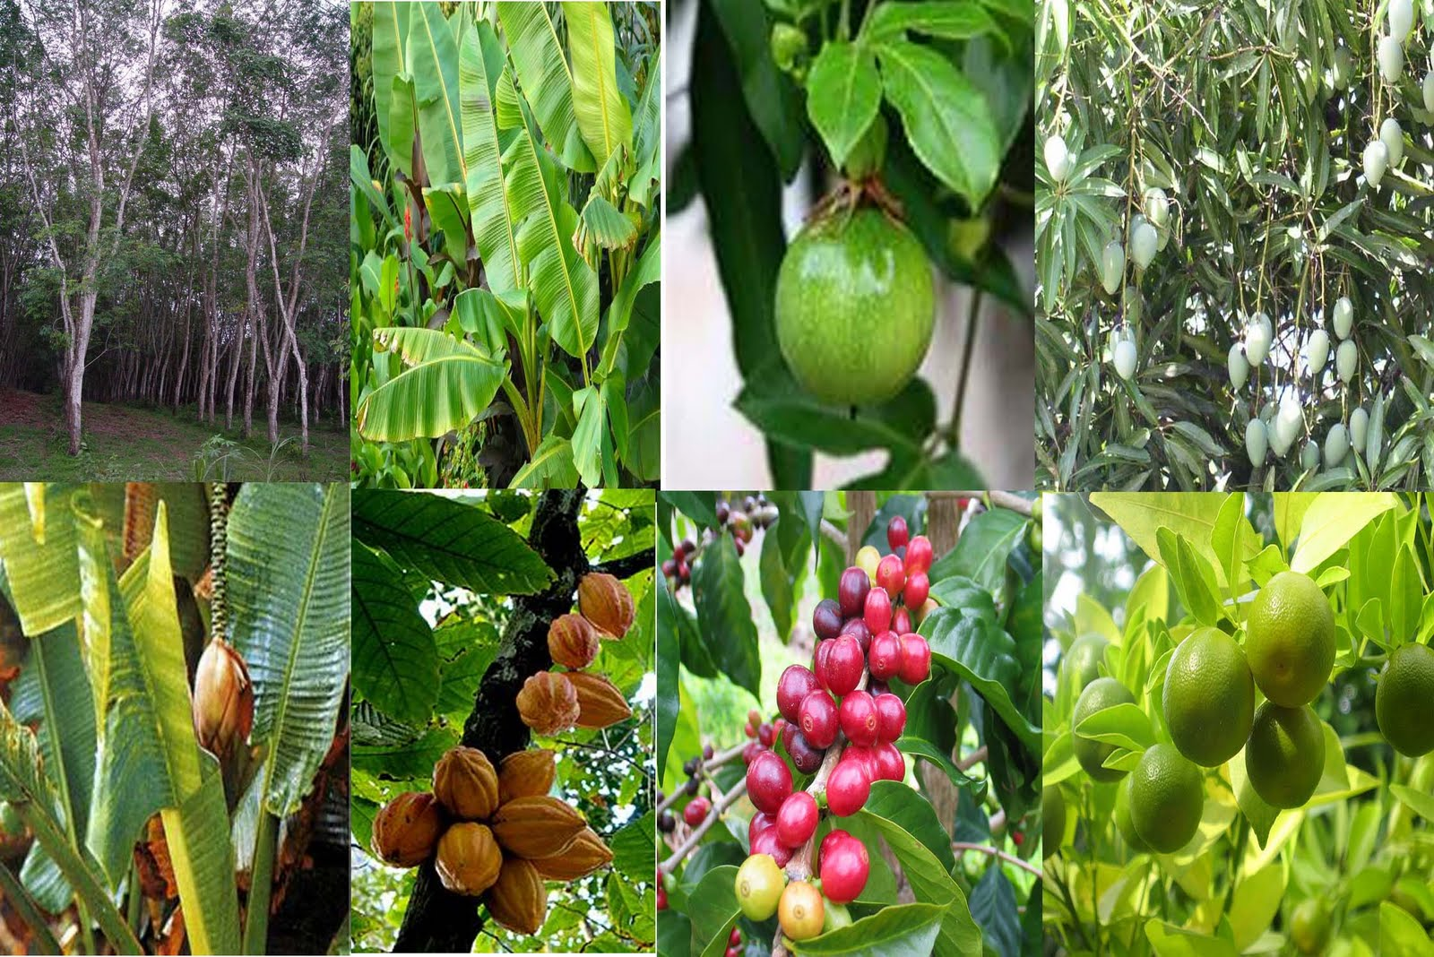
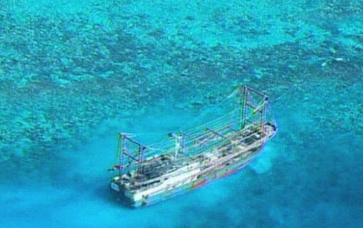
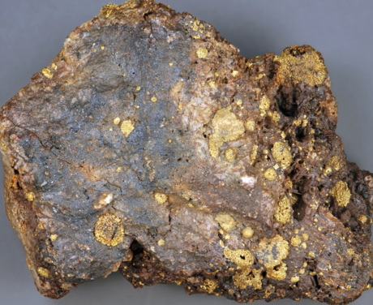
T H E P H I L I P P I N E S
Resources: rice, corn, fruits, root crops, abaca, rubber, coconuts, sugar cane, gold, copper, oil, silver, carbon, bauxite, uranium, nickel & more

Slide 6
What classes can you choose from?
ENGLISH WRITING/LITERATURE
EWRT1A, EWRT1B, EWRT 2
ELIT 10 - Intro to Fiction
ELIT 22 - Intro to Mythology/Folklore
ELIT 24 - Asian Pacific American Literature
COUNSELING
CLP 75 - Career Life Planning
HUMA 10 - Human Sexuality
HUMA 20 - Life Skills in Higher Education
HUMA 30 - Understanding & Managing Stress

Slide 7

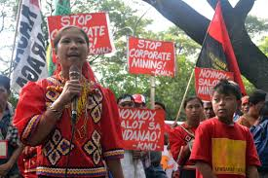
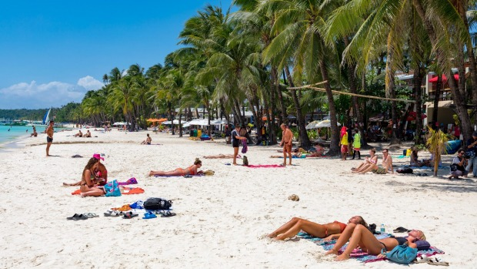
What will we be learning?
The theme of our trip:
Whose land is it?!

Slide 8
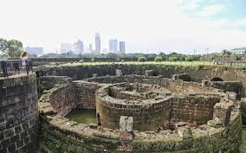

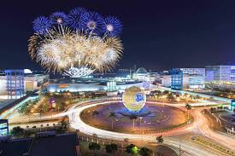
What are some places we’ll visit?

Slide 9

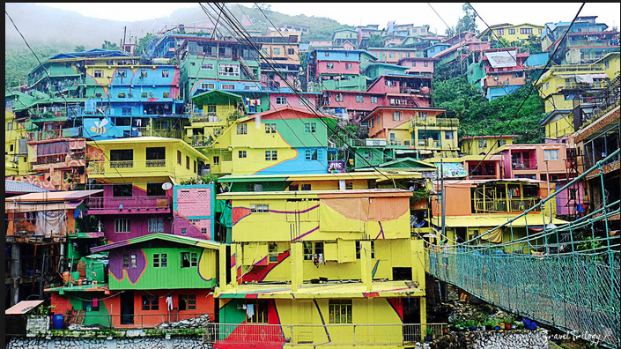
What are some places we’ll visit?

Slide 10




What kinds of books will we be reading?
All EWRT and ELIT courses will develop your analytical writing and critical thinking skills as we explore issues like: family ties in a global context, westernization and identity formation, and decolonization

Slide 11

Counseling Courses
CLP 75 - College Major & Career Options
Personality and career assessments
Exploration of labor history/trends
Self exploration
Career pathways

Slide 12

Counseling Courses
HUMA 10 - Human Sexuality
Study of the biological, psychological and socio-cultural aspects of human sexuality:
Values
Attitudes
Behaviors
Cultural aspects and safe sex practices
Exploration into values and attitudes and their relationship to behaviors

Slide 13

Counseling Courses
HUMA 20 - Life Skills for Higher Education
Goal setting
Time & money management
Learning styles
Major/career selection and communication

Slide 14
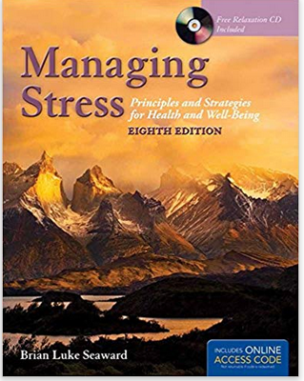
Counseling Courses
HUMA 30 - Understanding & Managing Stress
Distinguish and understand physiological symptoms when under stress
Develop and apply stress management strategies

Slide 15
Any other questions?
Feel free to contact us if you have any more questions:
teppangnoemi@fhda.edu
caparasfrancesca@fhda.edu
And check out the website: deanza.edu/philippines

